Slide 1
Narrow Bundles of Rays
LL2 section 56

Slide 2
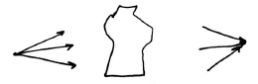
Homocentric rays all pass through one point
Only in special cases will the bundle be homocentric after the optical system
A luminous point is a source of homocentric rays
Optical system

Slide 3
Only if all homocentric bundles of rays remain homocentric after passing the optical system is identical imaging possible.
This does not generally happen except for a plane mirror.

Slide 4
For sufficiently narrow beams that pass close to a particular line called the “optic axis”, homocentric-to-homocentric transition is approximately possible.
Even infinitely narrow bundles are not generally homocentric due to different principal radii of curvature for wave surface: “Astigmatism”.

Slide 5
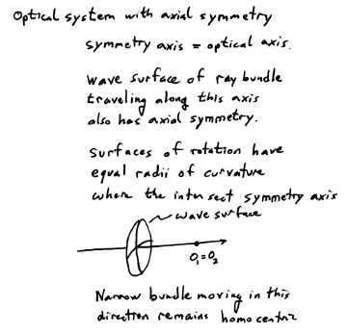

Slide 6
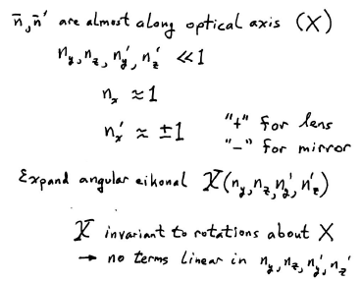

Slide 7
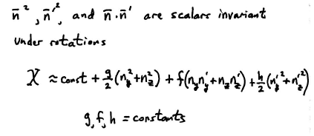

Slide 8
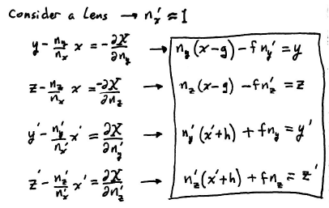

Slide 9
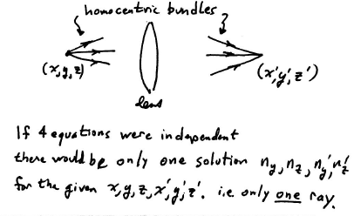

Slide 10
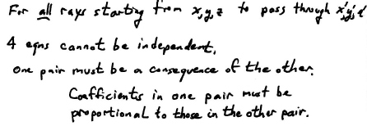

Slide 11
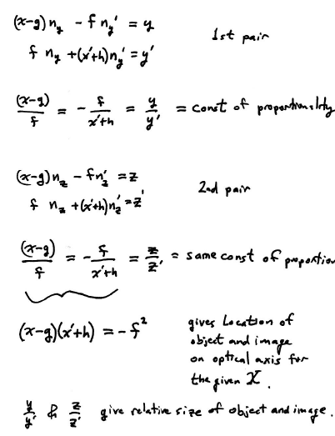

Slide 12
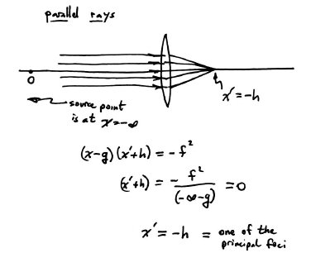
A parallel bundle of rays is caused by the optical system to intersect at a principal focus.

Slide 13
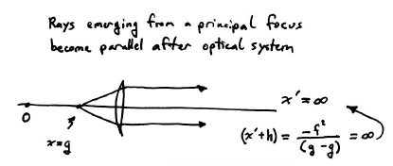

Slide 14
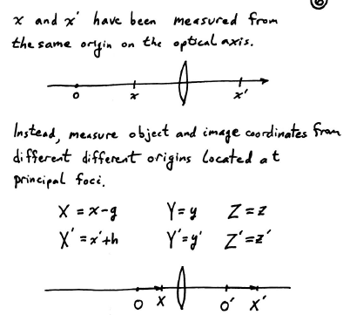

Slide 15
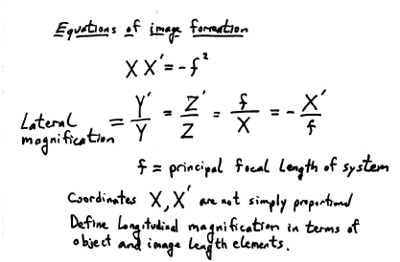

Slide 16
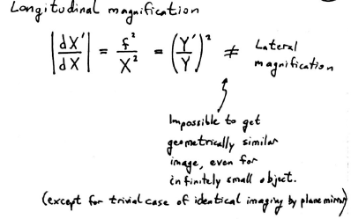

Slide 17
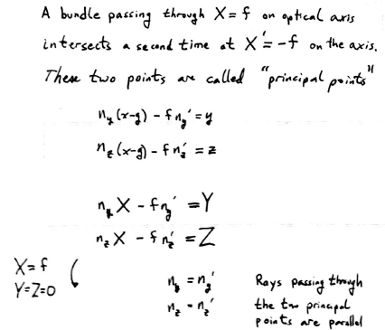

Slide 18
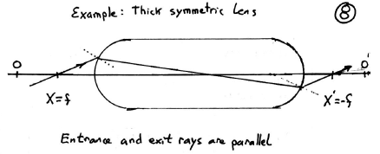

Slide 19
Vocabulary test.
For a given optical system, what are the meanings of
  Principal foci,
  Principal focal length,
  and
  Principal points?

Slide 20
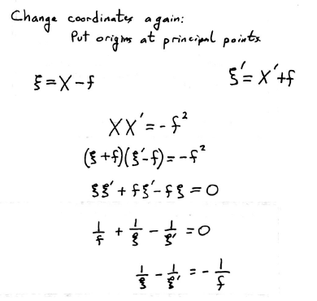

Slide 21
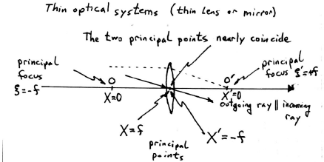

Slide 22
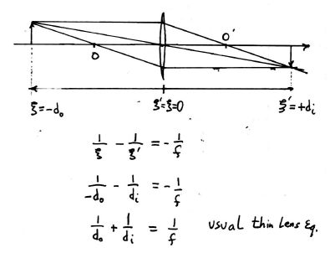

Slide 23
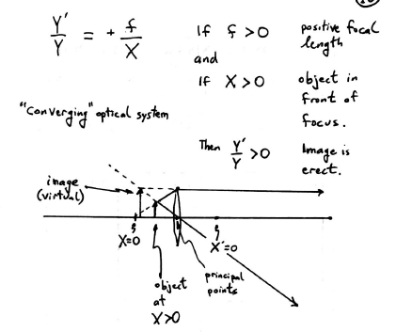

Slide 24
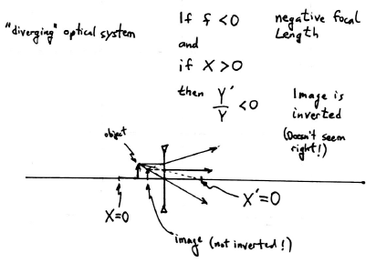
The problem turns to be which is X and which is X’ when f<0.

Slide 25
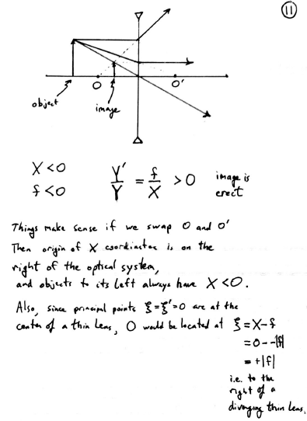
Seems to work when X<0.

Slide 26
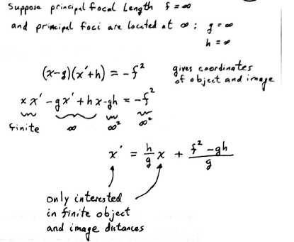
(a telescope)

Slide 27
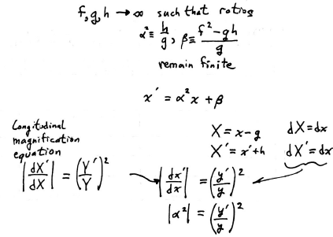

Slide 28
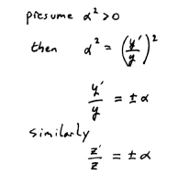

Slide 29
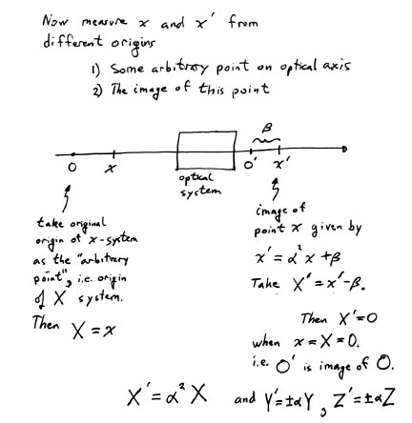

Slide 30
