Slide 1
Image formation with broad bundles of rays
LL2 section 57

Slide 2
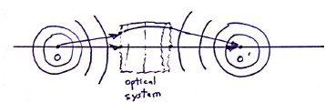
Image formation with broad bundles of rays is only possible for special optical systems
Suppose all rays starting from O that travel through the optical system intersect again at O’.
Wave surfaces near O for rays passing through O are spheres. Same for O’.
Wave surfaces are surfaces of constant phase.
The change in phase along different rays between points of intersection with two given wave surfaces is the same.
The total change in phase between the points O and O’ is the same for the different rays.
The optical path length ψ is the same for all these rays.

Slide 3
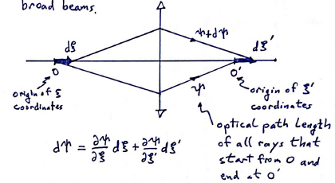
Conditions for imaging a line segment using broad beams.
Optical path length of all rays that start from O and end at O’.
(not the same ξ,ξ’ measured from principal points as in sec 56.)
ξ and ξ’ axes need not be parallel to each other or to the optical axis.

Slide 4
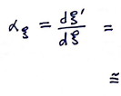
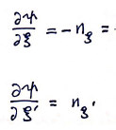

Magnification
Ratio of length elements for image and object.
Constant along a sufficiently small line element
Negative cosine of angle between direction of ray and x axis. (see (55.2) and following.

Slide 5

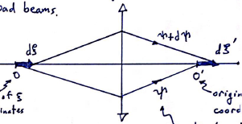
The optical path length ψ + dψ for all rays starting from point dξ and arriving at point dξ’ must be the same.
This is the condition that the paths of rays in the optical system must satisfy to have image formation for a small line segment using broad beams.
It must be fulfilled for all rays staring from O.

Slide 6

Image formation by axially-symmetric optical system.
Take object to be a line segment on the optical axis.
Image is also on optical axis by axial symmetry.
A ray approaching the optical system along the optical axis has n_{x} = 1.
Afterwards, n_{x}’ = 1 by symmetry, i.e. it is undeflected.

Slide 7
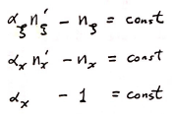
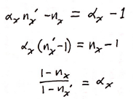
For these rays
General condition of image formation
A specific direction of line segment
Specific case of axial symmetry

Slide 8


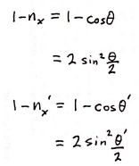

Condition for image formation

Slide 9
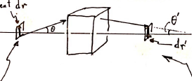
Next consider perpendicular line segment.
Line segment dr
Object is a small portion of a plane perpendicular to the optical axis.
Image is also perpendicular to the axis.

Slide 10
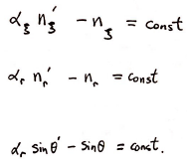
For arbitrary segment dy in plane to be imaged,
General condition for imaging
For specific line segment perpendicular to optical axis.

Slide 11



Rays emerging from intersection of object plane with optical axis with θ = 0 are undeflected due to assumed axial symmetry: θ’ = 0.
Then for non-zero angles, the condition for imaging of transverse planes is

Slide 12

Imaging of 3D object using broad beams is impossible even for small volumes because the conditions for longitudinal and transverse imaging
are incompatible.

Slide 13


