Slide 1
Section 6
Four vectors

Slide 2



1. Four-radius vector
Coordinates of an event in 4-space are (ct,x,y,z).
Radius vector in 4-space = 4-radius vector.
Square of the “length” (interval) does not change under any rotations of 4 space.

Slide 3
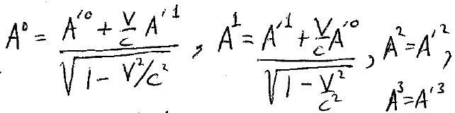



2. General 4-vector. Any set of four quantities (A⁰,A¹,A²,A³) that transform like (x⁰, x¹, x², x³) under all transformations of 4 space, including Lorentz transformations, is called a four-vector.
Lorentz transformation of A^{i}
Square magnitude of A^{i}

Slide 4




Two types of 4-vector components
Contravariant: A^{i} with superscript index
Covariant: A_{i} with subscript index
Lorentz transform contravariant components
Lorentz transform covariant components
Square of four vector =

Slide 5

Summation convention:
Summation is assumed if indices are repeated AND one is subscript while other is superscript.
Such repeated indices are called “dummy indices.”
4. Latin letters are reserved for 4-D indices.
Greek letters are reserved for 3-D indices.

Slide 6




5. Scalar Product of two different four vectors
We can switch upper and lower indices in any pair of dummy indices:
A^{i} B_{i} = A_{i} B^{i}
We can rename them:
A^{i} B_{i} = A^{k} B_{k}

Slide 7

6. Scalar Product A^{i} B_{i} is a four-scalar.
4-scalars are invariant under rotations in 4D.
The interval is a 4-scalar.

Slide 8







7. The components of a general 4-vector have either time or space character
A⁰ is the “time component”
A¹, A², A³ are “space components”
If square of A = A^{i}A_{i} is
  >0, then A is time like
  <0, then A is space like
  =0, then A is a null vector or isotropic

Slide 9




Under ordinary 3D space rotations, the three space-like components of a 4-vector transform like a 3D vector A, and the time component transforms like a 3D scalar.
A 4-vector is often written as
For 3D vectors, no distinction between covariant and contravariant

Slide 10
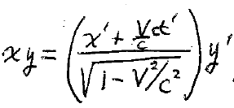








9. A four-tensor of rank 2 is a set of sixteen quantities A^{ik} that transform like products of two four vectors
For example, A¹² transforms like x¹x² = xy

Slide 11
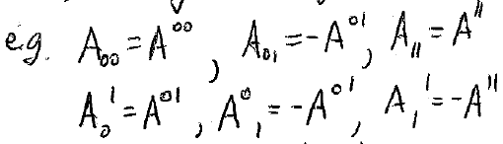

10. Three forms for second rank tensors:
  Contravariant: A^{ik}
  Covariant: A_{ik}
  Mixed: A^{i}_{k} and A_{i}^{k} Be careful, these two are not generally the same thing.
Raising or lowering an index 1,2,3 changes sign of component
Raising or lowering the index 0 does not.

Slide 12





















Tensor subparts have 3D meanings under purely spatial transformations
E.g. under 3D rotation,

Slide 13
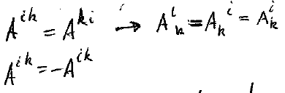



12. Some special tensors in Electrodynamics have a particular symmetry
Symmetric tensors
Antisymmetric tensors
Diagonal elements of antisymmetric tensors are zero, since we must have

Slide 14
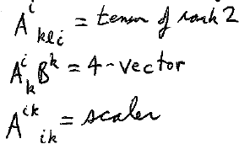
Rules for tensor equations
  (E.g. Maxwell’s equations will be written as a pair of tensor equations.)
The two sides of every tensor equation must contain identical, and identically placed, free indices.
Shifting of free indices must be done simultaneously on both sides.
Pairs of dummy indices can be renamed or raised/lowered anytime.
Which are the free indices in each of these examples?
Which is a proper tensor equation?
= C_{lk}
= C_{lk}
= C_{lk}

Slide 15

14. Contraction
From tensor A^{ik}, we can form a scalar by contraction: A^{i}_{i} = “the trace” of A^{ik}

Slide 16
15. The scalar product A^{i} B_{i} is a contraction of the tensor A^{i} B_{k}
Contraction lowers rank of tensor by 2

Slide 17
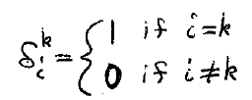



16. Some special tensors are the same in all coordinate systems by definition
Unit 4-tensor
Trace

Slide 18
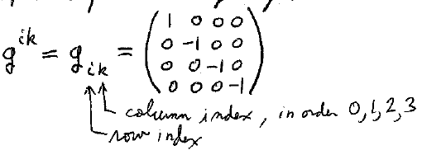
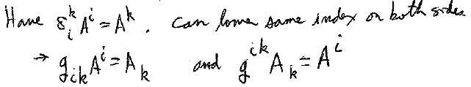


17. Metric tensor, obtained by raising or lowering one index of unit tensor, taking into account the sign change for the space components.
(Components are the same in all coordinate systems)
Column index, in order 0,1,2,3
Row index
We can lower the same index on both sides
We hardly use the metric tensor at all in ED1, but in general relativity it’s the “Main Event.”

Slide 19
18. Completely antisymmetric unit tensor of 4th rank e_{iklm}.
Components = ± 1 or 0. (Same in all coordinate systems by definition)
Antisymmetry: Components change sign under interchange of any pair of indices.
All components with any two indices the same are zero.
e⁰¹²³ = +1 and e₀₁₂₃ = -1
Other non-zero components of e^{iklm} = ±1, depending on whether an even or odd number of permutations bring iklm to 0123.
The number of permutations is 4! = 24.
e^{iklm}e_{iklm} = -24, (“-” because covariant component is always opposite of the contravariant one.)

Slide 20
19. e^{iklm} is a pseudo tensor
Under rotations of 4-space (Lorentz transformations) e^{iklm} behaves like a 4-tensor.
But under inversions and reflections (change of sign of one or more coordinates) it does not.
By definition e^{iklm} is invariant under any transformation, but components of a true rank-4 tensor (e.g. x^{i}x^{k}x^{l}x^{m}) with all indices different change sign when one or 3 coordinates change sign.
Pseudo tensors, including pseudo scalars, behave like tensors for all coordinate transforms except those that cannot be reduced to rotations (e.g. reflections)

Slide 21
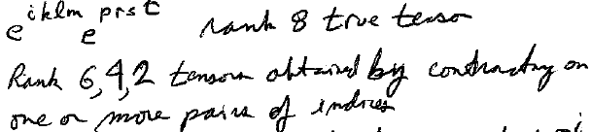
20. Other invariant true tensors:
Is a rank 8 true tensor
Rank 6,4,2 tensors are obtained by contracting on one or more pairs of indices
All are invariant under coordinate transformations: They formed from products of components of unit tensor.

Slide 22
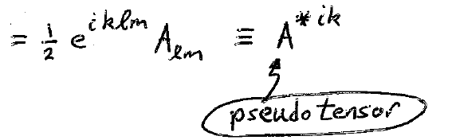
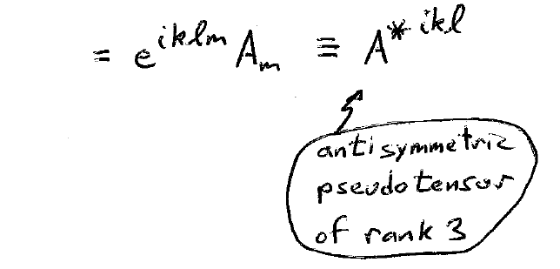


21. “Dual” of an antisymmetric tensor A_{ik}
Dual of the 4-vector A^{i}
An example of a dual relationship is that between a 2D area element and the normal vector with magnitude equal to the area.

Slide 23
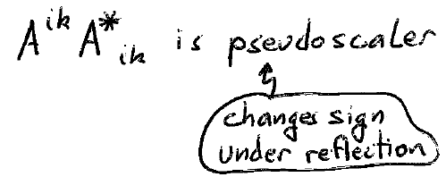
Product of dual tensors
True scalars are invariant under ALL possible symmetry operations
Two tensors that are dual have the same components, but differently arranged.

Slide 24
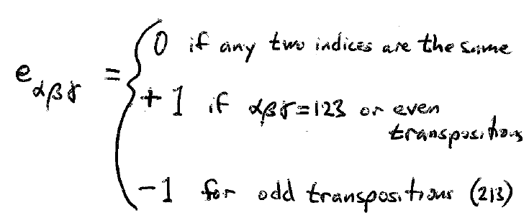
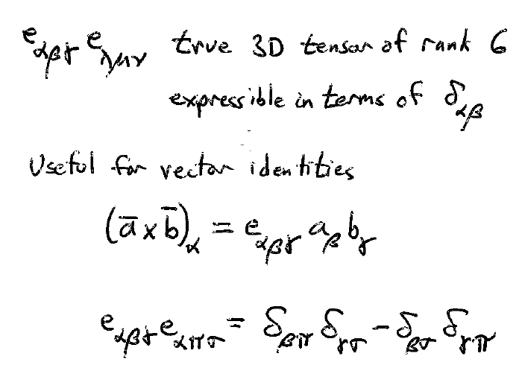
22. 3D vectors and tensors
Completely antisymmetric unit pseudo tensor of rank 3
We use this ALL THE TIME to derive vector identities. “Levi-Civita” method.

Slide 25
23.

Slide 26
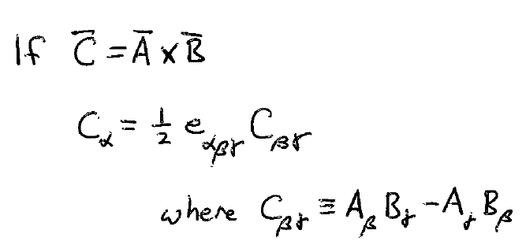
24. Inversion of coordinates
  Components of ordinary vector change sign (polar)
    e.g. position vector r
  Components of cross product of two polar vectors do not (axial)
    e.g. torque τ = r x F
  Scalar product of polar and axial vector is a pseudo scalar
  An axial vector is a pseudo vector dual to some antisymmetric tensor.

Slide 27
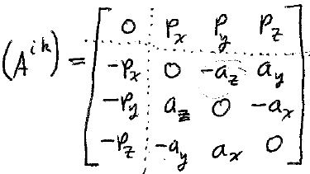
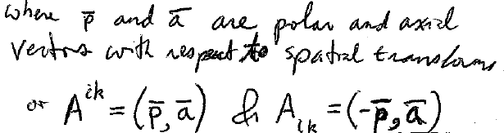












25. Antisymmetric 4-tensor A^{ik}
Space components (i,k, = 1,2,3) form a 3-D antisymmetric tensor with respect to spatial transforms. By dual relationship, the components are expressed in terms of 3-D axial vector.
  e.g. A¹² transforms like 3rd component of an axial vector by dual relationship.
Components A⁰¹, A⁰², A⁰³, form a 3-D polar vector with respect to spatial transforms.
  e.g. A⁰¹ tranforms like tx, which changes sign on spatial inversion.
Where p and a are polar and axial vectors with respect to spatial transforms

Slide 28
Tensor Calculus
Differential operations

Slide 29
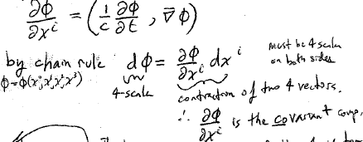
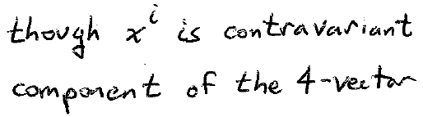







27. 4-gradient of a scalar function of space and time: φ = φ(x⁰, x¹, x², x³)
Must be a 4-scalar on both sides
Is a covariant 4-vector
Even though x^{i} is contravariant

Slide 30
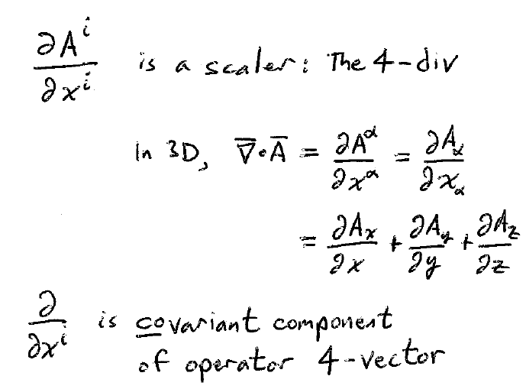
28. 4-divergence of 4-vector

Slide 31
29. Tensor calculus, Integral operations.
In 3D, we have 3 types of integrals
  Line
  Surface
  Volume
In 4D, there are 4 types
  Curve in 4-space
  2D surface
  Hypersurface (3D manifold)
  4D volume

Slide 32
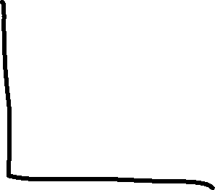

30. Integral over a curve in 4-space
The infinitesimal line element is a 4-vector: dx^{i}

Slide 33
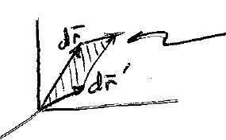
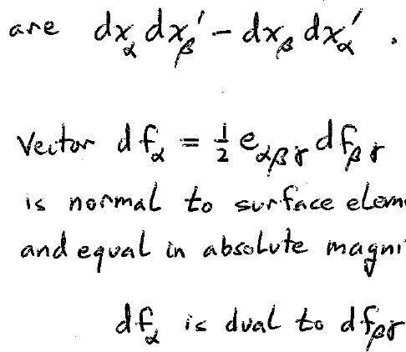


31. Integral over 2D surface First review 3D.
Surface area element in 3D
The projections of the area of a parallelogram on the coordinate planes αβ are
which is an antisymmetric rank 2 tensor
The vector
is normal to the surface element and equal in absolute magnitude

Slide 34


Integral over 2D surface in 4D
The infinitesimal surface area element is a rank 2 antisymmetric tensor, whose components are the projection of the area element onto the coordinate planes.
16 components.
Only 12 are non-zero.
Only 6 are unique, corresponding to the 6 planes in 4 space.
Its dual describes a surface element that is equal in area and normal to df^{ik}.
All segments in df*^{ik} are orthogonal to all segments in df^{ik}:
      df*_{ik} df^{ik} = 0.

Slide 35
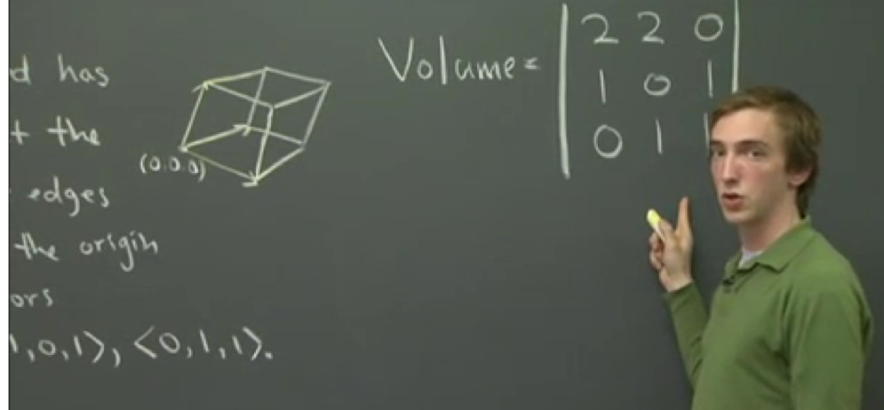
32. Integral over a hypersurface (3D manifold)
In 3D, the volume of a parallelpiped spanned by 3 vectors is a determinant

Slide 36



In 4D, the “area” elements of hypersurface are 3D volumes of parallelepipeds spanned by three 4-vectors dx^{i}, dx’^{i}, and dx”^{i}
A rank 3 tensor that is antisymmetric in all 3 indices
What two properties of determinants show that the tensor must be an antisymmetric one?

Slide 37
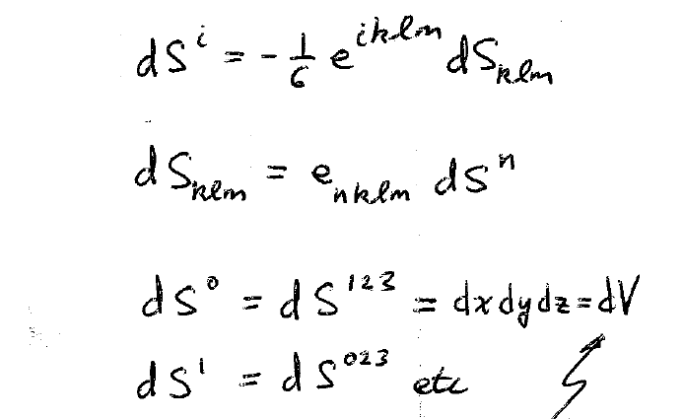












A more convenient integration element is the 4-vector which is dual to the hypersurface area element
Projection of hypersurface element on the hyperplane x⁰ = constant.
(This hyperplane is all of 3D space at a given time.)
A hypersurface area element described as a normal vector in the direction of the time axis

Slide 38













33. Integral over 4D volume
4D volume element is a 4-scalar.

Slide 39
34. 4D analogies of Gauss and Stokes Theorems from 3D

Slide 40
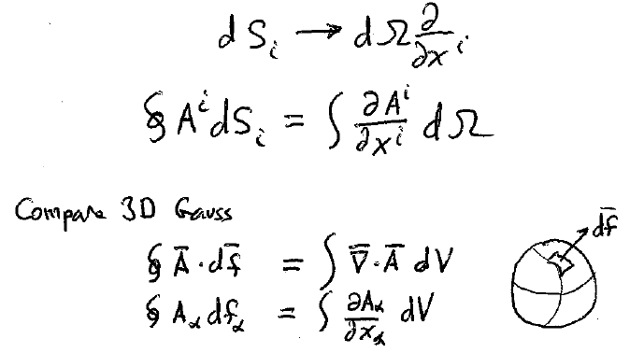
4D Gauss theorem
Integral over closed hypersurface transforms to an integral over the 4-volume inside by the replacement

Slide 41
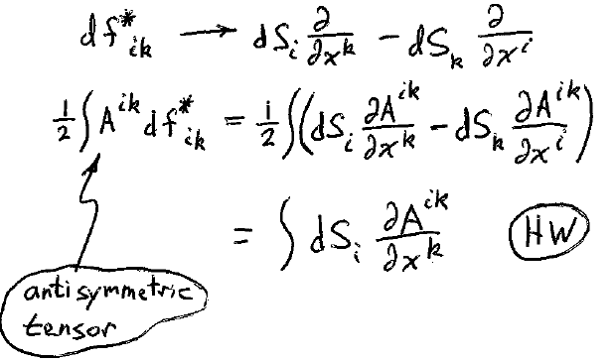
An integral over a 2D surface transforms to an integral over the hypersurface spanning it by the replacement

Slide 42
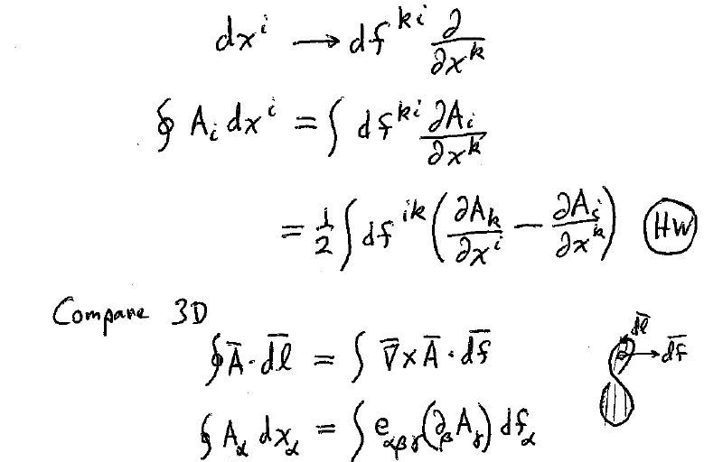
4D Stokes Theorem
The integral over a 4D closed curve tranforms to an integral over the surface than spans the curve via the replacement

