Slide 1
The retarded potentials
LL2 Section 62

Slide 2
Until now we considered fields due to charges at rest or due to stationary currents.
Now we consider the fields of arbitrarily moving charges or changing currents.
These fields vary in space and time.

Slide 3


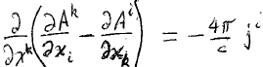






2. Potentials for arbitrarily moving charges
2nd pair of Maxwell’s equations (30.2) in 4-D
Choose the Lorentz gauge (46.9)
Equation for potentials of arbitrary field

Slide 4
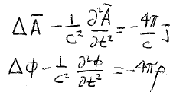
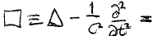



3. Three dimensional form gives equations for φ and A.
Space Components:
Time Components:
If fields are constant, we get Poisson equations (36.4) & (43.4)
If there are no charges, we get the homogeneous wave equation (46.7)
d’Alembertian operator

Slide 5














4. Solution to inhomogeneous equation
= solution to homogeneous equation
+ particular solution
Homogeneous equation is the wave equation: solutions are waves f(ξ) and f(η)
Recipe to find particular solution
Divide space into infinitesimal volume elements
Find field due to charges in each element
The total field is the linear superposition of the fields from all elements

Slide 6
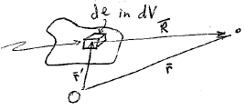














5. The charge in de in volume element dV is generally time dependent.
Field point
Source point
Put the origin inside dV.
Then…
Field point
Equation for the scalar potential

Slide 7





6. Everywhere but at the origin δ(R) = 0.
Field point

Slide 8


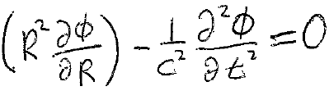

7. The problem is centrally symmetric
Use spherical coordinates
Away from the origin

Slide 9
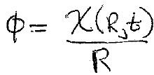
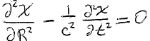
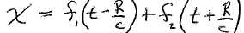





8. Trial solution (HW)
We get the 1D wave equation
Solutions to the 1D wave equation are of the form

Slide 10
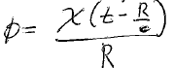












9. Only one of the solutions is needed for the particular solution.
Allow outgoing waves only
Substitute this combination of R and t into the trial solution
(Holds everywhere except the origin.)

Slide 11
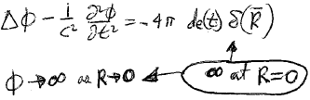



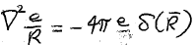





10. Now determine χ to match the potential at the origin
Δφ increases more rapidly than
as R goes to zero.
Neglect the time derivative
We already know the solution to this from Coulomb’s law (36.9)

Slide 12
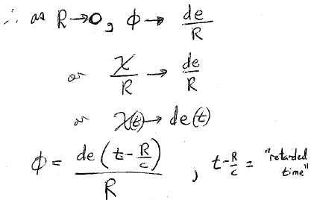




Slide 13
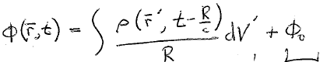
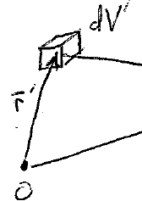
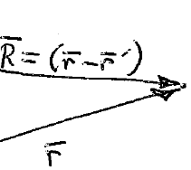


























11.For an arbitrary distribution of charge, set de = ρ dV and integrate
Retarded time
Particular solution
Solution to the homogeneous equation
Field point
ρ is evaluated at the retarded time t-(R/c)
Prime omitted
Shorthand expression
Note that the integration variable r’ is buried in R in two places.

Slide 14
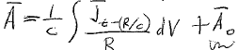










12. Same method for vector potential
Solution of homogeneous equation
13. Particular solutions are called the Retarded Potentials

Slide 15
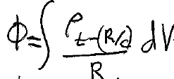
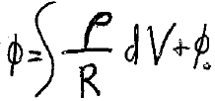
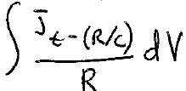
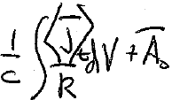




14. If charges are stationary, scalar potential should reduce to usual result (36.8) for constant E-field
+ φ₀
If currents are stationary, vector potential should reduce to usual result (43.5) for constant H-field
+ A₀
<A>_{t} =

Slide 16
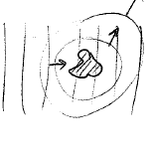




15. Homogeneous solutions φ₀ and A₀ are determined by initial conditions or by constant boundary conditions
Example: Scattering
Scattered radiation is determined by retarded potentials
Incident radiation from outside is determined by φ₀ and A₀

