Slide 1
Lienard-Wiechert Potentials
LL2 Section 63

Slide 2
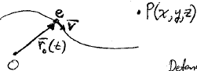
1. Lienard-Wiechert potentials are the retarded potentials of a point charge moving in a trajectory r = r₀(t)
2. Potentials at the field point are determined by the state of motion at the earlier time t’, where t = “now”.

Slide 3
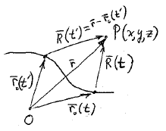

Slide 4
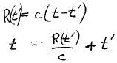
Information about the state of motion at t’ propagates to P at speed c.
The time t’ , when the signal that arrives to P at time t was sent, is determined by the root of this equation.

Slide 5
The charge is momentarily at rest in an inertial reference frame at time t’
E-field line at t

Slide 6

In that inertial frame, the potentials at P at time t are
(since charge is at rest in that frame)
Potentials for the lab frame are found from potentials in the charge’s frame by Lorentz transform

Slide 7
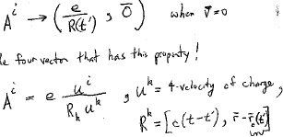
If v = 0, then the lab frame coincides with the rest frame of the charge, and the potentials coincide.
If we can guess a 4-vector that has this property, then we know the 4-potential in any other frame
Four-velocity of the charge
(Abbreviated as r’ in the text)

Slide 8
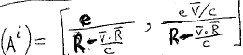
The equation that determines t’ , R(t’) = c (t - t’), is equivalent to R_{k}R^{k} = 0 (HW).
Lienard-Wiechert Potentials (HW)
R and v are evaluated at t’

Slide 9
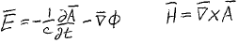
Fields
Differentiations are with respect to coordinates of the field point P(x,y,z) at time of observation t.
Potentials are functions of t’, which depends on r & t through r - r₀(t’) = c (t-t’)
We need the derivatives of t’ with respect to t, x, y, & z.

Slide 12
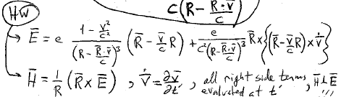
E-field has two terms
  The 1st depends only on v, not dv/dt. Goes as 1/R². This is the field of a uniformly moving charge.
  The 2nd depends on dv/dt. Goes as 1/R, i.e. falls off more slowly. This is the radiation term.
All right side terms are evaluated at t’.
H and E are perpendicular.

Slide 13
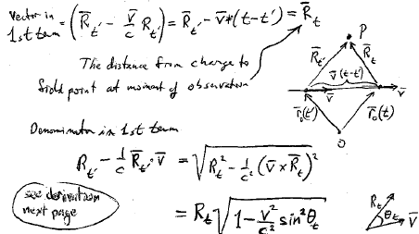
Constant velocity
Vector in the first term =
The distance from charge to field point at the moment of observation
Denominator in the first term
See derivation on the next page

Slide 14
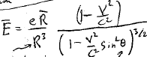
Electric field points along the line from the present position of the charge, even through the “message” originated at the retarded position.
Sin²θ factor flattens field in the forward and backward directions.
First term
Field of a uniformly moving charge.
Same formula as (38.8).
R and θ are evaluated at the present time t, not the retarded time t’.

Slide 15
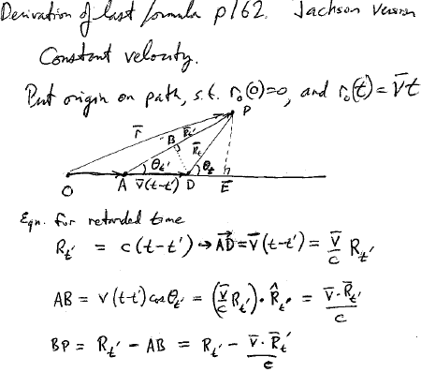
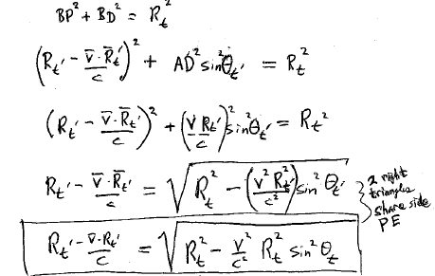

Slide 16
