Slide 1
Spectral resolution of retarded potentials
LL2 section 64

Slide 2
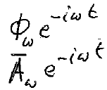
Electromagnetic waves were spectrally resolved in section 49.
Static fields were spectrally resolved in section 51.
Now, spectrally resolve the fields due to moving charges.
In the Fourier expansion of the potentials of φ(t) and A(t), we have the ω components
The sources of φ(t) and A(t) are ρ(t) and j(t).
Each ω component in the expansions of ρ(t) and j(t) gives the corresponding component of the potentials.

Slide 3


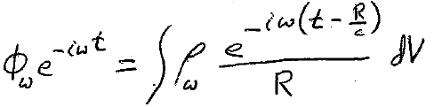
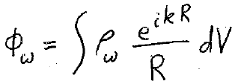


From (62.9)
The phase depends on the distance R from source point dV to field point.
similarly

Slide 4

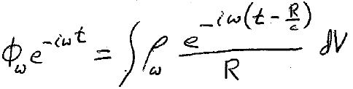

The differential equation for arbitrary field with charges
(62.3)
Must be satisfied for each ω component
Time dependence is gone

Slide 5


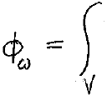





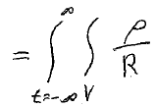

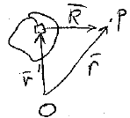
Fourier components of charge density
Prime means source coordinates

Slide 6

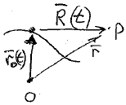







Single point charge
Substitute, and do V integral: r’ r₀(t)
similarly

Slide 7


Periodic motion, discrete frequencies, multiples of fundamental ω₀ = 2π/T
Spectral resolution contains only integer multiples of ω₀

