Slide 1
Field of a system of charges at large distances
LL2 section 66

Slide 4
Approximate form at large distances
Exact retarded potentials (62.9) and (62.10)
r.n is neglected in the denominators
But not in the retarded times
t_{r} = t - R/c = t – R₀/c + r.n/c
because ρ and j might change a lot during the time r.n/c even if that time is short compared to R₀/c.
Note that both φ and A go as 1/R₀

Slide 5
Large distances
“Wave-zone”. Field looks like a plane wave in a small region.
Need R₀ >> λ.
Need R₀ >> size of the distribution

Slide 6
Plane waves:
We need only A, not φ, to find the fields in the wave zone.
Evaluated at the retarded time
t’ = t - R/c
(47.3)
Since A goes as 1/R₀, the field in the wave zone also goes as 1/R₀

Slide 7
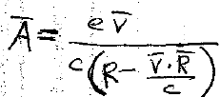
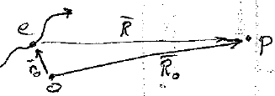
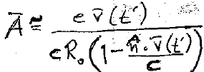
If the source is a single point charge, use the Lienard-Wiechert potentials
(63.5), exact
At large distances R R₀ (constant)
Then equation (63.1) for the retarded time t’
, where t’-r₀(t’).n/c = t – R₀/c determines t’

Slide 8
Energy flux density
Energy Flux = amount of energy per unit time passing through area df = R₀²do
LL calls this “Intensity” dI, which is usually reserved for <S>_{t}
Solid angle
Since H² ~ 1/R₀², dI is the same for all distances if t - R₀/c is the same for them
Units of dI = speed x energy density x area = Power

Slide 9
Spectral resolution of radiated waves

Slide 10
Substitute the monochromatic parts from the Fourier expansion
Time-dependent fields

Slide 11
What is the total energy radiated from a non-periodic event, e.g. a collision?
dE_{nω} = energy radiated into do with frequencies in the range ω to ω + dω

Slide 12
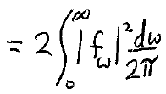
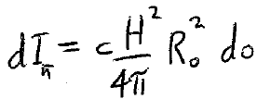
From (49.8) for any time dependent field f
From (66.6), the radiated intensity is
The part of the total radiated energy that is within the interval dω/2π

Slide 13
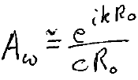
ω^{th} coefficient in Fourier expansion of current density
Substitute into (66.7)

Slide 14
Line integral along trajectory of particle

