Slide 1
Dipole Radiation
LL2 Section 67

Slide 2

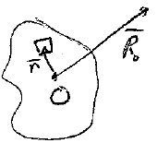
Retarded potential at large distance
If j hardly changes during the time r.n/c, then we can neglect this time. The effect on H ~ dA/dt will be small.
This means all parts of the distribution have the same retarded time.

Slide 3



Condition of validity
Let T = characteristic time for change in j
Radiation will have frequencies ~ 1/T
Radiation will have wavelengths ~ c T since ω = c k
Let a = dimensions of the system
A time interval
The condition
means there is no significant change in j during r.n/c
For this we need

Slide 4
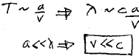
Alternate form
V = characteristic velocity of charges
Condition of validity is that the charge distribution is non-relativistic

Slide 5




If we are at large distances
And if we assume a small distribution
Then we get plane waves
,

Slide 6
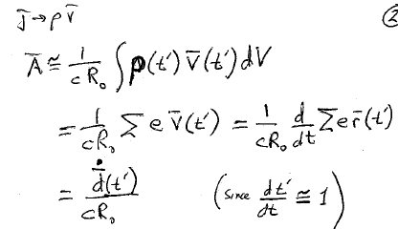

Slide 7
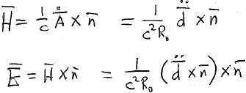

“Dipole” radiation
2nd derivative evaluated a retarded time
Fields evaluated at field point R₀ and at present time t

Slide 8
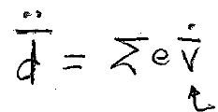
Charges radiate only if they are accelerating

Slide 9



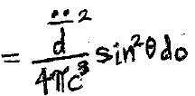
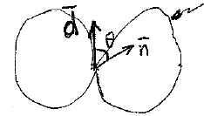
Intensity (actually, differential intensity, since units are power)
Angular distribution of radiation

Slide 10

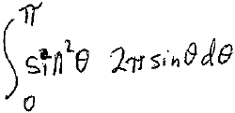

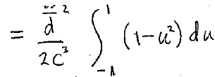





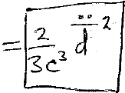
Total power radiated
6

Slide 11
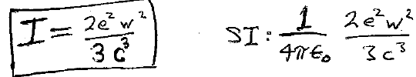
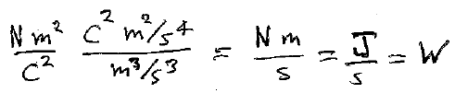
For a single charge
acceleration
Total radiated power
(Power)

Slide 12







Closed system with all particles having the same e/m, e.g. an electron cloud.
Center of mass position
Center of mass of closed system moves at constant velocity
No dipole radiation is possible in this case,
Even if individual charges are accelerating.

Slide 13
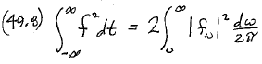
Spectral resolution of the intensity of dipole radiation
Total radiation from a non-periodic event, such as a collision

Slide 14
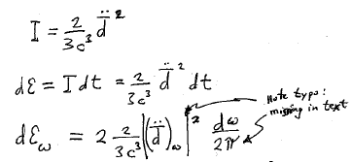

Slide 15
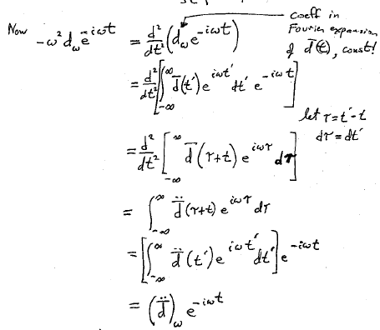


Slide 16
