Slide 1
Principle of least action for free particle
LL2 section 8

Slide 2

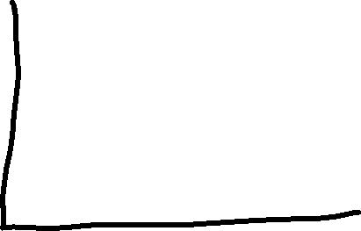
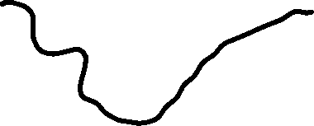


1. The principal of least action: for each mechanical system, there is a certain integral S, called the action, which has a minimum value for the actual motion, so that its variation δS = 0.

Slide 3
2. Principle of least action is a law of physics.
It must be invariant under Lorentz transform.

Slide 4




= first variation of S
= δS
Condition that S be a minimum is that
δS = 0
If this condition is invariant, S itself must be an invariant scalar.

Slide 5











The only invariant for free particle going from event a to event b is the interval s =
The only possible form for the action of a free particle.
Integrate along the world line to obtain a finite invariant interval for the particle.
Since the interval is maximum along a straight world line, but can be arbitrarily small, the “-” ensures that the action has a minimum.
α is a constant that characterizes the particle. It should be related to the particles mass (inertia), since no other property affects free motion.

Slide 6
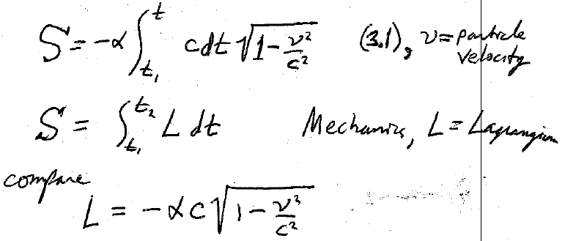

3. From Mechanics, action is the time integral of the Lagrangian
The relativistically correct action for a free particle is
From (3.1) v = particle speed
Therefore
Relativistic Lagrangian for a free particle.

Slide 7






4. Finally we have to find the constant a.
The classical Lagrangian for a free particle is
Classical mechanics is obtained in the limit c →∞.
Expand the relativistic Lagrangian in powers of v/c.
Compare:
Exact relativistic Lagrangian for a free particle:

