Slide 1
Energy and Momentum
LL2 Section 9

Slide 2
1. Momentum of a particle is the velocity gradient of the Lagrangian L(r,v). Conservation of momentum is due to the homogeneity of space.
Lagrange equations
Definition of momentum.
Momentum is conserved in homogeneous space, but that doesn’t mean invariant.

Slide 3

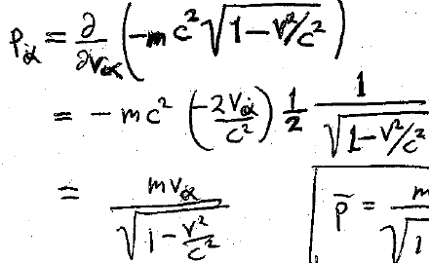





v² = v_{α} v_{α}
For v << c,
or c →∞,
p → mv.

Slide 4
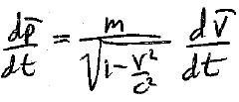
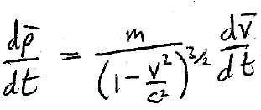
Force on a particle is the time derivative of its momentum.
If the force on the particle is perpendicular to the velocity, then the velocity changes only in direction, and
If the force on the particle is in the same direction as the velocity, the velocity changes only in magnitude, and
HW. (Note typos in new printing of book.)
The ratio of force to acceleration, dp/dt : dv/dt, is different in the two cases.
In classical mechanics, F/a = m always has the same value.

Slide 5

3. Energy of a particle is also defined in terms of the Lagrangian.
If time is homogeneous, Lagranian cannot depend explicitly on time.
Energy is conserved if time is homogeneous, but that doesn’t mean invariant

Slide 6
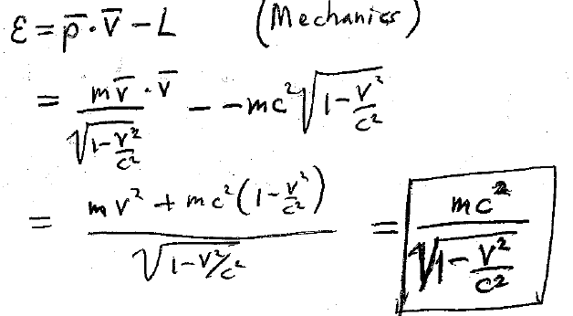









Energy

Slide 7



Energy of a free particle does not go to zero as v → 0.

Slide 8
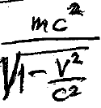

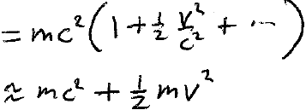

5. In low velocity limit, rest energy and kinetic energy separate into a sum
For v/c << 1
Rest energy Classical kinetic energy of free particle

Slide 9




The energy of any particle, even composite particles such as an atom, is
  where m is the total mass of the particle, and v is its velocity as a whole
The relativistic ε is completely definite and positive.
Classical ε is defined only to within and arbitrary additive constant. It may be positive or negative.

Slide 10
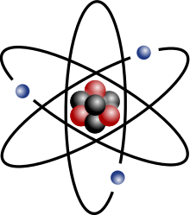






The energy of a composite body at rest = M c², which contains
      the rest energies of constituents
      +
      their kinetic energy
      +
      their interaction energies
An atom.
No conservation of mass in relativistic mechanics.
Only conservation of energy (including rest energies) is valid.

Slide 11
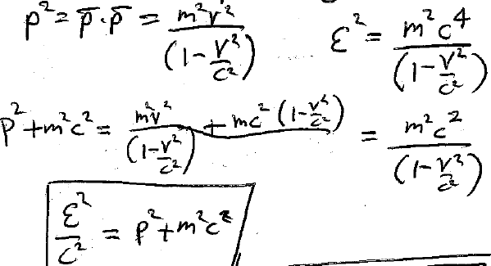

8. The relation between relativistic momentum p and relativistic energy E is
= ε²/c²

Slide 12





Energy expressed in terms of the momentum is the Hamiltonian
Usual classical expression

Slide 13
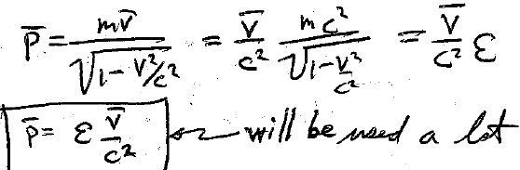









9. A useful relation between
This will be used a lot

Slide 14
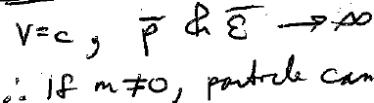



10. If
the particle cannot move at speed c.
Thus, if
Particles with m = 0 can have velocity c. Then p = ε/c.
For ultra relativistic particles with mass
HW

Slide 15



11. Principle of least action leads to all formulats in 4D form
The action for a free particle
12. We compare the trajectories between the same two world points.
At the limits,

Slide 16
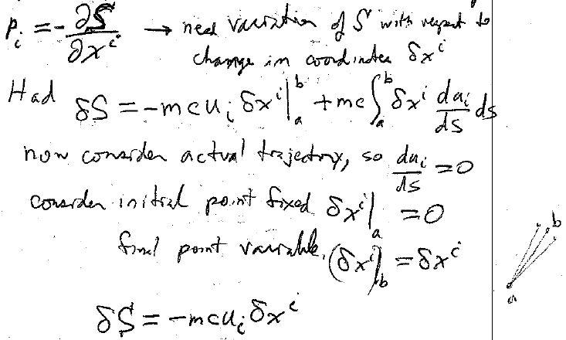










13. To find the momentum, we need S as a function of x^{i}.
We need the variation of S with respect to a change in the coordinates.
We had
Now consider the actual trajectory, so
Take the initial point to be fixed
Allow the final point to vary

Slide 17



14. Momentum 4-vector

Slide 18













15. Formulas for relativistic momentum and energy are contained in a single 4-vector

Slide 19
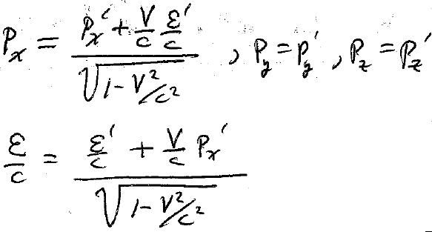






16. Momentum & energy are components of a single 4-vector. Transformation formulas follow immediately from Lorentz transform (6.1)

Slide 20
17. Square of 4-momentum
(7.3)

Slide 21
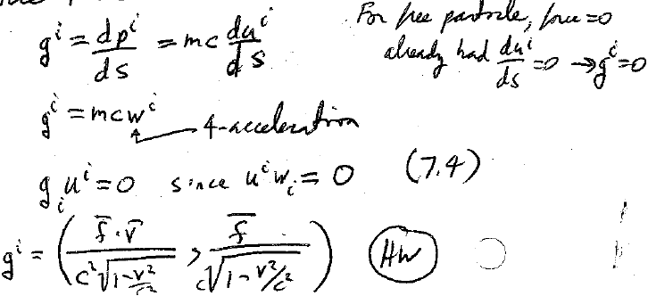













18. Force 4-vector
For free particle, force = 0
Equation of motion for free particle
4-acceleration

Slide 23
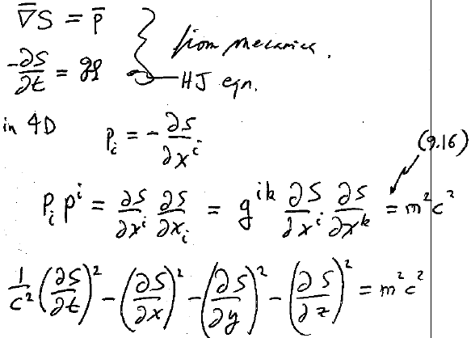








19. Relativistic Hamilton-Jacobi Equation of a free particle
From mechanics

Slide 24
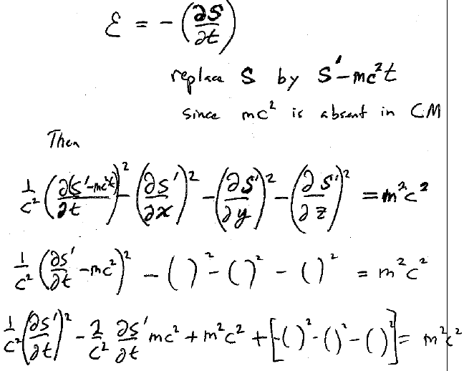




20. Transition to classical mechanics

Slide 25
