Slide 1
LL3 section 117
Nuclear Forces

Slide 2




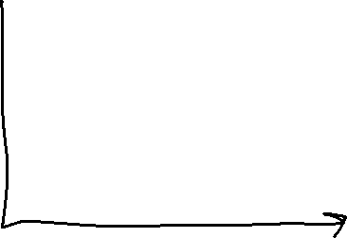














Slide 3






























Slide 4
































Slide 5
























Slide 6






















