Slide 1
LL3 Section 30
Parity

Slide 2


















































Slide 3














(Conservation of parity holds in non-relativisitic systems. Parity is not necessarily conserved in relativistic systems.)

Slide 4

















Slide 5
















Slide 6











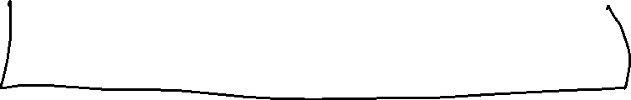













Slide 7


















Slide 8










































Slide 9



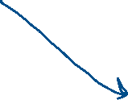



































Slide 10





























Slide 11
















Slide 12












Slide 13






































Slide 14


























Slide 15



























Slide 16






Slide 17

































Slide 18

































