Slide 1
Bending of rods
LL7 Section 17

Slide 5
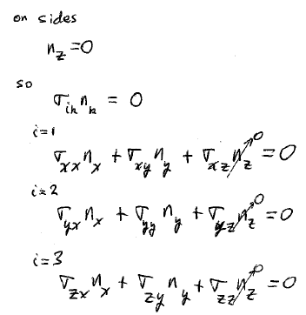

Slide 24
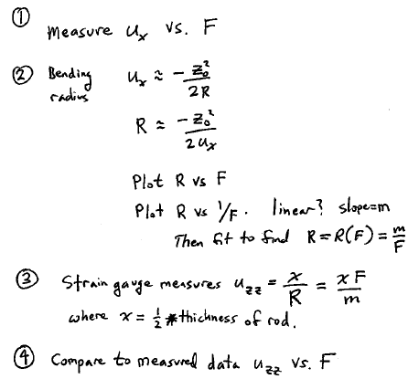

Slide 27
