Slide 1
The electrostatic field of conductors
EDII Section 1

Slide 2

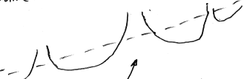













1. Macroscopic electrodynamics: fields in space occupied by matter
Some external electric field
Continuous medium with ions and electrons
Microscopic potential
Has variations on atomic or molecular length scales
Average potential
Spatially average the actual microscopic field over atomic length scales.
Actual microscopic field

Slide 3
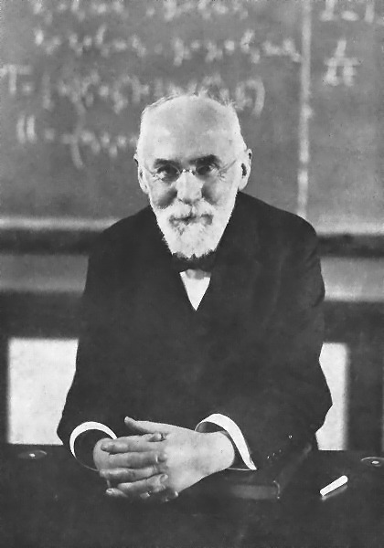

“Macroscopic” Electrodynamics
Equations of electrodynamics of continuous media are found by averaging the vacuum equations.
H. A. Lorentz (1902)
“The” macroscopic Maxwell’s equations

Slide 4
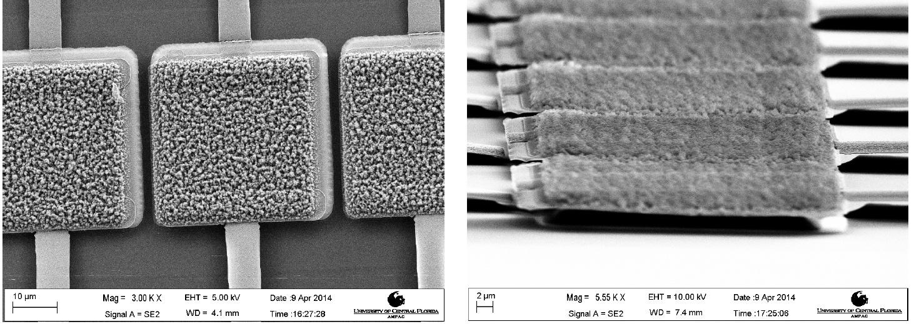
The length scale for averaging depends on the problem
For these devices, we average over scales at least 10 nm, but less than 10 microns.

Slide 5

3. The form of the ED equations depends on the nature of the medium and on the time-dependence
Conductors
Semiconductors and ionic solutions
Dielectrics
Plasmas
Superconductors
Magnetic materials
Pryo-, ferro-, piezo-electrics
Inhomogeneous
Anisotropic
Constant fields
Constant currents
Low frequencies (rf to microwaves)
Optical (far IR to UV)
Pulses
X-rays
There is not one set of field equations (Maxwell equations), there are many variations.

Slide 6
4. Bodies can be roughly divided into two types.
Conductor: Medium in which an electric current (flow of charge) is possible
Dielectric: An electric field causes no current.
Actually, it isn’t black and white. There is continuum of conductivity values spanning the most orders of magnitude of any property of materials.
And
The classification depends on the frequency and on the strength of the field.

Slide 7
5. Electrostatics of conductors: Stationary state of constant energy.
Theorem
The electrostatic electric field inside a conductor is zero.
  A non-zero field would cause current.
  Then there would be dissipation of energy.
  Then the state of the conductor would not be stationary.

Slide 8
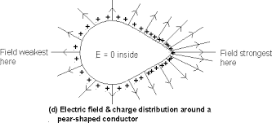









6. Any excess charges in a conductor must reside at the surface.
  Otherwise there would be non-zero field inside.
  Charges on the surface are distributed so that E = 0 inside.
7. Finding these is the problem of the electrostatics of conductors.

Slide 9
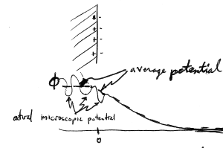
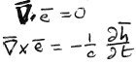
















8. Far from the surface, the mean field and the average field are almost the same.
Surface
Medium Vacuum
Only near the surface is there a difference, and that difference averages out.
Average potential
Actual microscopic potential
Exact microscopic field equations in vacuum
Now take spatial average < >_{r} . Set <h>_{r} = 0,
because in electrostatics there are no macroscopic net currents as sources of magnetic field.

Slide 10
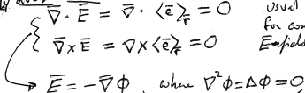





Spatially averaged fields
These are the usual equations for constant E-field in vacuum
Laplace’s equation
φ is a “potential function”
Laplace’s equation plus boundary conditions solve the problem of electrostatics of conductors

Slide 11
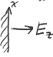


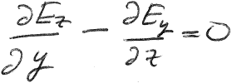














9. Boundary conditions on conductor surface follow from Curl E = 0 both inside and outside
For a homogeneous surface
and
are finite
is continuous across the boundary. Same for E_{x}.
Since E = 0 inside a conductor, E_{t} =0 just outside. E is perpendicular to the conductor surface every point.

Slide 12
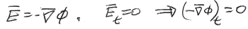

Surface of a homogeneous conductor is an equipotential of the electrostatic field.
No change in φ along the surface

Slide 13
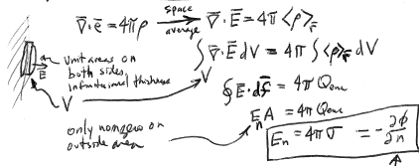
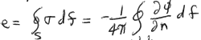






10. Normal component of E field and surface charge density are proportional
Unit area.
Infinitesimal thickness.
Non-zero only on the outside surface of the integration volume
Derivative along the outward normal
Total charge on the conductor is the integral of the surface charge density

Slide 14




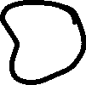


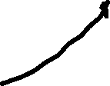










11. Theorem: The potential φ(x,y,z) can take max or min values only at the boundaries of regions where E is non-zero (boundaries of conductors) .
Consequence: A test charge e cannot be in stable equilibrium in a static field, since its potential energy eφ has no minimum anywhere.

Slide 15
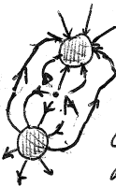
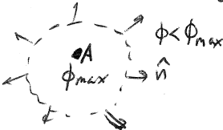


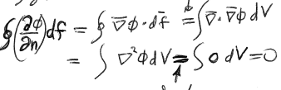






12. Proof. Suppose φ has a maximum at point A not on a boundary of a region with non-zero E.
Surround A with a mathematical surface.
Then on the
surface at all points, and
But
Gauss
Contradiction!
Laplace

