Slide 1
Thermodynamic relations for dielectrics in an electric field
Section 10

Slide 2
Basic thermodynamics
We always need at least 3 thermodynamic variables
  One extrinsic, e.g. volume
  One intrinsic, e.g. pressure
  Temperature
Because of the equation of state, only 2 of these are independent

Slide 3
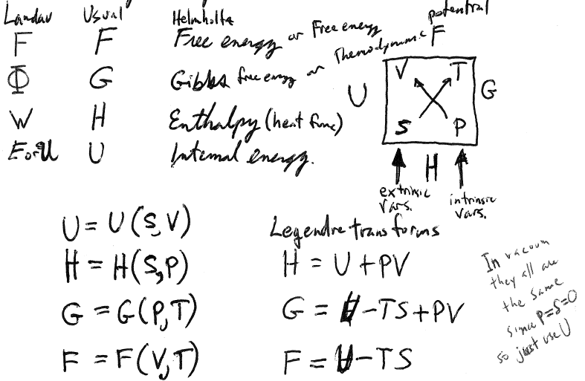






Thermodynamic Potentials
Helmholtz free energy or free energy
Gibbs free energy or Thermodynamic potential
Enthalpy or heat function
Internal energy
In vacuum, they are all the same, since P = S = 0, so we just used U

Slide 4






Internal energy
U is used to express the 1st law (energy conservation)
  dU = TdS – PdV
  = dQ + dR
  = Heat flowing in + work done on

Slide 5
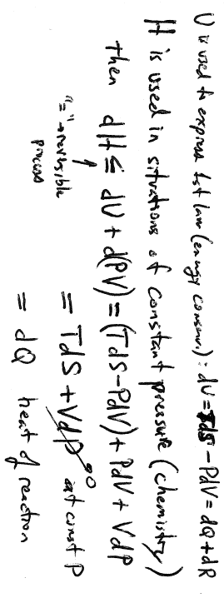


Heat function or Enthalpy
H is used in situations of constant pressure
e.g. chemistry in a test tube

Slide 6
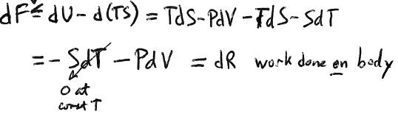


Helmholtz Free Energy
F is used in situations of constant temperature, e.g. sample in helium bath

Slide 7
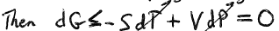
Gibbs Free Energy or Thermodynamic Potential
G is used to describe phase transitions
  Constant T and P
  G never increases
  Equality holds for reversible processes
  G is a minimum in equilibrium for constant T & P

Slide 8


Irreversible processes at constant V and T
dF is negative or zero.
  F can only decrease
  In equilibrium, F = minimum
F is useful for study of condensed matter
  Experimentally, it is very easy to control T, but it is hard to control S
    For gas F = F(V,T), and F seeks a minimum at constant V & T, so gas sample needs to be confined in a bottle.
    For solid, V never changes much (electrostriction is small).

Slide 9
What thermodynamic variables to use for dielectric in an electric field?
P cannot be defined because electric forces are generally not uniform or isotropic in the body.
V is also not a good variable: it doesn’t describe the thermodynamic state of an inhomogeneous body as a whole.
F = F[intrinsic variable (TBD), extrinsic variable (TBD), T]
Thermodynamic state of any system always defined by a minimum of 3 variables

Slide 10






1. Why for conductors did we use only U?
E = 0 inside the conductor.
The electric field does not change the thermodynamic state of a conductor, since it doesn’t penetrate.
Does not affect the entropy of the conductor.
Conductor’s thermodynamic state is irrelevant to the electrostatic energy.
Electrostatic energy does not depend on temperature of conductors.
Situation is the same as for vacuum, where
  U = F = H = G.

Slide 11





2. Electric field penetrates a dielectric and changes its thermodynamic state
What is the work done on a thermally insulated dielectric when the field in it changes by an infinitesimal amount?

Slide 13
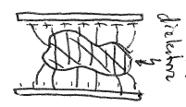
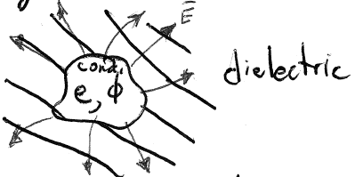




























3. Field in a dielectric is due to charged conductors somewhere outside.
A change in the field is due to a change in the charge on those conductors.
Simpler, but equivalent:
A charged conductor surrounded by dielectric
We calculate the work needed to bring an infinitesimal charge from infinity and to place it on the conductor.
Might be non-uniform and include regions of vacuum

Slide 14










4. The work done in adding charge equals the change in the field energy of the dielectric. That field is represented by the induction D.
If dielectric is anisotropic, D does not have to be perpendicular to the conductor surface.
Direction of normal here is out of the dielectric and into the conductor.
Surface charge on conductor is extraneous charge on the dielectric

Slide 15
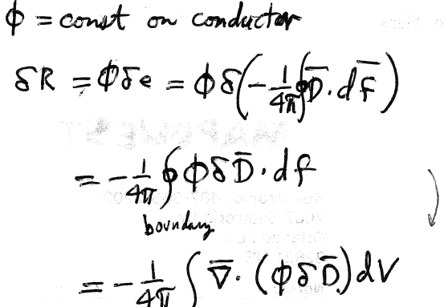












Work done to increase charge by δe is δR = φ δe
~same φ
Gauss
Volume outside conductor
=volume of dielectric, including any vacuum

Slide 16
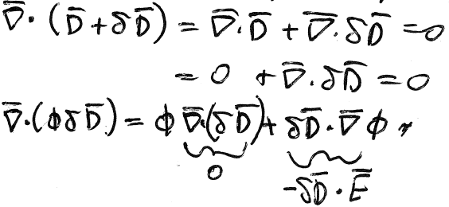
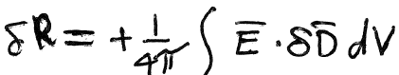







The varied field must satisfy the field equations. Within dielectric ρ_{ex} = 0.
Work done on dielectric due to an increase of the charge on the conductor
Volume outside conductor
=volume of dielectric, including any vacuum

Slide 17
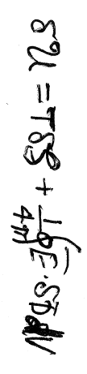
5. First Law of Thermodynamics for a dielectric
Change in internal energy = heat flowing in + work done on
δU = δQ + δR = TδS + δR
For thermally insulated body, δQ = TδS = 0
  (Constant entropy)
Then δR = δU|_{S}
1st law for dielectric
No PdV term, since P and V are not a good variables. They do not characterize the thermodynamic state of body, which becomes inhomogeneous in an E-field.

Slide 18
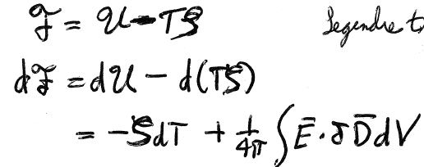




6. As long as there are no temperature gradients, T does characterize the thermodynamic state of the dielectric and is a good variable. Helmholtz free energy has T as an independent variable.
Legendre transform

Slide 19










7. Basis for thermodynamics of dielectrics
Not these: These extrinsic quantities are proportional to the volume of material
These: Define new intrinsic quantities per unit volume
Integral over volume removed
New one
Energy per unit volume is a function of mass density, too.
Chemical potential referred to unit mass
For gas we use μdN, where μ = chemical potential referred to one particle

Slide 20
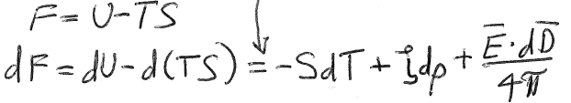




Free energy per unit volume F is found from U, as before for F, by Legendre transform

Slide 21
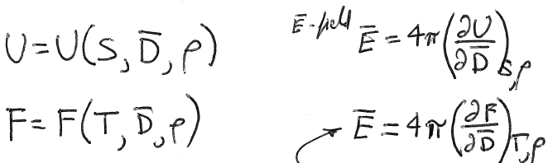









8. Independent variables for U and F are different
Electric field
F is the more convenient potential: It is easier to hold T constant than S

Slide 22
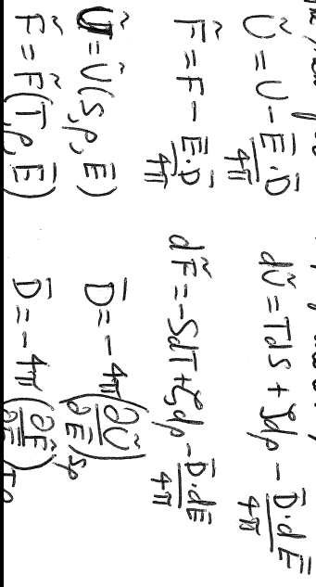









9. Change the independent variable from D to E by Legendre Transformation
T, ρ

Slide 23
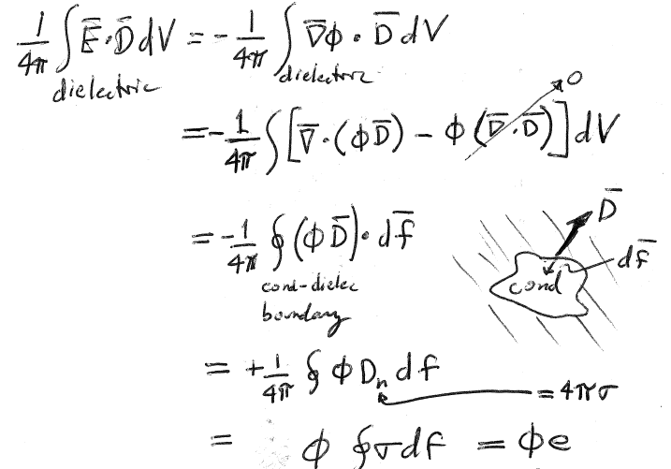





















10. We can also write the energy functions of dielectric in terms of e and φ on the conductors, instead of E and D in the dielectric.
φ constant on conductor
Total charge on conductor
σ on conductor is extraneous to dielectric

Slide 24
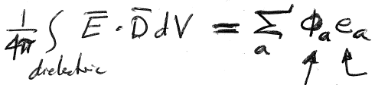



































For several conductors
The extrinsic internal energy of the whole dielectric with E as the independent variable can now be written in terms of potentials on conductors as the variables
This is the same relation as (5.5) for conductors in vacuum, where mechanical energy
in terms of e_{a} was
and
in terms of φ_{a} was

Slide 25
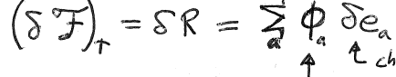


We found the changes of
in terms of infinitesimal changes in induction or field respectively.
What are the changes in terms of infinitesimal changes in charges or potential?
Variation of free energy at constant T = work done on the body
Extra charge brought to the a^{th} conductor from infinity
Potential of a^{th} conductor
(potential energy per unit charge)

Slide 26
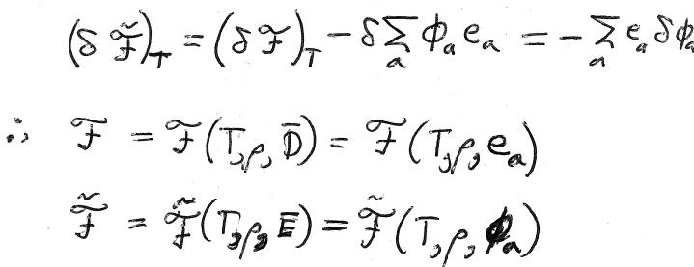










Variation of free energy, with E as variable (at constant T) can be written instead in terms of potentials on conductors as variables.
(by yet another Legendre transformation)
Similarly for
And

Slide 27


12. In calculations, which energy function should you minimize to find the equilibrium state of the system?
For T and e_{a} constant, a body will undergo irreversible processes until is minimized. Then equilibrium is established.
For T and φ_{a} constant, a body will undergo irreversible processes until is minimized. Then equilibrium is established.
For S and e_{a} constant, a body will undergo irreversible processes until is minimized. Then equilibrium is established.
For S and φ_{a} constant, a body will undergo irreversible processes until is minimized. Then equilibrium is established.

Slide 28








Other processes not directly related to the electric field can occur, such as chemical reactions. Then, in equilibrium

Slide 29

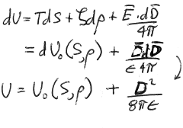
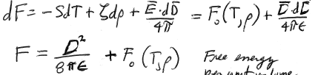



Up to this point, we considered the general case where D(E) is some arbitrary function of E. Now consider linear isotropic dielectrics
integrate
= internal energy per unit volume of dielectric
Free energy per unit volume of dielectric
For linear isotropic dielectric, U and F have definite values, not just their infinitesimal changes

Slide 30
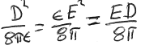

Electric part of the energy functions for linear isotropic dielectric
is the change in U for constant S and ρ due to the field
and
it is the change in F for constant T and ρ due to the field.
But both U and F energy functions need to be written in terms of D, which is their proper variable.

Slide 31





15. For linear isotropic dielectric, the tilda energy functions also have definite values.
Properly written in terms of independent variable E
Difference is in sign, just as in section 5 for field energy of conductors in vacuum.
For dielectric, this only holds if the dielectric is linear.

Slide 32

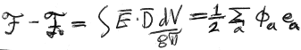


















Total free energy = integral over space of free energy per unit volume
If dielectric fills all space outside conductors
  For given changes on conductors e_{a}
    Dielectric reduces the φ_{a} by factor 1/ε
    Field energy also reduce by factor 1/ε
  For given potentials on conductors φ_{a} maintained by battery
    Charges on conductors increased by factor ε
    Field energy also increased by factor ε

