Slide 1
The energy of the electrostatic field of conductors
EDII Sec2

Slide 2
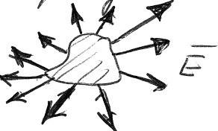
1. The total energy of the electrostatic field of charged conductors is
This ignores the internal energy of the conductor where E = 0, but where the microscopic field e is non-zero.

Slide 3
Since ρ = 0 in vacuum
Boundary surface
= surface of conductors + infinitely remote surface
E = 0 here
Surface of conductors

Slide 4
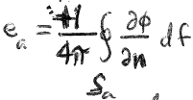
df is inward
Surface of conductors
Normal component of E (the only one) is outward from the conductor opposite to the outward normal of the region of integration
Sign change
Potential is constant on each conductor
since
Same expression as for system of point charges

Slide 5
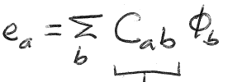
2. e_{a} and φ_{a} are related. Because the field equations in vacuum are linear and homogeneous, the relation is linear.
Integral-differential operator
Normal is outward from conductor again
The most general linear relation can be written
Depends on geometry of problem
Units: length (φ = e/r)

Slide 6
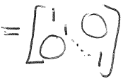
C_{aa} = “capacity coefficients”
C_{a≠b} = “electrostatic induction coefficients”
A potential φ_{b} on conductor b induces a charge e_{a} on conductor a
Single conductor
C = “Capacity”
magnitude of C = linear dimension of the conductor
The converse relations are
C⁻¹_{ab} = inverse of matrix C_{ab}

Slide 7
3. How does the energy change when we vary the charges on the conductors?
All space outside of conductors. (E=0 inside)
Div of change in field = 0 since ρ = 0 still in vacuum
Conductor surface + infinite surface (where E = 0)

Slide 8
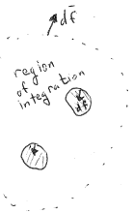
Field is outward from the conductor while df is inward
Surface of a^{th} conductor
= Sum over conductors of the work needed to bring a small charge δe_{a} from infinity where φ = 0 to conductor a at potential φ_{a}.

Slide 9
4. How does the energy change when we vary the potentials on the conductors?
By similar arguments
= Sum over conductors of the work needed to change potentials by δφ_{a} on conductor a with given charge e_{a}.

Slide 10
5. Differential relations and the symmetry of the C matrix
Order of partial differentiation doesn’t matter, so

Slide 11
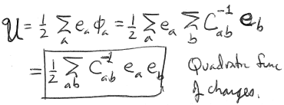

Slide 12
6. Both quadratic forms must be positive since
is positive definite.
This condition leads to two inequalities for the coefficients of capacitance

Slide 13
Proof: Consider two conductors. The coefficients C_{ab} depend only on geometry
1. Might be positive or negative depending on the relative sign of e₁ and e₂.
2. Needs to be positive, regardless of the relative signs and sizes of e₁ & e₂.
Generally, for any number of conductors,
similarly
i.e. capacity coefficients are positive

Slide 14
7. Electrostatic induction coefficients are negative
Proof. Ground all conductors except the a^{th}.
All
Sign of induced charge must be opposite that of the inducing potential
Therefore C_{ba} < 0.
Negative charge is drawn up from ground by attraction of positive voltage on conductor a

Slide 15
Since φ can have no minimum in vacuum, φ > 0 in all space.
The minimum value of φ (zero) appears on conductor b.
Since dφ/dn > 0 we have
< 0.
b
b

Slide 16
The energy of the electrostatic field of conductors has an extremum property, called Thomson’s Theorem.
The energy of the actual field is
We can extend this integral over all space including volume of the conductors, since electrostatic field is zero there.
Now allow charges to penetrate infinitesimally into the conductors, without changing the total charge on them.
How does the energy change?

Slide 17
The change in energy due to the redistribution of charge <ρ>_{r} is
Vol. of conductor
only
φ is the potential of the actual field, i.e. φ = constant inside the conductors.

Slide 19
9. Thomson’s Theorem. The energy of the actual electrostatic field is a minimum relative to the energy for any other distribution of charges on the conductors.

Slide 20
10. Consequence of Thomson’s theorem: An uncharged conductor inserted into a system of charged conductors is attracted to those conductors.
This fictitious field supposes that no charge is induced on the conductor surface to screen its interior. It is the same field as before the conductor was inserted.
By Thomson’s theorem, the energy of the shown fictitious field is not a minimum
The actual field.
The energy of the actual field is a minimum by Thomson’s Theorem.
It is lower than for the previous field shown.
The inserted conductor alters the field and lowers its energy.
An uncharged conductor is attracted to any system of charges.

Slide 21
11. A conductor, charged or uncharged, cannot be in stable equilibrium under electric forces alone.
Proof: Combines theorem that point charge cannot be in stable equilibrium in an electrostatic field and Thomson’s theorem
No way to trap a conductor in an electrostatic bottle

Slide 22
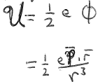
12. Energy of an uncharged conductor in a uniform external field
Uncharged conductor in the field of a distant point charge.
The field that would be if the conductor were not there is
The “-” is due to the chosen direction of r
- er/r³
This field is uniform over the volume of the conductor
Remote charge e
An electric dipole moment is induced
The energy of interaction = the energy of the conductor in the external field of e = the energy of e in the field of the conductor.
Potential at e due to the conductor is a dipole field =
Dipole moment of conductor that is
Field from e that would be

Slide 23
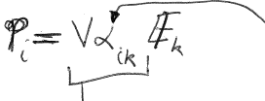
13. Since field equations are linear, components of are linear functions of
Polarizability tensor. Depends on shape of conductor. Symmetric.
Coefficients are proportional to the volume of the conductor
Energy of a conductor in an external field
Double sum

