Slide 1
Current density and conductivity
LL8 Section 21

Slide 2
Steady motion of charges in conductors is electric current.
We need a differential equation for the mean charge flux density j = electric current density
j = mean charge flux density
= current density
= charge/area-time
Constant current:
The flow in and out of every volume element is constant.
No charge builds up or is depleted at any point.
By continuity

Slide 3
To sustain a steady current flow in the presence of energy dissipation, we need a constant electric field.
This condition gives a differential equation for the spatial distribution of E
If E is constant, so is D.
If D is constant, there is no displacement current.
The H-field from constant j is constant.
A potential field

Slide 4
3. We next need a relationship between E and j to solve for either.
These 4 equations are insufficient to solve for the 6 unknowns j and E.
For an isotropic conductor, Ohm’s law usually holds.
σ= “electrical conductivity”

Slide 5
4. Special case: Conductor is homogeneous and Ohm’s law holds
In a homogeneous conductor, σ is spatially uniform.
Laplace’s equation holds in a homogenous linear conductor when current is constant
For constant current, φ is not spatially uniform,and E is not zero inside the conductor

Slide 6
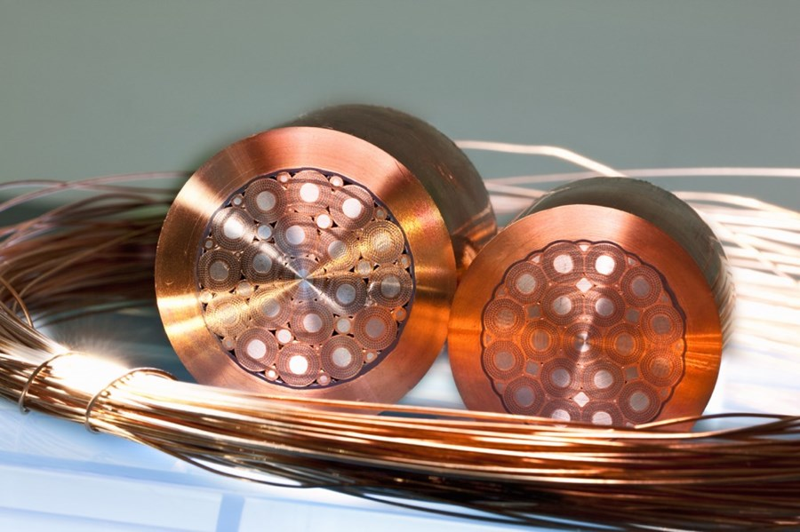
5. Boundary conditions for j and E
Inhomogeneous conductors
Normal components of current density must be equal at the boundary due to charge conservation.
All charges incident from the left must cross to the right.

Slide 7
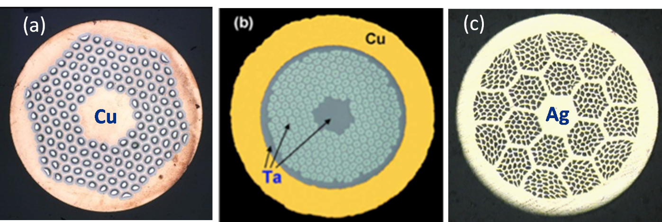
The tangential electric field component is continuous

Slide 8
Boundary conditions at the boundary between a conductor and a dielectric
No charge crosses into the insulator
On both sides , assuming no extraneous charge on the interface.

Slide 9
6. Constant currents dissipate energy: Joule’s Law
Electric field does work on the charge e:
Power per unit volume needed to maintain constant current. Dissipated as heat since current stays constant.
For a isotropic homogeneous linear conductor

Slide 10
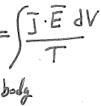
7. Evolution of heat causes increase in entropy, which defines the sign of the conductivity for constant current .
Since the total entropy of the body must increase.
For isotropic linear conductors

Slide 11
8. For anisotropic bodies such as crystals, j need not be parallel to E.
Conductivity tensor
Symmetric!
Onsager’s principle
From volume 5 Statistical Physics section 120, “Symmetry of kinetic coefficients.”

Slide 12
9. Symmetry of the crystal would allow a constant current term.
But such a term can’t exist because jº.E could have either sign, while entropy must increase.

Slide 13
10. Sign of principal values of conductivity tensor
When coordinate axes are chosen to coincide with the principal axes of the conductivity tensor, it becomes diagonal.
All three principal values must be positive because

Slide 14
11. The number of independent components of the conductivity tensor
Every symmetrical tensor of rank 2 can be diagonalized by a suitable choice of the coordinate axes. Then there are three nonzero principal values of the tensor.
Biaxial crystals: All three principal values are different
Uniaxial crystals: Two principal values are the same
Cubic crystals: All three are the same.
A cubic crystal behaves as an isotropic body, since all three principal values of σ_{ik} are the same (= σ).

Slide 15
12-15. Crazy hard formulation of Onsager’s principal
We won’t need this now, but we do need it to do section 26, Thermoelectricity (EDIII)

