Slide 1
The Hall Effect
LL8 Section 22

Slide 2




1. A magnetic field breaks the symmetry of the conductivity tensor
A conductor in an external magnetic field H
Onsager’s principle doesn’t hold anymore
Instead
v.5 section 120, and v.2: Time-reversal symmetry only if H -H

Slide 3




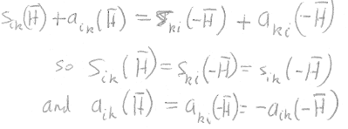

2. Separate conductivity tensor into symmetric and antisymmetric parts.
This is always possible for a rank 2 tensor.
But

Slide 4


Components of s_{ik} are even functions of H
Components of a_{ik} are odd functions of H

Slide 5
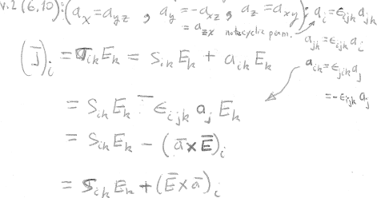






3. The a_{ik} has only 3 components, like a vector.
Any antisymmetric a_{ik} is dual to an axial vector (no sign change under inversion)

Slide 6
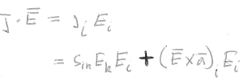
4. Joule heating is determined by the symmetrical part of the conductivity tensor alone.
Joule heat
Zero, since E ⊥ (E x a)

Slide 7


5. External H-fields are usually weak. Expand σ(H) in powers of H.
a(H) is odd, so expansion contains only odd powers of H.
a_{i} = α_{ik} H_{k} + …
a is an axial vector
H is an axial vector
Must be ordinary polar tensor.
Transforms like products of components of vectors that changes sign under inversion.
s_{ik}(H) is even.
Expansion of s_{ik} has only even powers
Zero-field conductivity tensor
Symmetrical in (i,k) and in (l,m)

Slide 8
6. The first order term in the expansion of σ_{ik}(H), gives the Hall effect.
First order effect of H-field is linear in H.
j_{i} = s_{ik} E_{k} + (E x a)_{i}
This term might also have a component perpendicular to E.
Hall effect.
Axial vector a is linear in H.
a_{i} = α_{ik} H_{k}
Hall current is perpendicular to E and proportional to H & E

Slide 9
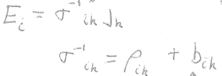
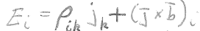


7. Inverse of j_{i} = σ_{ik}E_{k} , and the resistivity tensor.
Inverse formula
Resistivity tensor
Antisymmetric part
Symmetric part
Math arguments repeat
The axial vector b is dual to b_{ik}, b is linear in H for small H
Ordinary Ohm’s law
Hall effect
perpendicular to j and proportional to H and j, but not necessarily perpendicular to H

Slide 10


8. For isotropic conductor (e.g. cubic semiconductors) axial vectors a and b must be parallel to H. (Then Hall current and Hall field are perpendicular to H.)
For non-isotropic conductors,
All tensors that characterize an isotropic medium must be invariant under all rotations about H

Slide 11
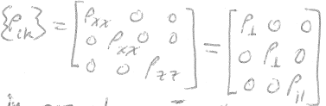
Likewise, symmetric parts of conductivity and resistivity tensors must be invariant under rotations about H

Slide 12

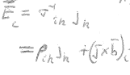











Let j lie in the xz plane of an isotropic conductor

Slide 13
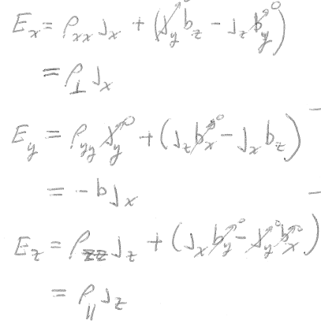

In an isotropic conductor, the Hall field is the only E-field that is perpendicular to both j and H.
Hall field

Slide 14
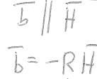

9. The Hall constant R
In an isotropic body
Hall Constant,
can be positive or negative

Slide 15
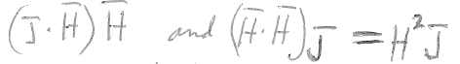



Next terms in expansion of ρ_{ik}j_{k} must be
  quadratic in H,
  linear in j,
  And be a vector
Only possible combinations of H & j are
and
in an isotropic body

Slide 16
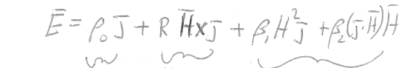


General form of E = E(j)
Zero-field term with isotropic resistivity.
Hall term
E_{H} ⊥ H
E_{H} ⊥ j
Quadratic terms
E_{Q1} || j
E_{Q2} || H

