Slide 1
Static Magnetic Field
Section 29

Slide 2
Find differential equations for the macroscopic magnetic field
Start with the microscopic magnetic field equations
Current density
Spatial average over microscopic length scales
“Magnetic induction” = macroscopic magnetic field: B. Not H.
Zero, since <e>_{r} = E = constant in electrostatics
Generally can be non-zero in either dielectrics or conductors

Slide 3
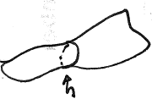
2. Consider case of zero net current through any cross section of the body, either dielectrics (always true) or conductors (special case).
Dielectrics: No net current density, even though <ρv>_{r} might be locally non-zero
Some cross section
Conductors: If we assume for now that net current = 0 through any cross section then
holds in this case, too.

Slide 4
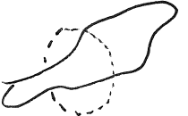
3. Introduce magnetization M and the “H”-field
If
Then
M = some vector, which is zero outside the body
Proof.
Net current through some cross section
By hypothesis
By Stokes Thm
Boundary of cross section, which needs to be outside of body.
M = zero outside body
The hypothesis gives the required condition of no net current through any cross section.
M = “magnetization”

Slide 5
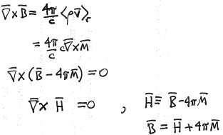
Macroscopic Maxwell equation
Definition of H-field
Magnetic induction
= Macroscopic magnetic field.
Magnetization
H-field
Analog of
Definition of D
Electric induction
Macroscopic electric field.
Polarization

Slide 6
Magnetic induction B is the macroscopic magnetic field, not H.
E is the macroscopic electric field, not electric induction D.
In vacuum (v.2), H was the magnetic field because M = 0 in vacuum. Then h = H = B = <h>_{r}

Slide 7
4. Physical meaning of magnetization
Total magnetic moment of a system of moving charges
Integrate over any volume that includes all of the body
=
Homework
= 0 outside body
Homework
Magnetization = magnetic moment per unit volume

Slide 8
5. We need supplemental relations between B and H to solve the differential equations for them.
Equations of magnetostatics in matter
These are insufficient to solve for B and H.
For weak fields in non-ferromagnetic isotropic media
“permeability”
“susceptibility”

Slide 9
6. Magnitude of μ and sign of χ
μ is always positive, but not always >1.
can be positive or negative.
Unlike electric case

Slide 10
7. Usually the magnetic susceptibility (for non-ferromagnetic bodies) is very small compared to dielectric susceptibilities
Magnetism is a relativistic effect, ~ v²/c², v = electron velocity

Slide 11
8. Anisotropic bodies (crystals)
Permeability tensor is symmetric

Slide 12
9. Boundary conditions on B and H
Compare to BCs for neutral dielectrics
(No extraneous charge)
Magnetic scalar potential

Slide 14
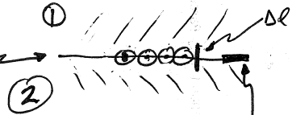
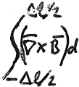
10. Surface current density
B_{t} is discontinuous
Surface current at interface
Unit length in the surface
Integrate along Δl crossing the normal
= Charge passing per unit time through unit length in the surface

Slide 15
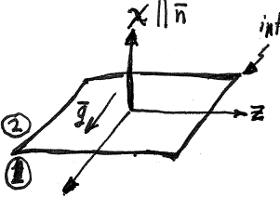
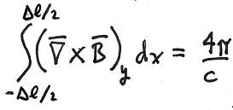
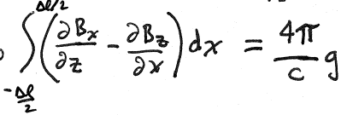
Choose coordinates
Interface
Lim
Δl->0
y
Lim
Δl->0
Surface current density
1st integral
is finite at homogenous interface, and the same on both sides

Slide 16
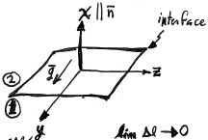
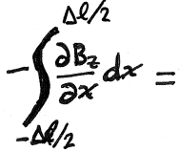
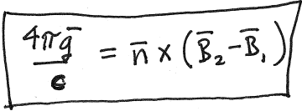
Second integral
Thus, the discontinuity in B_{t} is
Unit normal into region 2
= B_{t2} – B_{t1}
and
so

