Slide 1
Magnetic field of a steady current
Section 30

Slide 2
1. Now we allow there to be a conduction current density
Previously supposed zero net current.
Then
For a conductor, there can be non-zero net current. Now we suppose there is such.
Then
Magnetization gives no contribution to net current, even though there is surface current
“Conduction” current density
Rate of energy dissipation per unit volume = E . j

Slide 3
2. We next need the differential equations for B and H in the presence of conduction current j. Boundary conditions are unchanged: H_{t}, and B_{n} are continuous.
Distribution of j is determined from section 21 by
These equations do not involve the magnetic field created by j itself.
If we ignore the effect of the j-generated H-field on the conductivity of the body, then
Then, H is determined from the j distribution according to equations of section 21.
Recipe: Find j. Then find H. Ignore the effect that this H has on j.

Slide 4
New differential equations in the presence of conduction current
H determined from given j.
Same boundary condition as when j = 0

Slide 5
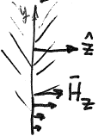
Boundary condition H_{1t} = H_{2t} still holds, as when j = 0
Proof:
Homogeneous interface between conductors.
For homogeneous interface, Is finite
J is finite everywhere, including boundaries
finite
H_{y} is continuous. (H_{t} is continuous.)

Slide 6
3. The vector potential A and differential equations for it.
For the given j, we want to find H and B
These are the equations we need to solve.
Introduce the vector potential A and find the equation for it.
Due to gauge invariance, we can place a condition on A, namely
Assume isotropic linear medium (B = μ H), or else there are too many unknowns
A differential equation for A with j as the source.
Recipe: Solve for A, then find B, then H.

Slide 7
4. Special case: Homogeneous media.
Special case: homogeneous medium where μ is spatially uniform
Differential equation for A with given j source term
Recipe: Find A, then find B, then H.

Slide 8
Special case: Piecewise homogeneous medium
Different parts have different μ
holds in each part.
Boundary conditions for A at interface between different homogeneous media.
Boundary condition between the parts
is continuous.
is continuous.

Slide 9
5. Special case: Two-dimensional problems, and boundary conditions for A between different 2D homogeneous media.
For example, systems with translational invariance along one axis, like a straight wire.
(but not assumed homogeneous in the xy plane)
By assumption
y
One possibility for current:
z
Then we expect:
Condition
holds automatically
Magnetic field lies in the xy plane, e.g. cylindrical wire.

Slide 10
What equation does A satisfy in this 2D problem?
Homework
But
Scalar differential equation for scalar A(x,y) when μ = μ(x,y) and j = j(x,y)e_{z}

Slide 11
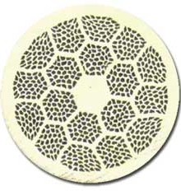
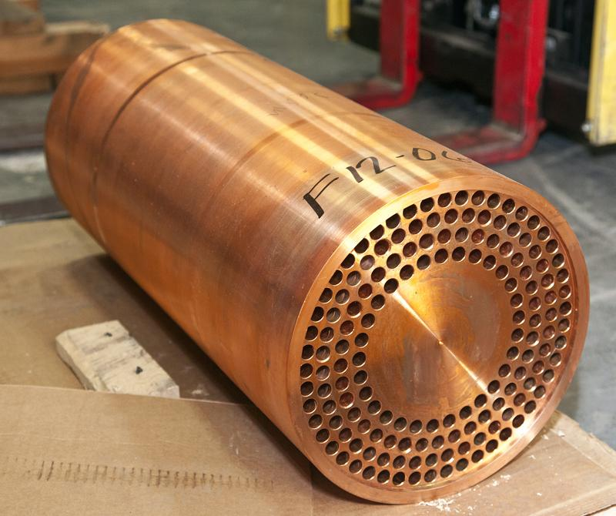
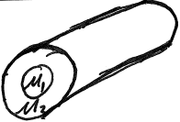
What if 2D problem is piecewise homogeneous?
holds in each region with own μ
Boundary conditions are continuity of A, , and (curlA)_{t}/μ.
Homework

Slide 12
6. Special case of 2D problem with current along axis: cylindrical symmetry.
If current is symmetrical about the z-axis, j_{z} = j(r)
Then magnetic field lines are circles (r = constant)
(the field must have the same symmetry as its sources.
Stokes
r = const
Any surface bound by contour r = const
Total current enclosed within radius r

Slide 13
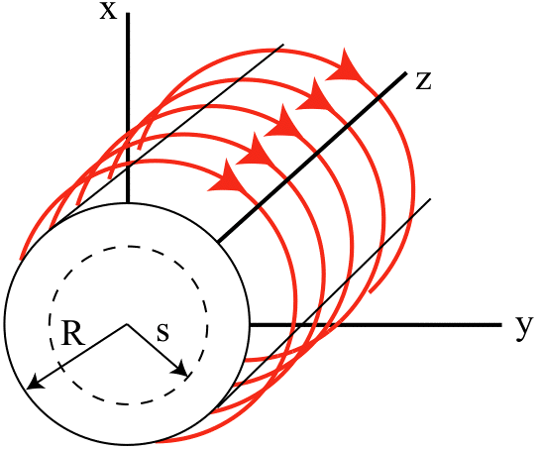
7. Another kind of 2D problem is the axially symmetric current distribution
We expect
Magnetic induction (field)
H-field
Solve for A, then

Slide 14
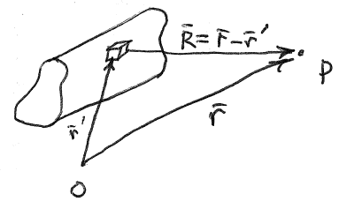
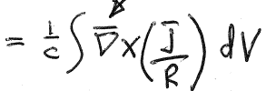
8. Non magnetic media: μ = 1
Now there are no conditions at interfaces or surfaces since all media are magnetically identical
(v.2 section 43)
Since μ = 1, H = B
Acts on coordinates r of field point P
HW

Slide 15
Thin wires, neglect internal regions of wire: “linear currents”
9. Linear circuits, and the Biot-Savart law
Total current in the conductor
Biot-Savart law.
R³

Slide 16
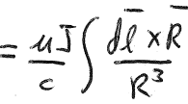
10. Linear circuit embedded in a magnetic medium
If thin conducting material is surrounded by magnetic material of permeability μ
e.g. wire wound iron core

Slide 17
11. Magnetic potential theory
If j = 0 except for linear currents
Except for line singularities
Then
Magnetic scalar potential
Contrast with electrostatics
In all space
φ is single valued.

Slide 18
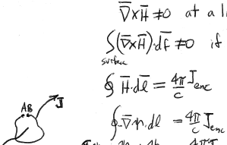
In magnetic case
at a line current
If the line current penetrates the surface of integration.
δΨ = -Ψ_{B} + Ψ_{A} = (4π/c) J_{enc}
Magnetic scalar potential Ψ is many valued.

Slide 19
12. Magnetic moment
If we are at large distances from a finite current distribution…
Magnetic moment
HW
What is magnetic moment of a flat circular wire loop?

Slide 20
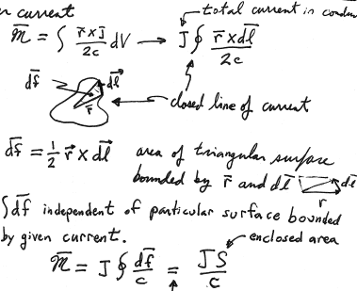
13. Magnetic moment of linear circuit
Linear current
Total current in the wire
Closed loop of current
= Area of triangular surface bounded by r and dl
is independent of the particular surface bounded by the given current loop.
Enclosed area if current lies in a plane

Slide 21
14. Energy flux in a conductor
Electromagnetic field energy is dissipated as Joule Heat
HW:
Poynting vector for field in vacuum

Slide 22
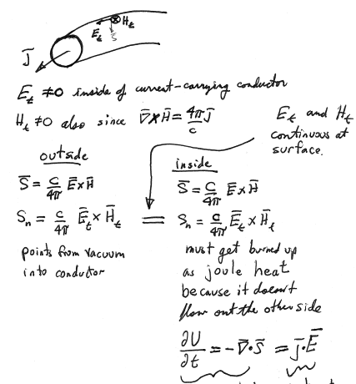
Inside of a current-carrying conductor
E_{t} and H_{t} are continuous at the surface
Direction is from vacuum into the conductor
This energy flux must get burned up as Joule heat because it doesn’t flow out the other side
Rate at which Joule heat is generated per unit volume (21.6)
Rate at which energy density leaves the EM field by energy continuity

