Slide 1
Thermodynamic relations in a magnetic field
LL8 Section 31

Slide 2
1. Thermodynamic relations for magnetic materials in a magnetic field are similar to those for dielectrics in an electric field, but they must be derived differently.
Magnetic fields do no work on charges.
But when B-fields change, they induce E-fields.
These induced E-fields do work on the currents which produce the B-fields,
and are responsible for changes in the energy of the medium.

Slide 3
2. Find the differential equation that gives the induced electric field.
In electrostatics, the right side was assumed zero. Now it is not.
Average the microscopic Maxwell equation

Slide 4
3. Find the work done on the magnetic field by the external emf which maintains the current during time δt
Power density =
Work done on the currents j by the E-field during time δt =
Work done on the field by the external EMF that maintains the currents is the opposite:

Slide 6
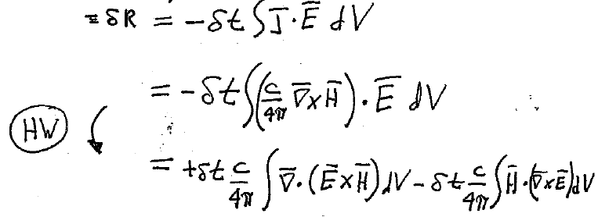
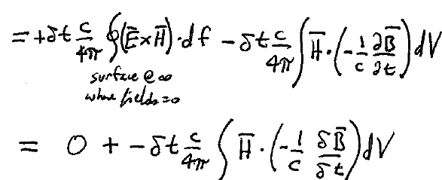

Slide 7
4.Imperfect analogy with work done by change in electric field.
Work done on the fields by an infinitesimal change in B
Analogy: (10.2)
Magnetic induction
Electric induction

Slide 8
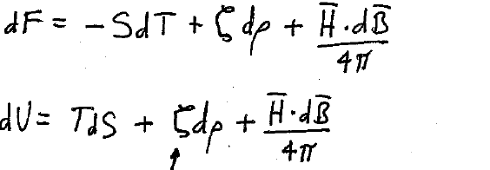
5. Thermodynamic relations are found by analogy
Small changes in…
Total free energy
Total internal energy
Corresponding energy functions per unit volume
B is the independent variable.
Chemical potential per unit mass

Slide 9
Legendre transformation changes independent variable from B to H.

Slide 10
Linear media: B = μ H.
With this definite relation, we can integrate to the incremental changes to find definite values of magnetic energy.

Slide 11
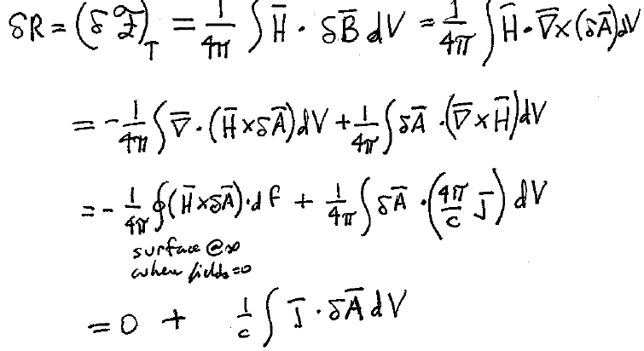
6. We can write the incremental work done on the magnetic field in terms of vector potential and current density.
Now the independent variable is the vector potential instead of the magnetic induction

Slide 12
Or, we can make current density the independent variable
Legendre transform,
HW

Slide 13
Another manifestation of the imperfect analogy.
Currents are the sources of the H-field. Charges are the sources of the electric field.
Are currents the analogs of charges in the energy equations?
Is vector potential the analog of the scalar potential?
Magnetic field energy
Electric field energy
Currents j are analogs of potentials φ, not charges ρ
Source of H
Source of E
Vector potentials A are analogs to charges ρ, not scalar potentials φ

