Slide 1
The total free energy of a magnetic substance
LL8 Section 32

Slide 2
The work done on a dielectric by the electric field when charges and temperature are constant is
The work done on a magnetizable body by the magnetic field for constant currents and temperature is
Magnetizable body
Magnetic field

Slide 3
Magnetizable body
Magnetic field
The thermodynamic potential with respect to T and j is
For constant T and j, irreversible processes occur until is minimized.
In equilibrium is a minimum with respect to changes in state occurring at constant T and j.
For given j and constant T, the change in is the work done by the field on the body.

Slide 4
2. The part of the free energy that depends on the thermodynamic state and properties of the body alone.
In the absence of the body, the free energy density of the field is
is the magnetic field produced by the given j without contribution from the magnetized body.
Thing to remember: H is not the same as , but for non-ferromagnetic bodies, they are often almost the same.

Slide 5
With the body present, includes the energy of ,
Field part of the energy density, which includes the contribution from M
Free energy density of body without field.
New definition
The difference in old and new definitions does not affect the differential thermodynamic relations of the body.

Slide 6
3. Change in free energy due to infinitesimal change in magnetic field.
For a reversible change in at constant T

Slide 7
4. After completing derivation in the HW…
Magnetization of the body
Change in the original external field that created M
Compare to (11.3):

Slide 8
For a uniform external applied magnetic field
is also uniform
comes out of integral
Total magnetic moment of the body
When temperature is not constant

Slide 9
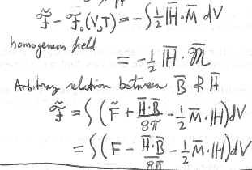
5. Formulas analogous to those for dielectrics (section 11)
For linear media, with B = μ H
Absolute, not differential
(if the externally applied field is homogeneous)
If the function B(H) is arbitrary (not linear), then

Slide 10
6. Common case of small magnetic susceptibility (diamagnetic and paramagnetic)
Usually the magnetic susceptibility is small for non ferromagnetic bodies, so that their magnetization does not affect the currents that create the field that magnetizes the body. Then the free energy is linearly proportional to the susceptibility.
This is found from the original current distribution (e.g. an electromagnet) without any magnetizable material around.

Slide 11
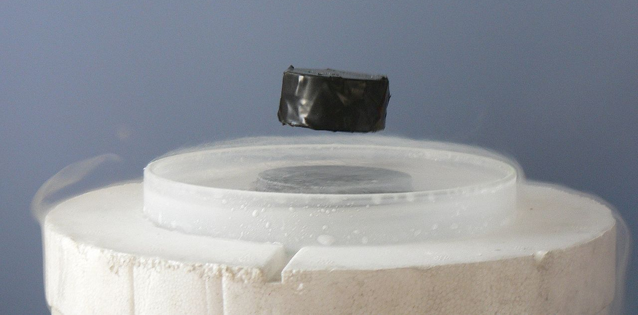
7.
Reason magnetic susceptibility can be positive or negative: QM
9. Sign of force on paramagnetic and diamagnetic bodies

