Slide 1
Linear conductors with currents
Section 33

Slide 2










1. The free energy of a universe comprising current-carrying conductors and surrounding medium, all linear (non-ferromagnetic).
Assume B = μH everywhere.
Then
Ignore this term, which is unrelated to the currents

Slide 3



2. The same free energy can be expressed in terms of the currents (sec. 31)
Since j = 0 outside of the wires

Slide 4













3. Superposition principle is applied to the magnetic field.
Since Maxwell’s equations are linear in the fields, the superposition of field solutions is also a solution
= sum over fields from each current alone.
Free self energy
Interaction energy
Energy of a^{th} conductor in its own field
Energy of a^{th} conductor in the field of the b^{th} conductor

Slide 5


The interaction energy is symmetric
Since, at each point in space,

Slide 6
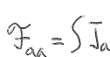










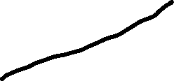




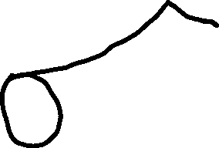



4. The self- and Interaction-Energies can be written in terms of currents.
Also
Field at dV_{a} due to j_{a}
a^{th} conductor
Field at dV_{a} due to all the currents in conductor b
a^{th} conductor
Field at dV_{b} due to j_{a}
b^{th} conductor

Slide 7


















5. Self Inductance and Mutual Inductance
For a given current-density distribution, self energy
depends only on the total current
a
Cross section
Both j_{a} and the field A_{a} produced by j_{a} are proportional to total current J_{a}
Proportionality constant L_{aa} = “self-inductance”
Depends only on geometry of conductors and how current is distributed

Slide 8



Similarly
and
So interaction energy is
A different proportionality constant.
L_{ab} = “mutual inductance”
Also depends only on geometry of conductors and current distribution

Slide 9
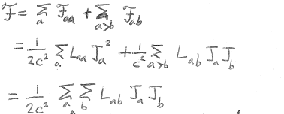

Total free energy of system
Magnitude of free energy depends on relative sense of currents
No restriction a>b now, due to factor ½ applied to interaction term

Slide 10










6. Conditions on coefficients
>0
(Positive definite)
Puts conditions on the coefficients
L_{aa} > 0 for all a (e.g. consider a single conductor)
L_{aa} L_{bb} > L_{ab}²
Mutual inductance is always less than or equal to the product of self inductances of two circuits.
L_{ab} = k Sqrt[L_{aa} L_{bb} ]
Coupling coefficient |k|

Slide 11
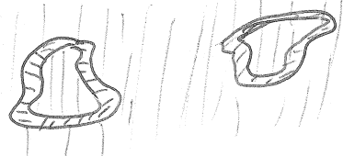








































7. Simplifying assumption
Calculation of for arbitrary 3D currents is hard.
If μ = 1 in both conductors and surrounding media, the problem simplifies.
Then μ(T) is not a factor in , which then is independent of the thermodynamic state of the materials.
Then = , i.e. “free energy” -> “energy”.

Slide 12

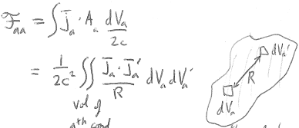










































8. Self- and Interaction Energies for non-magnetic media.
Non-magnetic μ = 1 case
(30.12), same as in vacuum
Self energy
a^{th}
conductor
a^{th}
conductor
Interaction energy

Slide 13

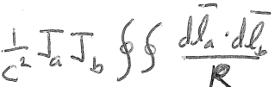














9. Linear conductors
Linear circuits
Depends only on shape, size, relative position, and relative direction of currents
Does not require μ = 1 for the linear conductors themselves, since their magnetic energy is tiny.
If surrounding medium has μ > 1, L_{ab} μ L_{ab}.

Slide 14






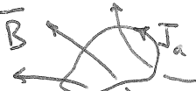









10. Total energy of linear conductors in terms of magnetic flux
The total free energy is
Linear circuits
The vector potential of the total field from all conductors at dl_{a} of the a^{th} conductor.
= Φ
= Magnetic flux through a^{th} circuit

Slide 15

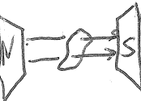















Then
Flux of field from all circuits through the a^{th} circuit
For a linear current J in an external B-field
No self-energy for the sources of B.
No factor of 2 to correct for double counting of interaction pairs.

Slide 16















For uniform external B-field and non-permeable medium surrounding conductor
External field without linear circuit
Magnetic moment of linear circuit

Slide 17





11. Forces on linear current-carrying conductors
If energy is known as a function of shape, size, and relative positions, then forces on conductors are found by differentiation with respect to the proper coordinates.
But which thermodynamic potential should we use?
It is easy to hold currents constant during the differentiation.
It is difficult to hold fluxes constant when the wires move.
The free energy with respect to currents is

Slide 18
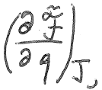


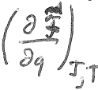









Generalized force F_{q} in the direction of the generalized coordinate q.
Omitting terms that are independent of currents,
See (31.7)
Includes energies of power supplies that maintain constant currents as circuits move and change shape.
Energies of linear circuits alone

Slide 19

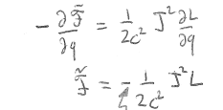











12. Forces exerted on a conductor by its own magnetic field
For given J and T, spontaneous irreversible changes occur that reduce until it reaches a minimum.
Forces on a conductor, which tend to minimize , will tend to maximize L
[L] = length (HW)
L~ dimension of conductor
For example, a current carrying loop. Opposite sides have opposite currents and repel.
A magnetic field from J in a conductor tends to increase its size.

Slide 20
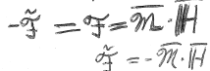













13. A linear current in an external magnetic field.
for linear J in an external field.
A decrease here
requires an increase here,
which happens when the loop gets expands.

Slide 21
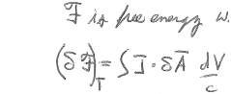
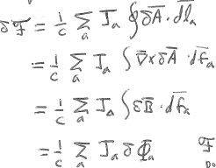





14. What if the function B(H) is non-linear?
We have assumed B = μH. Now consider an arbitrary non-linear relation
= free energy with respect to the vector potential
(31.8)
For a system of linear currents
thermodynamic potential with respect to flux is

Slide 22
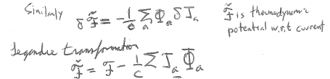


By Legendre transformation
Thermodynamic potential with respect to current is

Slide 23
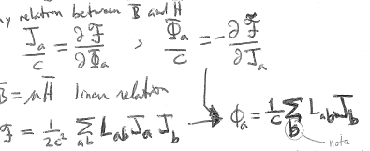






15. Thermodynamic relations
For arbitrary B(H)
But if B = μH (linear relation)
Note misprint in text
Inductances are coefficients of proportionality between the currents that produce the magnetic fields and the magnetic fluxes
= magnetic flux through the circuit of current J_{a} due to the current of J_{b}.
= magnetic flux through the circuit of current J_{a} due to the current J_{a} itself.

