Slide 1
The forces on a conductor
Section 5

Slide 2
1. The force per unit area on a conductor in an electric field is always a negative pressure directed along the outward normal with magnitude equal to the field energy density
A conductor in an electric field experiences forces

Slide 3
1. Momentum flux density in an electric field in vacuum is given by the Maxwell stress tensor
n
The amount of p_{i} passing through df_{k} per unit time per unit area

Slide 4
Force on element df on conductor surface
= flux of momentum through it from outside
sum
n
(F_{s})_{i} = i^{th} component of force per unit area on conductor = σ_{ik}n_{k}
E is normal to the conductor surface
Let e_{z} = n at a certain point on the surface
Then E₁ = E₂ = 0.

Slide 5
(F_{s})_{i} = σ_{ik}n_{k}
= σ_{i3}n₃
= σ₃₃n₃
Energy density
The direction of F is outward:
A negative pressure
In terms of surface charge density σ = E_{n}/4π
F_{s} = 2 π σ² n = (1/2) σ E

Slide 6
Direction of F is outward: Negative pressure
Charged conductor
Uncharged conductor in an external field

Slide 7
Total (net) force on a conductor is the integral of F_{s} over the surface
(This would be responsible for the acceleration of the body as a whole.)
But F_{s} varies in a complex way. Integral can be arbitrarily difficult.
Easier to use energy methods
The energy of a conductor in its field and in field of other charged conductors is U.
The force on a conductor =
The component of force in the direction q is

Slide 8
Conductors floating in vacuum of outer space have constant charge, but their potentials vary as the conductors move around.
In this situation, we write energy U as a function of charges e and positions q
(not both e and φ, since they are not independent.)
U (e, q)
Then to calculate the forces on conductors from the function U (e, q), we take the gradient while mathematically holding charges constant.
e
General coordinate q could be an angle, not a displacement.
Projection of torque on an axis
rotation angle about that axis.

Slide 9
4. In the lab, keeping charge constant on a conductor is almost impossible.
Conductors in a lab are usually maintained at constant potential, by means of large external charge reservoirs, e.g. capacitor, battery, or power supply
Then charges on conductors change as the conductors move around.
We then write energy of conductors as a function of potentials and positions.
U (φ, q)
Forces are calculated by taking gradients while mathematically holding φ fixed, but there is an additional complication: U (φ, q) is the energy of all the conductors, but it is not now the energy of the entire universe!

Slide 10
In constant potential situations, when a conductor moves, the energies of all conductors change AND the energies of all the charge reservoirs ALSO change.
Motion dq
Charge transfer maintains φ = φ_{a} on the conductor
The energy of the reservoir is reduced by e_{a}φ_{a}

Slide 11
The total energy of the universe when potentials are held constant is now….
A “Legendre Transform”
This is what changes due to the motions dq
This is the energy of the conductors alone
This is the energy lost by the reservoirs in putting e_{a} on each conductor.
Opposite sign for the case of constant e_{a}

Slide 12
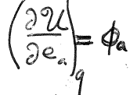
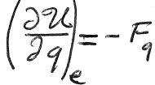
5. Derive the result mathematically: Write the energy again as a function of e_{a}, which is convenient in cases of constant charge.
Can change if charges change, or if conductors move.
Energy of conductors=
Potential energy per unit charge, a function of e_{a}.
Work done by the field on a system of conductors, reduces the potential energy of the system in the field.
So that
and
Same as (2.7)
new

Slide 13
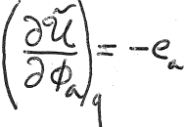
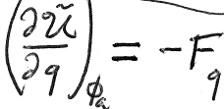
In cases of constant potential, express energy in terms of the potentials
Energy of universe: conductors AND of charge reservoirs the are attached to:
So that
and

Slide 14
6. The net force on an uncharged conductor = 0 in a perfectly uniform field.
Uniform external field
(in absence of the conductor)
Spatial derivatives are zero!
This field!
Not this field!
Equation (2.14) can still be useful if the field varies only slightly over the conductor. Then

Slide 15
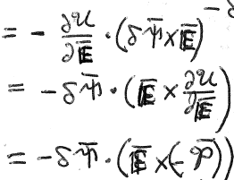
7. The total torque is non-zero even in a perfectly uniform external field.
Angle of rotation
A rotation of the body in the field is equivalent to a rotation of the field relative to the body by the opposite angle
Dipole moment of body.
Where does that come from?

Slide 16
By (2.13)

Slide 17
Torque
Same as vacuum expression
External field that would be present without the conductor
Dipole moment of body induced by

Slide 18
8. Electrostriction
If force and torque are zero, then the deformation of a conductor is the most important effect.
Electric force on surface is a negative pressure
Body expands

Slide 19
9. First approximation gives the change in volume, ignoring change in shape.
Force per unit area =
Uniform outward pressure Δp
fractional change in volume
Coefficient of expansion
(bulk modulus)⁻¹
From 1st law of
Thermodynamics for hydrostatic system

Slide 20
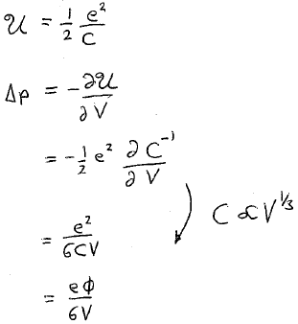
10. Expansion of a charged conductor in its own field

Slide 21
11. Expansion of an uncharged conductor in a uniform external field

