Slide 1
Magnetic properties of superconductors
Section 53

Slide 2
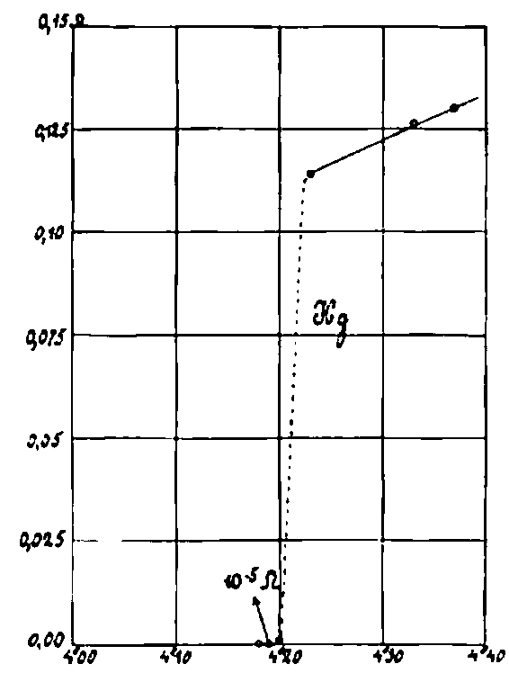
The first discovered and most striking property of many conductors at low temperature is superconductivity, the complete absence of electrical resistance to steady current.
Superconductivity transition point
Second order phase transition

Slide 3
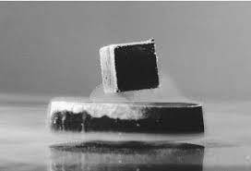
2. Superconductivity is a consequence of a magnetic effect that is more fundamental.

Slide 4
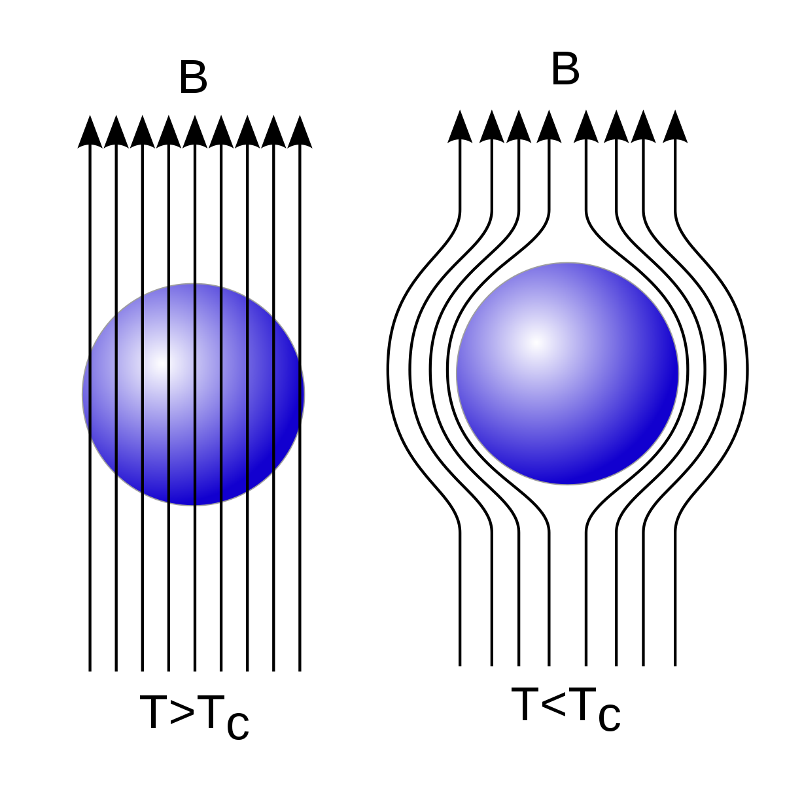
3. The fundamental magnetic effect is that the magnetic field does not penetrate into a superconductor: B = 0. “Meissner effect”.

Slide 5
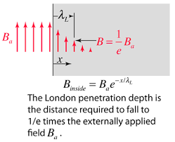
4. Caveat: Actually, B penetrates a little, ~100 nm, so this “rule” is not valid near the surface of bulk superconductors, for thin films, or for small particles.

Slide 6
We consider only thick superconductors and neglect surface penetration.

Slide 7






6. Boundary condition on B
Always true, since there is no magnetic charge
is continuous at boundary of superconductor
inside superconductor by Meissner Effect
B is everywhere tangential to the surface of a superconductor

Slide 8
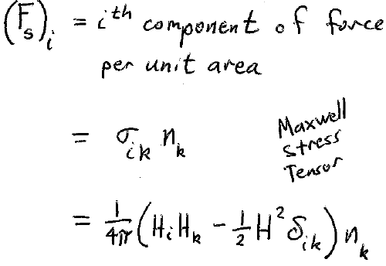
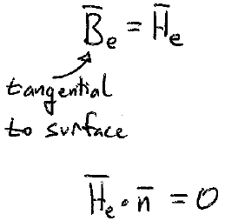
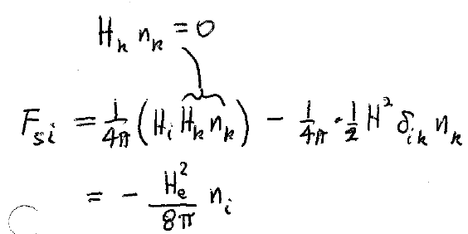
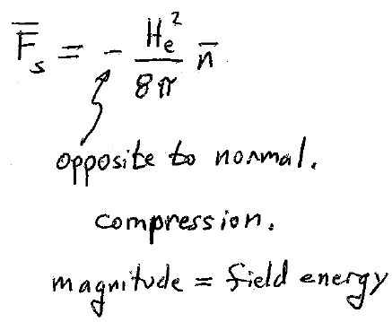



7. Forces on a superconductor
Magnetic field in the vacuum outside of a superconductor
Compare to electrostatic force on conductors!

Slide 9
8. A superconductor has no macroscopic volume currents inside, because of Meissner effect.
Includes conduction and magnetization currents
= 0,
since B = 0 inside.
Mean current density

Slide 10
One cannot isolate the conduction and magnetization current contributions within
We cannot define M as for normal conductors according to
when
on any cross section.
M and H have no physical significance in superconductors.

Slide 11
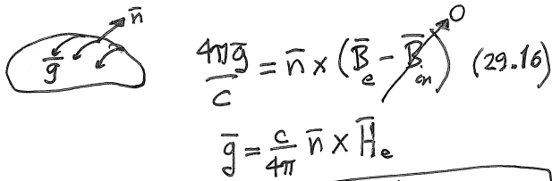














9. All electric current in superconductor is surface current.
Surface current is determined by H-field outside a superconductor

Slide 12
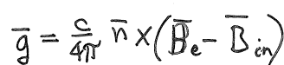







Non-superconducting magnetized bodies also have surface currents
For a normal conductor
is continuous
For non-superconducting materials, this equation restricts the possible value of the current based on the internal magnetic field B_{in}.
For a normal magnetized material , surface current is determined by B-field inside, which arises from the magnetization.

Slide 13


























10. For non-superconducting magnetized body, the surface currents for any cross section always balance out to zero. But not for super conductors.
Singly connected normal body
Doubly connected normal body
One cross section. Another one.

Slide 14

For superconductor, we can have non-zero total current on the surface.
Even though H has no physical meaning inside, it need not be zero.
Continuity of H_{t} still holds.
In super state B -> 0 implies μ = B/H -> 0 simultaneously.
Then is indeterminate.
Does not restrict values of current.
Total current through any cross section need not be zero in a superconductor.

Slide 15
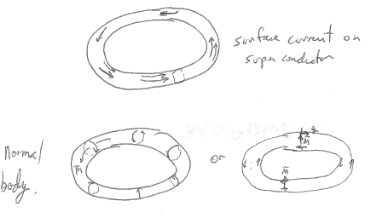












Magnetized normal body also has a surface current, but it is restricted so that the net current through any cross section is zero.
11. Net non-zero surface current can exist only on multiply connected superconductors, or on simply-connected ones that are part of a closed circuit that includes a non-superconducting source of emf

Slide 16
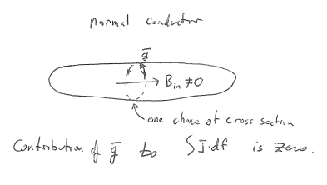
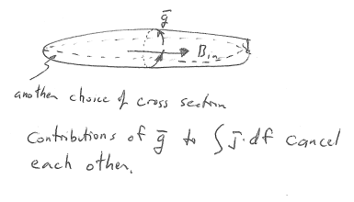






Slide 17
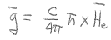


12. The complete absence of electrical resistance (and dissipation) is a consequence of the Meissner Effect
is determined by the field outside the superconductor, not by any field inside.
Net current can exist without an E-field applied to the superconductor.
That means the electrical resistance = 0
And there is no dissipation of energy j.E = 0.

