Slide 1
Superconductivity Current
Section 54

Slide 2



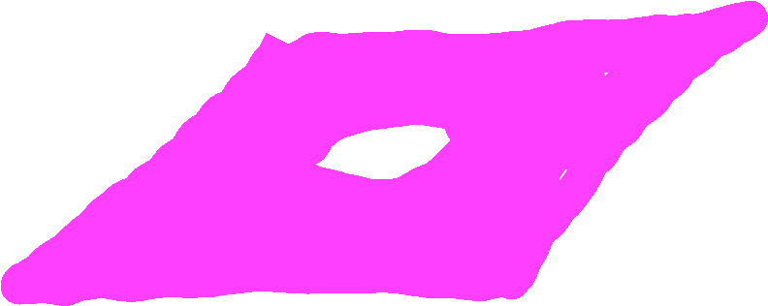

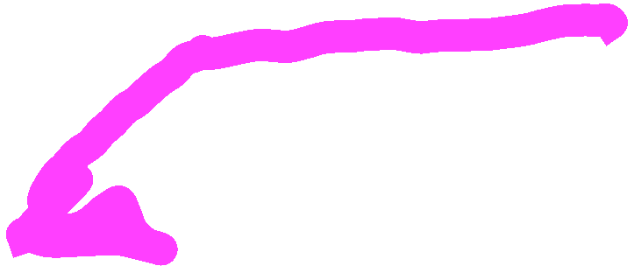
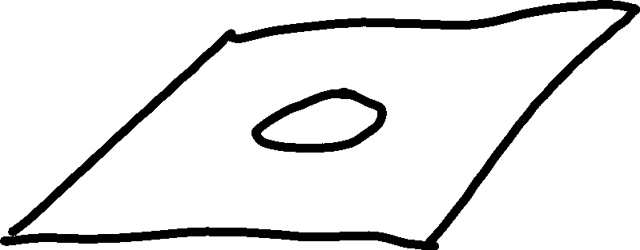



1. Properties of superconductors that depend on their shape
A simply connected region or domain is one in which every closed contour in that region encloses only the points contained in it (the region). If a region is not simply connected, it is called multiply connected. As an example of a multiply connected region, consider the z-plane with the interior of the unit circle excluded, since the unit circle is a closed contour within the region that encloses points that are not part of the region.
The “region” is shaded pink.
The unit circle is a contour that encloses points that are not part of the region

Slide 3

2. A simply-connected superconductor can have no steady surface current in the absence of an externally-applied magnetic field.
Proof
Suppose otherwise: A simply connected superconductor that is the only object in the universe, and it has steady surface currents on it.
These steady currents must generate a steady H-field outside the body.
This H-field vanishes at infinity.
Curl H = 0 in vacuum in steady state, so H is a potential field.
Div H = 0 in vacuum, so potential satisfies Laplace’s equation.

Slide 4


Boundary of superconductor: B_{n} = 0, means H_{n} = 0 in the vacuum just outside.
And
Magnetic scalar potential must equal the same constant at all points outside, or else a radial component of H would appear exclusively at points far from any currents.

Slide 5
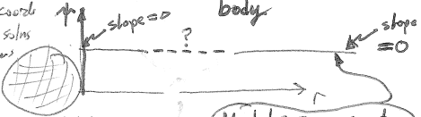

In spherical coordinates, ΔΨ = 0 has solutions that are powers of r: r^{α}, where α can be positive or negative.
If dΨ/dr is zero at both r = a and r = infinity, the only possible value of α is zero. Then dΨ/dr = 0, giving H_{r} = 0 at all r: Ψ = the same constant at all r.
An H-field of this kind cannot exist.
Supposition is false:
There can be no steady current on a simply connected body.

Slide 6
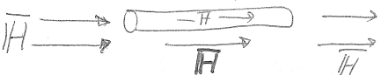




3. For a simply-connected body in an external -field, a magnetic moment appears, signature of surface currents.
4. Susceptibility is diamagnetic and has value -1/4π for any simply connected shape. We show it for a long needle shape.
Long superconducting cylinder
Generated by other current distributions.
Continuity of H_{t} holds even in the presence of surface currents (sec 29,30).
For this long-cylinder geometry,
H-field inside superconductor
Original external field.

Slide 7
“Magnetization”
B = 0 inside superconductor.
The total magnetic moment still has meaning and is given by
Diamagnetic volume susceptibility of a superconductor is -1/4π
But still no net current through any cross section for simply connected body

Slide 8




7. Multiply connected superconductor
A ring is “doubly connected.”
Surface currents need not balance out, giving total superconductivity current J, even without an externally applied emf.
The field of the ring is a potential field H = -grad φ, where φ is many valued.

Slide 9
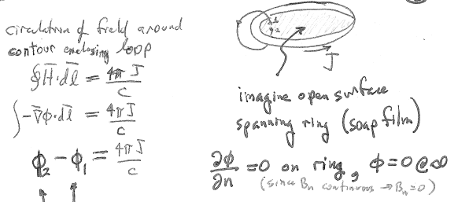




Circulation of field around any contour that encloses the loop.
Open surface that spans the ring, e.g. a soap film
Values of potential on opposite sides of the surface. Such a problem has a solution to Laplace Equation

Slide 10
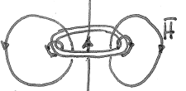



A magnetic field of this kind can exist, and so can the assumed surface currents.

Slide 11
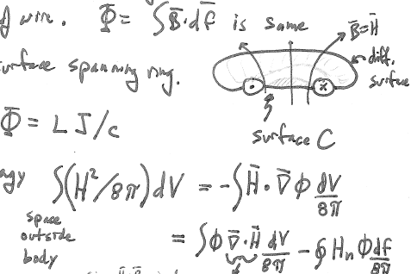



Magnetic flux through ring does not depend on the thickness of the wire.
Flux is same for any surface spanning the ring.
Total magnetic energy =
Div H = 0, since H = B outside and div B = 0.

Slide 12
Integration surface comprises
  The surface at infinity
  The surface of the ring
  The two sides of surface C.
H is zero here.
H_{n} is zero here.

Slide 13
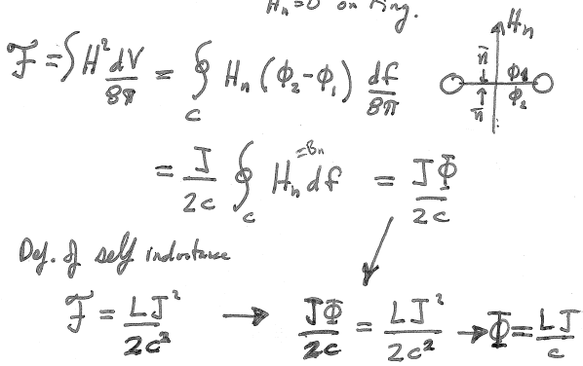

Integral over surface C
From the definition of self inductance

Slide 14
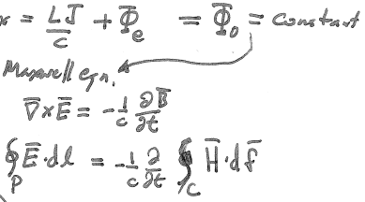






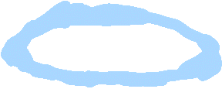
Flux from field of current on ring
Flux from external field
For a superconducting ring in an external magnetic field,
the total flux =
Follows from Maxwell’s equations

Slide 15
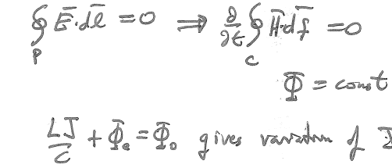
E = zero inside a superconductor
E_{t} is continuous at surface.
Tells how J changes if the external magnetic field changes.

Slide 16
