Slide 1
Equations of the Quasi-static Field
Section 58

Slide 2

Until now, we considered only static electric and magnetic fields. We used
only to derive the magnetic energy.
2. Electrodynamics in matter depends strongly on the nature of the medium and on the frequency. Here we consider extended conductors in variable external magnetic fields at “low” frequencies (usually microwaves and below).

Slide 3
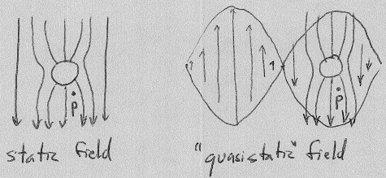


3. First assumption: wavelength λ ~ c/ω >> body dimension l
The field at P due to the proximity of the conductor is the same in both cases, except that the magnitude and sign of the field at P in the latter case is changing monotonically as Exp[-i ω t].
P has to be close enough to the conductor to avoid retardation effects: The field at P now is due to fields at the conductor now, not at earlier time.
Requires: distance to P << λ.

Slide 4
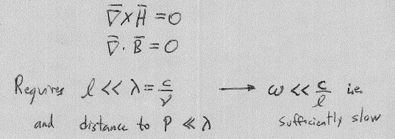
The equations of the static field should hold at the field point P, outside the conductor, where there is no charge current.
Let “l” be the dimension of the conductor

Slide 5
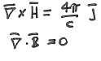

4. Inside the conductor, the equations are different because the conduction currents are non-zero
with j = σ E
We assume that Ohm’s law holds with the DC value of the conductivity:
This requires that the oscillation period of E >> electron response time τ.
Otherwise E changes sign before macroscopic charge flow can build up.

Slide 6
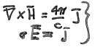













5. The given quasistatic field equations in the conductor are local relations: The j at a given point depends only on the E at that point, and not at other points.
Local relations
Requires: electron mean free path << characteristic length for changes in field.
Otherwise j at given point could be determined by E at distant points.

Slide 7

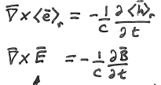


6. The E-field appear inside the conductor is induced by the variable B-field
small, but don’t discard it inside the conductor.
Any external slowly-varying E-field does not penetrate, but the B-field does.
Thus, dB/dt is the source for a macroscopic E-field inside.
This is the internal E-field that drives the internal currents j

Slide 8
Induced E-field distribution does not look like the external E₀-field distribution

Slide 9
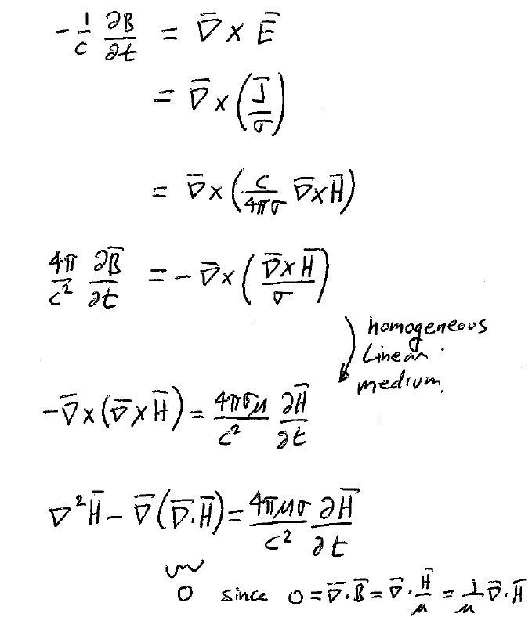



If H is known, then
Gives j(r,t).
Then Ohm’s law
Gives E(r,t)
and
We can eliminate j and E to get a differential equation for H and B

Slide 10


7. To eliminate B, we need to assume a relation between B and H. To simplify the equation, we need to assume medium is homogeneous.

Slide 11
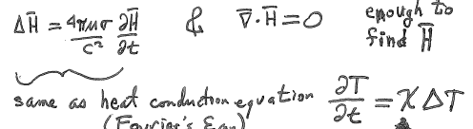

We get two equations for H, which suffice to find it everywhere at all times
Same as the heat conduction equation (Fourier’s equation):
H
Outside conductor
Inside conductor
Thermometric conductivity
z
Time rate of change of H(t) and curvature of H(z) are proportional at a given point

Slide 12
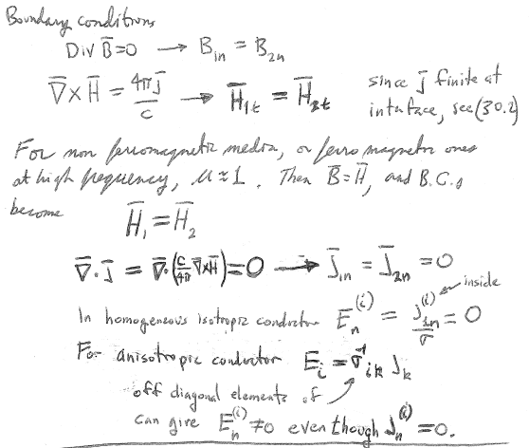





8. Need boundary conditions on H to solve Fourier equation for H(z,t)
Since j is finite at the interface, see (30.2)
For a non-ferromagnetic medium, or ferromagnetic one at high frequency, μ = 1.
Then B = H,
and boundary conditions become H₁ = H₂.

Slide 13
9. Boundary conditions on normal component of E
E_{n} is usually zero at the outer boundary with dielectric (air).

Slide 14
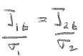
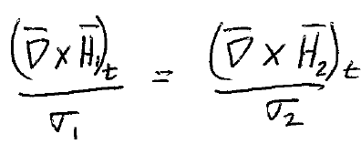
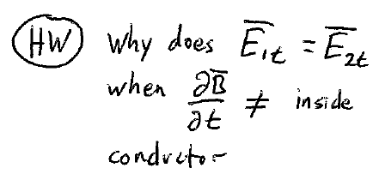
Boundary condition on E_{t} for composite conductor.
E_{1t} = E_{2t}
For a conductor with different parts of different σ, E_{t} is continuous at each interface.
This is a boundary condition for H that we can use to solve Fourier equation for H in the case that the conductor is piecewise homogeneous.
H
silver
σ₁
σ₂
copper
0
z

Slide 15
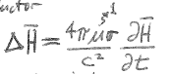
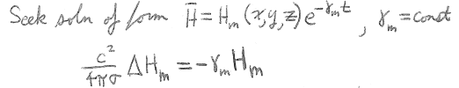



Suppose external H-field is suddenly removed.
The induced E and j don’t vanish immediately.
Neither does H in or around the conductor.
The decay of the field is determined by Fourier’s equation
Seek solutions of the form
This is an eigenvalue equation.
For a given conductor, solutions H_{m}(x,y,z) that satisfy the boundary conditions exist only for certain γ_{m} (real and positive).
{H_{m}(x,y,z)} = complete orthogonal set of eigenvectors.

Slide 16
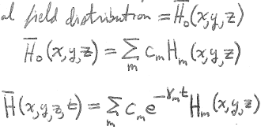
Let the initial field distribution

Slide 17
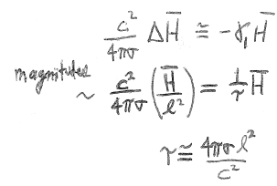




The rate of decay is determined mainly by the smallest γ_{m}. Call it γ₁
l = dimension of the conductor
= largest dimension of the problem
Gives longest τ, smallest γ
High conductivity and large conductor give slow decay

