Slide 1
The electric field in dielectrics
Section 6

Slide 2
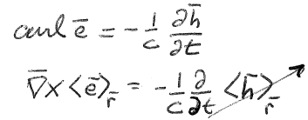




1. Dielectrics:
Constant currents are impossible
Constant internal electric fields are possible.
No macroscopic currents
Macroscopic field
Might be locally non-zero

Slide 3









2. Neutral dielectric: Includes only charges belonging to the dielectric, namely electrons and protons of neutral constituent atoms
Total charge =
Hence
where P = 0 outside the dielectric
Proof
Over volume of dielectric
On boundary that surrounds dielectric
since P = 0 outside the dielectric
P is the “dielectric polarization” or “polarization”. If non-zero, body is “polarized”.

Slide 4
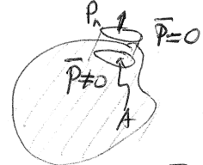
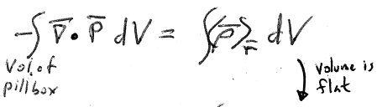
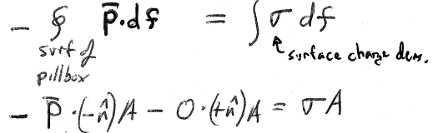



The component of P along the outward normal = P_{n} = P.n = σ

Slide 5
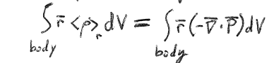


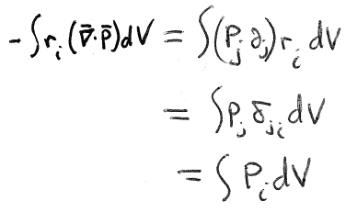




3. The meaning of P is found from the total dipole moment of the dielectric
i^{th} component
surface
Sum over j
Dipole moment =
= dipole moment per unit volume

Slide 6
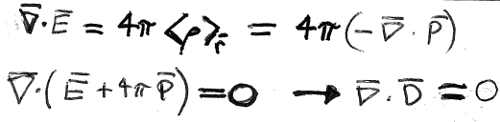












Introducing the Electric Induction
For neutral dielectrics, average <ρ>_{r} is over charges belonging to the dielectric
Holds both inside and outside (where D = E)
“Electric induction”
If extraneous charges are added, we get a “charged” dielectric
Extraneous charge density

Slide 7















6. Boundary between two dielectrics
E₁
=
E₂
E_{1t} = E_{2t}
Tangential component of electric field is continuous

Slide 8
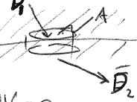

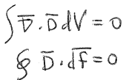











Boundary between two neutral dielectrics
D₁
If D_{n} = D_{z} were discontinuous, then
which would contradict

Slide 9





Boundary between dielectric and conductor
E_{t} = 0 in the conductor
Curl E = 0 still holds
E_{t} is continuous
Therefore E_{t} = 0 on both sides

Slide 10
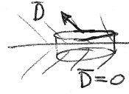
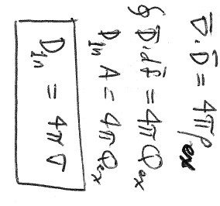









A conductor can have surface charge, which is extraneous to the dielectric. E and P are both 0 in the conductor, so D = 0 there.
dielectric
conductor
Surface charge density on conductor = extraneous charge on dielectric

Slide 11
Name and unit conventions
Landau, Gaussian Units
  D = E + 4 π P = electric induction
  D,E,P all have the same units
  Div D = 4 π ρ_{ex} (extraneous charge density)
  Div E = 4 π <ρ>_{r} (total charge density, intrinsic + extraneous)
Other books, S.I. units
  D = ε₀E + P = electric displacement
  D,P have the same units, E has different units (V/m)
  Div D = ρ_{f} (free charge density)
  Div E = ρ/ε₀ (total charge density, bound+ free)

