Slide 1
The Skin Effect
Section 60

Slide 2

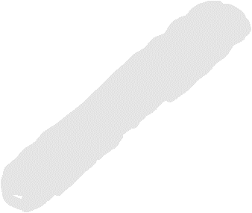

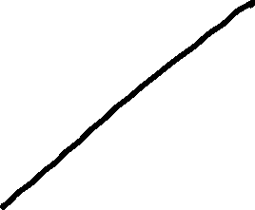
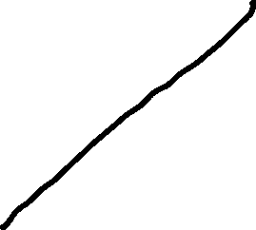





1. As frequency of variable total current in a conductor increases, current tends to be concentrated near the surface
A variable finite current flows inside the wire,
j = σE.
At high frequency, j is concentrated at the surface in a thin layer.
This is the “skin effect.”

Slide 3
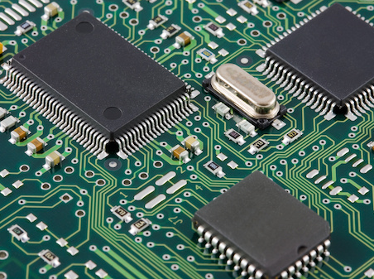
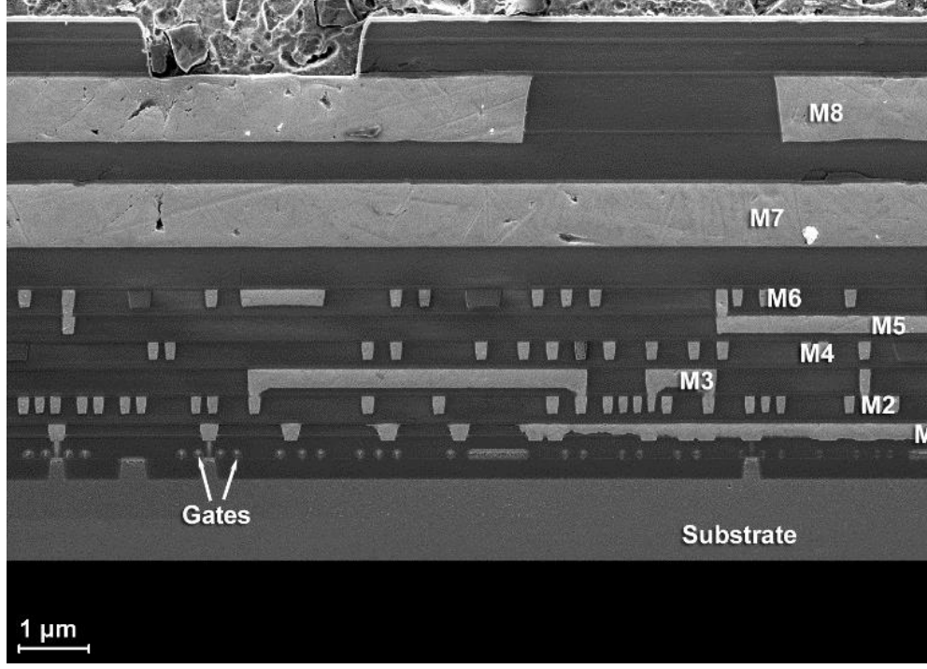
Important particular case is a long thin wire.
These might have circular cross-section, but…
flat wires on printed circuit boards
rectangular wires in semiconductor devices.
Nanospective

Slide 4
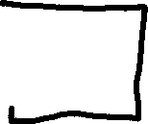




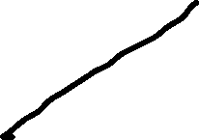




3. To calculate current distribution in short segments, we can consider them straight.
Then E is parallel to the axis of the wire, and B is in a plane perpendicular to the wire.

Slide 5
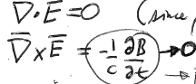


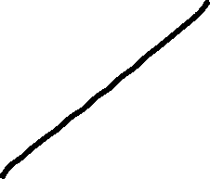



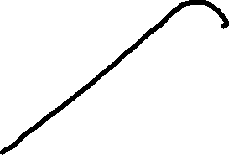


4. Thin wire with circular cross section
By symmetry, E is distributed uniformly around the surface of the wire.
The value of E is time dependent.
Since ρ = 0
E_{t} is continuous.
Then E just outside conductor is also spatially uniform and tangential:
E = E₀(t) e_{z}

Slide 6
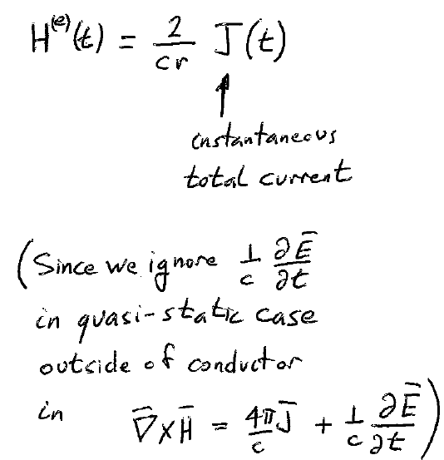
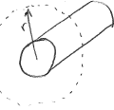




External magnetic field:
Instantaneous total current
Since we ignore
in the quasi-static case outside of the conductor
in

Slide 7
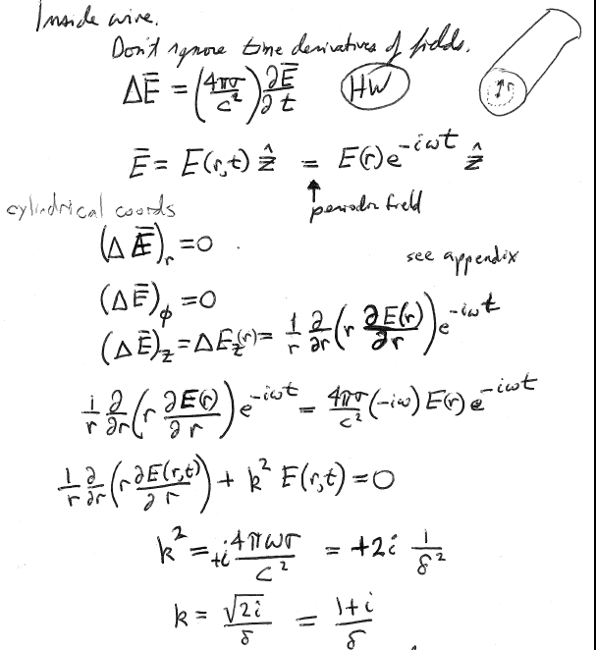








5. Differential equation for E(r,t) inside wire
Inside the wire, we don’t ignore the time derivatives of the fields.
Cylindrical coordinates
Periodic field
See appendix

Slide 8
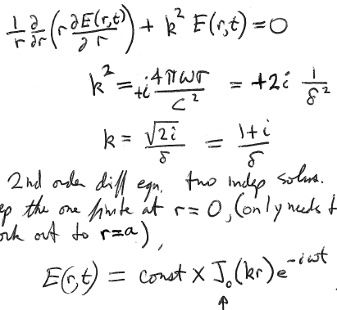







A second order differential equation has two independent solutions. Keep the one that is finite at r = 0. It only needs to hold out to r = a.
Bessel function of complex argument
Same distribution for j = σE.

Slide 9
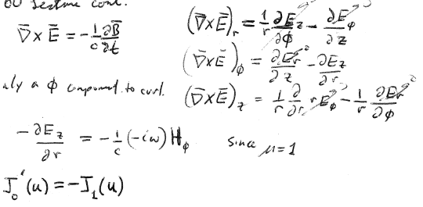









6. Magnetic field inside the wire
Still inside the wire…
Cylindrical coordinates
There is only a φ component to the curl.
Since μ = 1

Slide 10
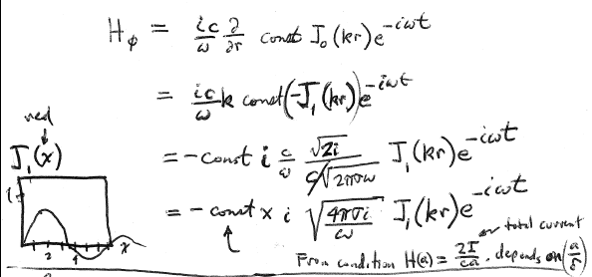





Find the constant from the condition H(a) = 2J/ca. It depends on
Total current

Slide 11
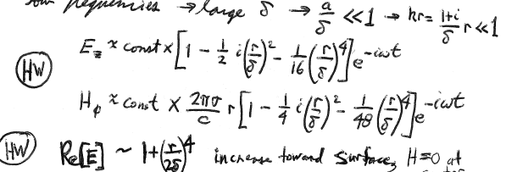








7. Distribution of fields within a long thin circular wire in the low-frequency quasistatic limit.
Low frequencies
E(r) increases toward the surface.
H = 0 at the center.

Slide 12
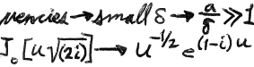

8. Distribution of fields within a long thin circular wire in the high-frequency quasistatic limit.
High frequencies
valid over most of the cross section
large
Keep only the rapidly varying exponential factor

Slide 13
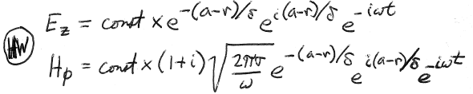





These equations are the same as (59.3)-(59.5) for the field near the surface of a conductor of any shape when the penetration depth is small.
Both E and H are small at the center (r = 0) and maximum on the surface r = a.

Slide 14
Non-circular wires.
This problem is difficult, unless the skin effect is very strong. Then it is the superconductor problem again.

