Slide 1
The Complex Resistance
Section 61

Slide 2
1. In AC circuits at low frequencies, the relation between current and voltage is the same as at DC
Linear circuit
  Zero frequency
    emf ε = RJ (Ohm’s law)
  Low frequencies
  ε(t) = R J(t)
DC resistance of wire
Instantaneous values

Slide 3
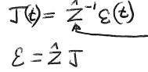


2. In AC circuits at high frequencies, J(t) is not proportional to ε(t) at the same instant
Instead J(t) is a linear function of ε(t) at all previous instants.
A complex number. The imaginary part gives the time delay.
Some linear operator

Slide 4







J(t) and ε(t) are generally not periodic.
But we can expand any time dependence as a series of monochromatic periodic Fourier components
For each Fourier component the operator reduces to multiplication by a complex number
Complex resistance or “impedance”

Slide 5



3. Z(ω) can be expanded in powers of ω.
Zeroth order term = R.
Next term involves the self-inductance of the conductor

Slide 6








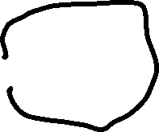



4. Obtain a differential equation for the current in a circuit driven by a period EMF, using energy conservation
Linear circuit with variable emf ε(t)
Power = work done by E-field on charges per unit time
= εJ
Part is lost as Joule heat per unit time = RJ²
Part causes change in magnetic energy per unit time

Slide 7
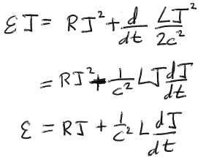

Energy conservation requires

Slide 8











5. Current amplitude and phase with respect to EMF.
In the quadratic expressions εJ and J², we must find the real parts before multiplying. But the final diff. eq. is linear in ε and J, so we can work with the complex Fourier components

Slide 9
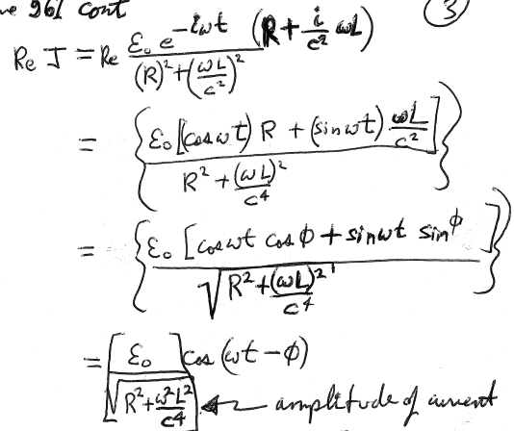












Amplitude of the current

Slide 10
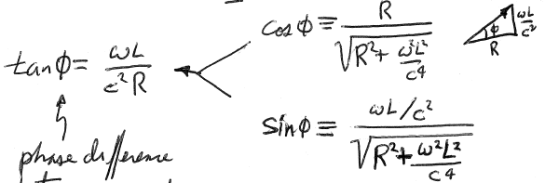
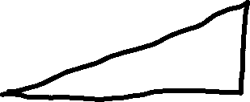


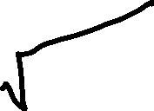





Phase difference between current and emf.

Slide 11

6. Energy dissipation is determined by Re[Z].
Low frequency impedance
Re[Z] = R, which determines energy dissipation.
DC values.
Neglects skin effect, which changes both R and L.
As ω increases, Z = Z’ + iZ” becomes less simple.
For example, Re[Z] = Z’ > R due to skin effect.
But still, Re[Z] determines the energy dissipation.

Slide 12
Proof that Re[Z] determines the energy dissipation.
εJ = power required to maintain periodic current
<part lost to dissipation>_{t} = nonzero.
<part goes to charging and discharging magnetic energy>_{t} = 0
Rate of energy dissipation = <ε J>_{t}
Have to take real parts of both factors in product
= (1/2) Re[ε J*]
Use complex form of each factor

Slide 13
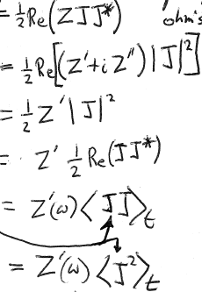





Rate of energy dissipation
Here use the real parts of J
Energy dissipation is determined by the real part of Z, whatever it is.
Proof complete.

Slide 14



7. The real part of the impedance is always positive
Rate of energy dissipation
The rate of energy dissipation must always be positive by the 2nd law of thermodynamics
Z’ > 0

Slide 15
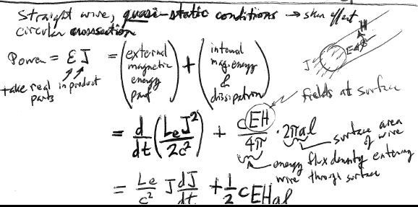








8. Straight wire, circular cross section, quasi-static conditions.
What does the skin effect do to the complex resistance?
Power = ε J (use real parts in products)
=(external magnetic energy part) + (internal magnetic energy and dissipation)
Fields at surface
Surface area of wire
Energy flux density entering wire through surface

Slide 16
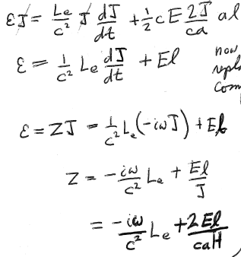










H-field at surface = 2J/ca
Now we have a linear equation.
Replace the real quantities by complex ones.
H-field at surface = 2J/ca

Slide 17
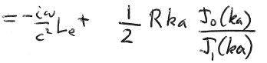





9. Impedance of cylindrical wire for general quasistatic frequencies
HW
Z
Complex

Slide 18

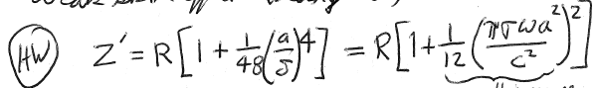




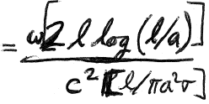








Low frequencies = weak skin effect = large
A small increase in resistance
If <<12, then Z’ ~ R
And neglecting all powers of (no skin effect)
=
Requires Z”/Z’<<
Typo in book
Then
with DC values of R, L

Slide 19

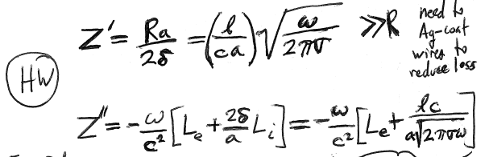





High frequencies = strong skin effect = small
Need to Ag-coat wires to reduce loss

Slide 20
10. Circuits with coils
If circuit has coils, the self-inductance of the circuit is much higher than for straight wire.
Then the main part of L comes from the coils and doesn’t depend on skin effect.
Then holds to higher frequency

Slide 21
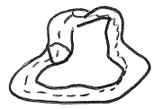
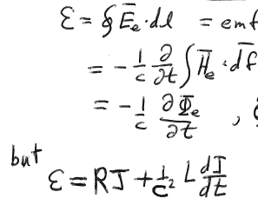










11. Ohm’s law in terms of total time-dependent flux
A variable external field H_{e} induces a field “E_{e}” in the absence of wires.
H_{e} and E_{e} vary only slightly over the thickness of a wire, though the fields induced in a wire vary a lot over the wire.
EMF = circulation of E_{e} around the wire circuit.
It doesn’t depend much on the exact contour chosen.
EMF induced in wire by H_{e}.
Faraday’s law
Flux of H_{e} through circuit.
H_{e}
But

Slide 22
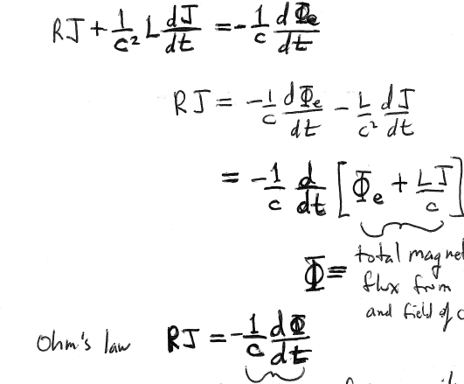




Total magnetic flux from H_{e} and field of current
Ohm’s law
Total EMF in circuit

Slide 23


12. If shape of circuit changes, so does L, and time derivative cannot treat L as constant in LJ term.

Slide 24


13. Multiple interacting circuits
Φ_{e} in each = sum of flux from all other circuits and from external H_{e} field
Flux through a^{th} circuit to due the current J_{b} in the b^{th} circuit =
Mutual inductance
EMF due to H_{e} in a^{th} circuit
Includes self-inductance term a

Slide 25



14. Multiple circuits with all currents periodic and at the same monochromatic frequency
b
Impedance matrix:
First terms in the expansion of Z(ω)
15. Ignores mutual effect of circuits on each others Re[Z].
Actually, conductors induce eddy currents in each other causing additional dissipation, but the effect is negligible in linear circuits (thin wires).

Slide 26
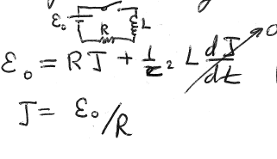




16. Constant EMF ε₀ suddenly removed at t = 0.
For t<0, steady state

Slide 27
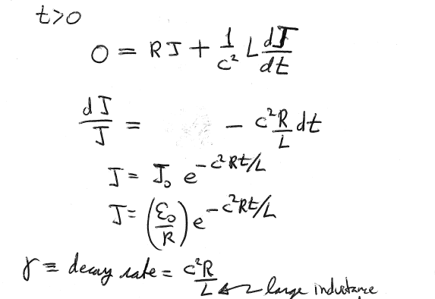







Large inductance means slow decay
Exact formulation is (58.10)
(Smallest)
Eigenvalue

