Slide 1
Capacitance in a quasi-steady current circuit
Section 62

Slide 2

1. Linear circuit connected to a capacitor
Charges and discharges
Source and sink of current
Volume between plates is small

Slide 3
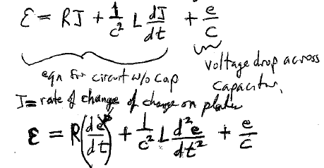








2. Differential Equation for charge on capacitor
The magnetic energy of the circuit is
self inductance of the circuit if the capacitor was shorted by a wire
EMF of circuit
Voltage drop across capacitor
Equation for circuit without capacitor
J = rate of change of charge on plate

Slide 4

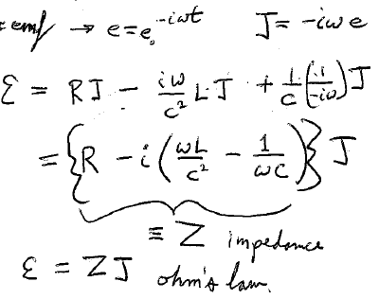




3. Periodic emf
Impedance
Ohm’s law

Slide 5
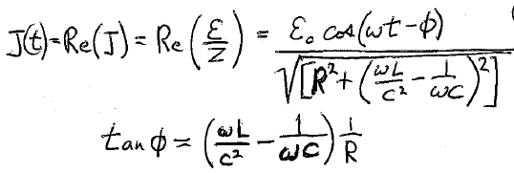









Slide 6
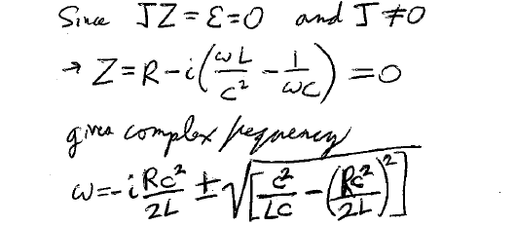



4. Free electric oscillations in LCR circuits
If ε = 0 (No driving force free oscillations)
Since
and
Solving for ω gives a complex frequency

Slide 7
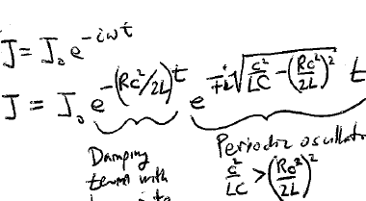







Since
Periodic oscillations if
Damping term with decay rate Rc²/2L
Otherwise it’s an aditional damping term (with “-” sign) and no oscillations

Slide 8
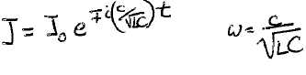
If R 0, there is no damping at all (no dissipation)
W. Thomson (1853)

Slide 9
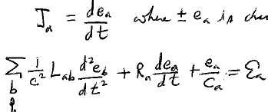



5. Consider several inductively-coupled circuits containing capacitors
E-field is contained within the capacitors
B-field goes everywhere
a^{th} circuit
where e_{a} is the charge on capacitor a
Sum is over all circuits, including the a^{th}

Slide 10
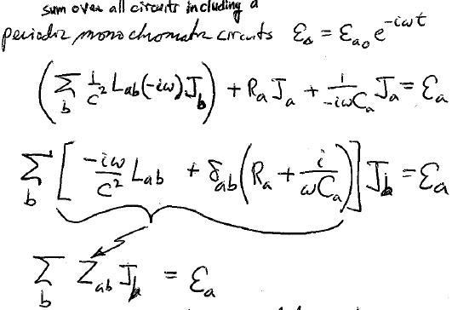

Periodic monochromatic circuits

Slide 11
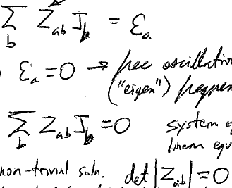






Complex impedance matrix
Free oscillations at “eigen” frequencies of the system
When
A system of homogeneous linear equations
For non-trivial solution,
This equation gives the eigen-frequencies of the system
All oscillations are damped if any R is nonzero

Slide 12
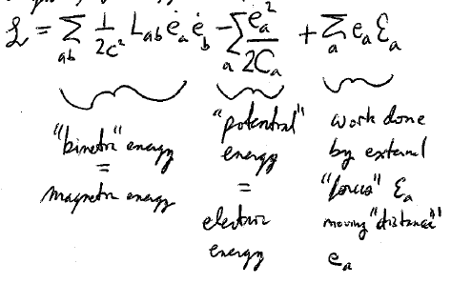
6. Analogy with mechanical systems
By analogy with forced coupled damped mechanical oscillators, the Lagrangian is
“potential” energy = electric energy
Work done by external “forces” ε_{a} moving a “mass” by “distance” e_{a}
“kinetic” energy = magnetic energy
LL1 Classical Mechanics, sections 25 and 26.

Slide 13
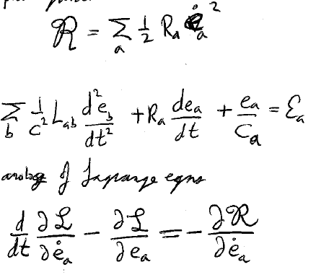
“Dissipative function”
See LL1 (25.11)
Then
is the analog of Lagrange equations

