Slide 1
The Permittivity
LL 8 Section 7

Slide 2

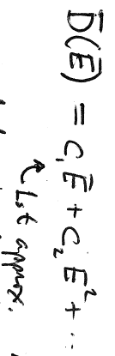
1. To solve Maxwell’s equations for a dielectric, we need a relation between induction D and field E.
Four equations for 6 unknowns
Can’t be solved
Polarization is due to external field
The field E that appears in the medium is usually small compared to the internal molecular fields: Expand the induction in powers of this field.
In most cases, we need keep only the first term. The relation we seek is usually linear.

Slide 3

2. Linear Isotropic Dielectric. The most important case. D and E must be in the same direction
D||E
D= ε E
ε = permittivity
  Depends on substance
  Depends on thermodynamic state

Slide 4
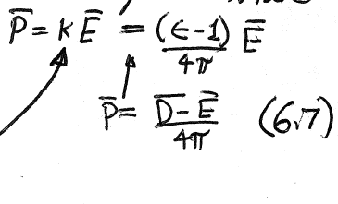



3. Dielectric susceptibility
This is not the field that causes the polarization. This is the field that exists after the polarization is established.
Polarization is also proportional to the field
Polarization coefficient
or
Dielectric susceptibility
For static fields
ε > 1 κ > 0
For a rarified medium (gas), κ is proportional to density

Slide 5
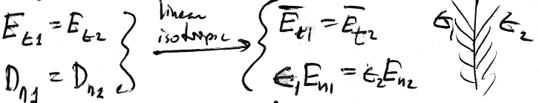










4. Boundary conditions at surface between two linear isotropic dielectrics
For linear isotropic dielectric
For any dielectric
The normal component of the field is discontinuous

Slide 6






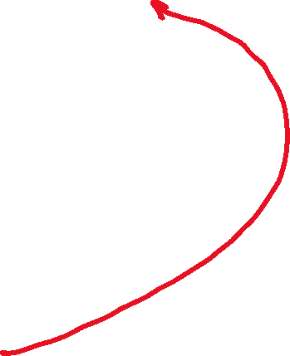


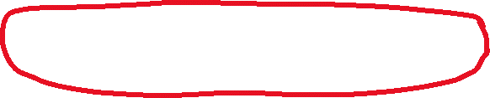
Spatially uniform neutral dielectrics have no volume charge density
5. Homogeneous linear isotropic dielectrics
Homogenous dielectrics have spatially uniform permittivity

Slide 7
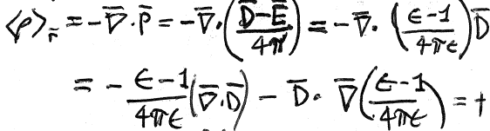













Volume charge density can occur for inhomogeneous linear isotropic dielectric
0 for neutral dielectric

Slide 8









What equation is satisfied by the potential in a neutral dielectric?
If dielectric is homogeneous, then
Laplace’s equation holds
For inhomogeneous dielectric, Laplace’s equation doesn’t hold.

Slide 9
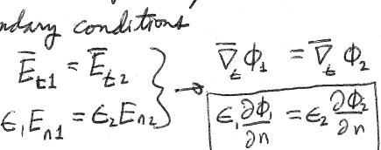





Boundary conditions on the potential for linear isotropic dielectric
φ₁ = φ₂
Potential is continuous.
(They could differ by a constant, but they wouldn’t they would also be different at infinity.)
Slope of φ in normal direction is discontinuous

Slide 10
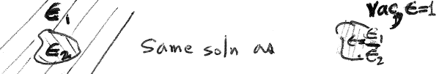













6. Piecewise homogeneous dielectric
(e.g. multilayer optical films)
in each homogeneous region.
Permittivity appears only in the boundary conditions
Boundary conditions involve only the ratios
Same solution as

Slide 11




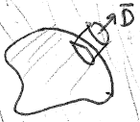













7. Conductor surrounded by homogeneous isotropic linear dielectric
0 everywhere
Constant on the conductor surface

Slide 12
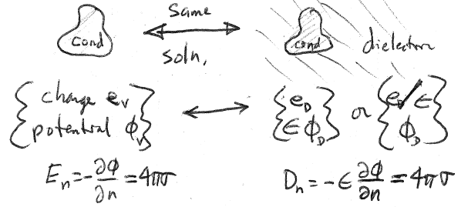








vacuum
If e_{D} = e_{V}, then φ_{D} = φ_{V} /ε.
If φ_{D} = φ_{V}, then e_{D} = ε e_{V}

Slide 13

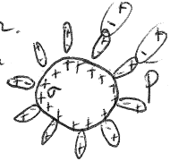


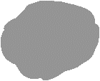



For a given charge on the conductor (e_{V} = e_{D})
and E are reduced by the factor ε compared to their values in vacuum.
The charge on the conductor is screened by the surface polarization charge on the dielectric.
Charged conductor surrounded by dielectric
Charged conductor in vacuum

Slide 14





If the potential of the conductor is maintained as it is placed inside dielectric
φ_{V} = φ_{D} e_{D} = εe_{V}
Field is unchanged but the charge is increased by the factor ε.
The extra charge is put there by the battery.

Slide 15
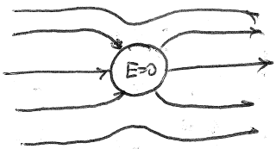
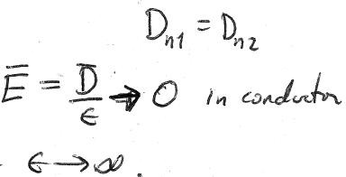


8. An uncharged conductor behaves like a dielectric with infinite permittivity
Normal component of electric induction is continuous
But
Requires

Slide 16
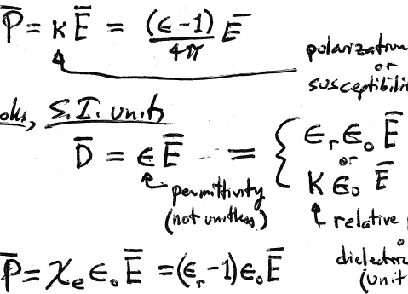





Conventions for linear dielectrics
Landau & Gaussian Units
“Permittivity”
or
“dielectric constant”
(unitless)
D = ε E
Polarization coefficient
or
Susceptibility
(unitless)
Other books & S.I. units
Permittivity
(not unitless)
Relative permittivity
or
Dielectric constant
(unitless)
Susceptibility (unitless)

