Slide 1
Electromagnetic wave equations: dielectric without dispersion
Section 75

Slide 2
1. In Chapter 7, section 58, we had for variable E-M field in a conductor:
Neglect displacement current
Ohm’s law
Faraday’s law
These equations require sufficiently slow variation that Ohm’s law holds with DC value of σ, and the dependence of B on H is the same.

Slide 3
2. This section: Variable E-M field in a dielectric
If the frequencies are low enough, D = D(E) and B = B(H) are the same as in the static case.
For example, linear isotropic case: D = εE and B = μH with static ε & μ values.
Dielectrics have σ = 0, so all action is due to displacement current, and none is due to conduction current j.

Slide 4
3. At higher frequencies, “dispersion” causes ε and μ to differ from their static values
Electric & magnetic polarization are caused by separation of charge or alignment of moments.
These motions have certain natural frequencies.
When ω of E-M field approaches such frequencies, polarization and loss are enhanced and differ from static case.
ε and μ change with frequency: dispersion
Electronic polarization in crystals
Orientation of molecular dipoles in fluids
Magnetic polarization in ferromagnets

Slide 5
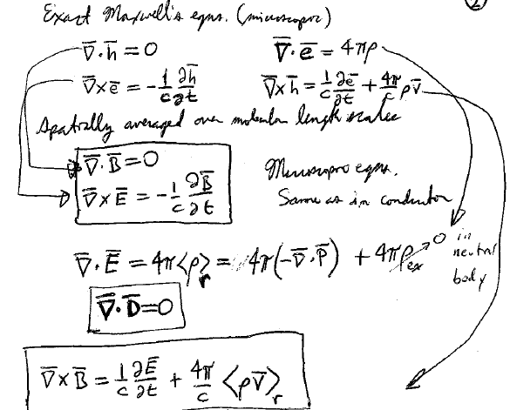
4. The macroscopic field equations in dielectric
Exact microscopic equations
Spatially average over molecular length scales
Microscopic equations,
Same as in a conductor
In a neutral body

Slide 6
5. The 4th equation presents a challenge
When the macroscopic fields are time dependent, what is this?

Slide 7
6. A trick will be used to avoid determining
Assume ρ_{ex} is placed in a dielectric. (We’ll remove it later.)
Any change in ρ_{ex} gives rise to conduction current j_{ex}
Continuity equation
Doesn’t involve
But what is H?

Slide 8
7. Interpretation of H
In the vacuum outside the dielectric body (ε = 1, j_{ex} = j) we have
Vol. 2 (30.3), Maxwell equation in vacuum
Here, H is the magnetic field
Inside the dielectric body, in the static case
H is a definite function of B, the true macroscopic magnetic field in matter.

Slide 9
Now allow fields to vary slowly inside the body
H = H(B) has the same definite relation as in the static case when variations are slow enough.
Now remove ρ_{ex} and j_{ex}, which were only needed to interpret H in the static case.
Maxwell equation for dielectric
“Displacement current”
(Replaces for conductors.)
We found and equation for curlH, and the magnetic field B is found from B(H)

Slide 10
8. Why didn’t we include a displacement current in metals?
First term of expansion in powers of ω
Since ω is assumed small, this second term in the expansion is a small correction. Spatial non-uniformity of the field (skin effect) becomes important in metals sooner.
Griffiths keeps the second term from the beginning, but this only results in more complicated formulae for the complex wave-vector without a significant improvement in accuracy.

Slide 11
9. Semiconductors
In poor conductors with small σ, the first term might be less important, e.g. semiconductors, electrolytes, semimetals, conducting oxides, conducting polymers.
The ratio of the second term to the first is
If this number is small (<<1), the material is a conductor with conductivity σ.
If this number is large (>>1), the material is a dielectric with permittivity ε.

Slide 12
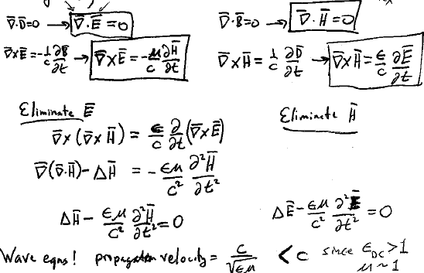
10. Homogeneous linear dielectric at sufficiently low frequency, ρ_{ex} = 0.
These are wave equations with propagation velocity

Slide 13
11. Energy flux density
Energy flux density = field part + matter part
Zero for matter at rest
Same formula as in metal (30.20).
But why?

Slide 14
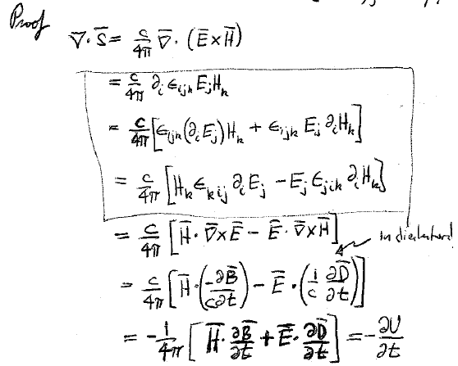

Slide 15
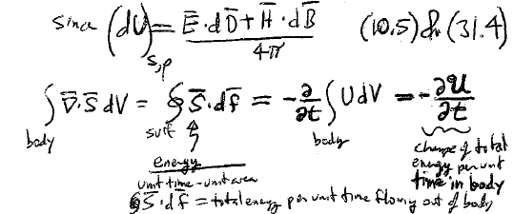
(10.5) & (31.4)
Change of total energy per unit time in the body
Energy per unit time per unit area
Total energy per unit time flowing out of the body

Slide 16
12. Spatial density of momentum is proportional to S
From energy momentum tensor (v.2)
Momentum density of the field
Forces on dielectric in a variable EM field.
Force per unit volume
= Maxwell stress tensor
= momentum flux density

Slide 17
