Slide 1
Dispersion of the permittivity
Section 77

Slide 2
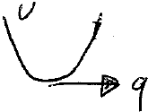


1. Now consider higher frequencies which are closer to resonances associated with electric or magnetic polarization
Polarization involves motion of charge against a restoring force.
When the electromagnetic frequency approaches the resonance frequency, new physics appears.

Slide 3

2. If frequency is too high, macroscopic electrodynamics may become invalid
An EM field that varies in time, varies in space too, due to finite propagation speed.
The spatial periodicity of the field is λ ~ c/ω
As ω increases, λ approaches interatomic distances “a”.
Then macroscopic electrodynamics makes no sense: since averaging over interatomic distances would produce a macroscopic field E= 0.

Slide 4


3. Frequencies close to polarization resonances, but where the macroscopic description of the fields still applies, must exist.
The fastest possible motion is electronic.
The period of natural electron motion T₀ ~ a/v.
Atomic velocities v << c.
At resonance, the applied frequency ω ~ 1/ T₀.
Then the resonance wavelength is
~ c/ω
~ c T₀
= c (a/v)
= (c/v) a >> a,
so that the macroscopic field description holds.

Slide 5













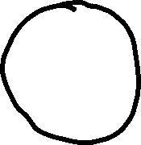

We will assume λ >> a when discussing dispersion.
That condition is not always enough to ensure that Macroscopic Electrodynamics is valid, e.g. metals at low temperature when mean free path is comparable to skin depth.

Slide 6


5. The following theory for the dispersion of the permittivity applies to both dielectrics and conductors
At high frequencies near 1/ T₀ for all electrons in an atom, metals and dielectrics behave the same (see section 78)

Slide 7
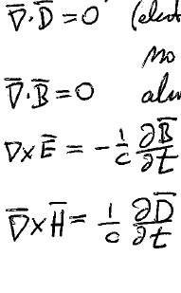
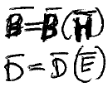


6. Macroscopic Maxwell’s equations for a dielectric
Electrically neutral matter without extraneous charge
Always true
Faraday’s law for macroscopic fields
Dielectric, without free current
Those Maxwell equations are not enough to solve for E, D, B, and H
The solution requires constitutive relations
But these relations are not as simple as in the static and quasistatic cases

Slide 8
7. D and B depend on E and H, not only at the present time, but also on their values at earlier times.
The polarization lags the changes in the fields.
The frequencies where these dispersion effects appear may be completely different for electric and magnetic properties.

Slide 9
8. Dispersion of permittivity usually appears at higher frequencies than for permeability
In this section, we deal only with dispersion of the permittivity (IR and optical frequencies)
Section 79 deals with dispersion of permeability (rf to mm waves) and ferromagnetic resonance

Slide 10





9. The derivation of divP = -<ρ>_{r} did not depend on the time dependence of the field and remains valid.
Microscopic charge density
(but still with no extraneous charge by assumption)
Depends only on electrical neutrality of body and condition P = 0 outside.
The total electric dipole moment of a body =
The interpretation of the polarization P = (D-E)/4π is electric moment per unit volume, regardless of the variation of the field.

Slide 11
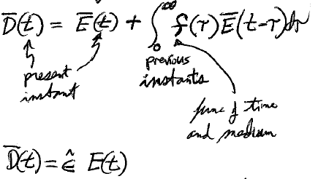















10. Rapidly varying fields are usually weak (except for laser fields in non-linear optics), so D = D(E) is usually linear in E.
Most general linear relation between D now and E at all earlier times is
Previous instants
Present instant
A function of time and the nature of the medium
Some linear integral operator

Slide 12
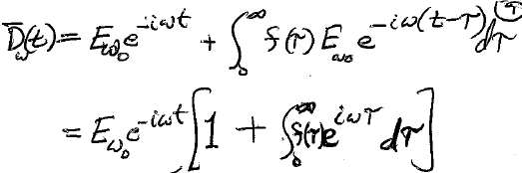



For ω^{th} Fourier component
11. A field with arbitrary time dependence can be decomposed into Fourier components
Because equations are linear, we can treat each monochromatic term in the expansion independently
Each has time dependence e^{-iωt}
A frequency dependent material property: “Dispersion relation”

Slide 13
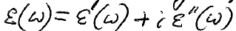
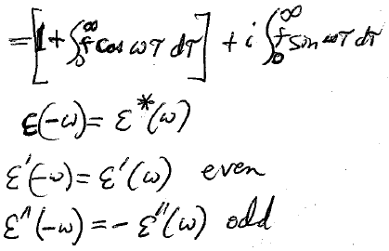
















12. Dispersion relation, generally complex
Real part
Imaginary part
An even function of frequency
An odd function of frequency

Slide 14
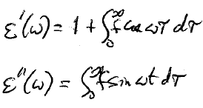
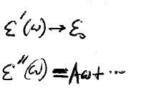







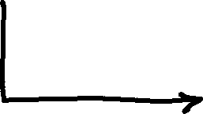



13. Well below resonances in the material, where the dispersion effects are small, we can expand ε(ω) in powers of ω.
Can have only even powers of ω, namely ω⁰, ω², ω⁴, etc.
Can have only odd powers of ω, namely ω, ω³, ω⁵, etc.
Static case: Limit ω -> 0

Slide 15
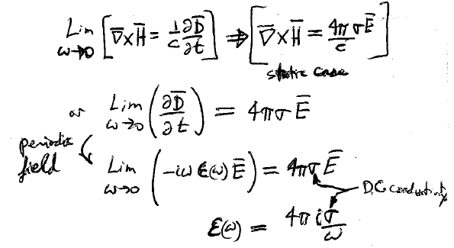










14. Conductors are a special case

Slide 16




15. Expansion of ε(ω) for metals begins with an imaginary term 4πiσ/ω
First term is an imaginary odd function of ω
The next term is a real constant
  This term is unimportant if effects of spatial variations (skin effect) are more important than effects of time variations.

