Slide 1
Permittivity at high frequency
Section 78

Slide 2
1. At very high frequency, ε(ω) tends to unity
Because polarization processes cannot keep up with high frequency driving forces.
Then P => 0, and
D = E + 4 π P => E

Slide 3
2. What function of frequency shows how ε(ω) approaches unity?
If the driving frequency ω exceeds the frequencies of motion for all electrons,
we can neglect electron interactions with each other and with nuclei.
Then all electrons are regarded as free.
Then, there is no difference between conductors and dielectrics.

Slide 4
3. To find the velocity acquired by an electron in a high frequency field, treat the field as being spatially uniform.
Usually, electron velocities are non-relativistic, v << c. Then the distance traveled during one EM-wave cycle is
Then, each electron is accelerated in a uniform field
v’ = the additional velocity acquired from the field

Slide 5
4. Equation of motion
Electron’s displacement caused by the field

Slide 6
Polarization = dipole moment per unit volume
P(r,t) =
N = number of electrons in all the atoms per unit volume

Slide 7
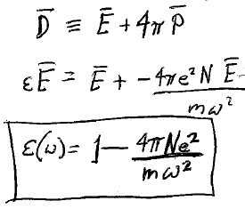
Electric Induction

Slide 8
Valid for very high frequencies: Far UV for light elements X-ray for heavy elements
Define the “plasma frequency”
Then

Slide 9
Real
Negative for ω < ω_{p} (metallic behavior)
Positive for ω > ω_{p} (dielectric behavior)

Slide 10
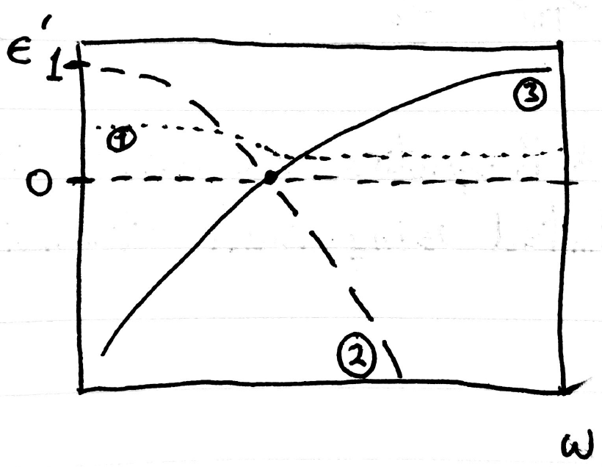
Which curve is a possible permittivity in the limit of high frequencies?

