Slide 1
Field energy in a dispersive medium
Section 80

Slide 2
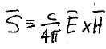
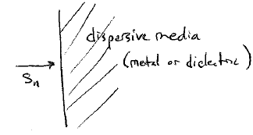




1. The expression and significance for the Energy Flux Density (Poynting Vector) are valid under all conditions.
This formula has been shown to hold in
  vacuum (volume 2.)
  in metals at zero frequency (v. 8 section 30)
  and in non-dispersive dielectrics (v. 8 section 75).
It also holds in variable electromagnetic fields when dispersion is present
The component of S normal to a surface involves only E_{t} and H_{t}, which are both continuous across a boundary.
S_{n} is continuous across boundary
Energy flowing from vacuum across boundary must be conserved, so expression for S remains valid for energy flux density in a dispersive dielectric.

Slide 3
This section considers four cases.
  Electromagnetic internal energy in non-dispersive bodies
  Rate of dissipation for monochromatic light in dispersive bodies
  Net dissipation of non-monochromatic wave packet in dispersive bodies
  Build up of internal energy for non-monochromatic wave packet in transparent dispersive body

Slide 4
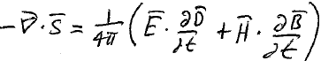
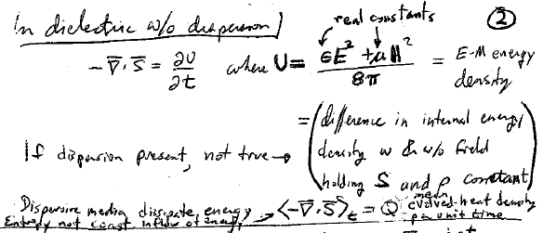


2. Case I: non-dispersive bodies
(75.15): rate of change of energy per unit volume
Take the real parts of the fields before combining them in this quadratic function
For non-dispersive linear media, permittivity and permeability are real constants, no ω dependence
where
= electromagnetic energy density
= internal energy difference for body with and without fields, holding entropy and density constant.
=total work done by turning on the fields
If there is no dispersion, no electromagnetic energy is lost and no heat is generated!

Slide 5
2. Dispersive media dissipate energy.
U is not a definite thermodynamic quantity.
Dispersive media absorb energy from the electromagnetic fields.
Electromagnetic energy U is not constant unless there is a net inflow of electromagnetic energy.

Slide 6
3. Case II. Monochromatic light in a dispersive medium
Mean evolved heat density per unit time Q = <-divS>_{t}
Under conditions of constant field amplitude, there is a constant inflow of energy <dU/dt>_{t} = <-divS>_{t} , which is converted to heat at a rate Q

Slide 7
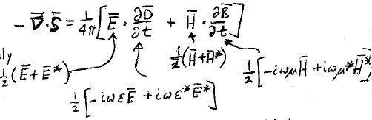
monochromatic fields are conveniently written in complex form E = E₀e^{-iωt}
An increment of electromagnetic energy that flows into unit volume is dU = (E.dD +H.dB)/4π. Some flows out the other side. Some remains as heat = <dU>_{t}
(We can’t write U itself as a definite quantity because of dissipation, but we can talk about changes in U.)
The rate of inflow of electromagnetic energy density is
dU/dt =
Use real fields in non-linear functions
Now take time average to find rate of heat generation Q per unit volume.

Slide 8
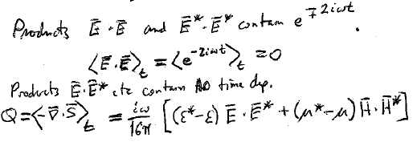
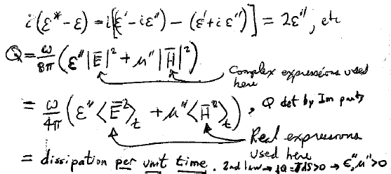








Products E.E and E*.E* contain oscillating factors
Oscillations disappear from products E.E*, so those remain after time averaging
Dissipation of field energy per unit time is determined by imaginary parts ε” and μ” . These are positive by 2nd Law.
Complex fields used here.
Real fields used here

Slide 9
Recipe: For monochromatic light, e.g. CO₂ laser light, dissipation is determined by the value of ε” at the corresponding frequency.
60.2

Slide 10
4. But what are you going to do if the light is not monochromatic?
Rate of heat generation is not constant since amplitude of non-monochromatic field is slowly time varying, see LL2 sec 50.
What value of ε” would you use? The average?
LWIR
Conversion of broad band infrared radiation to heat is an important practical problem
Proc. SPIE 9819 – 50 (2016).

Slide 11
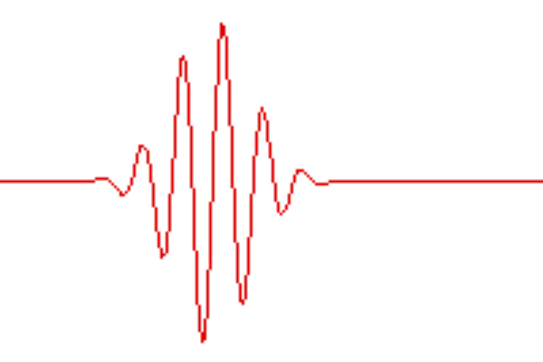
Case III: non-monochromatic fields in dispersive medium
We consider a pulse or wavepacket that goes to zero sufficiently rapidly as t →±∞
All light emission processes have finite duration.
Non-monochromatic
Instead of dissipation per unit time, consider time-integrated net dissipation.
We have to do this because dissipative effects depend on the entire history of the fields
An expression for instantaneous rate of energy dissipation isn’t possible in this case.

Slide 12
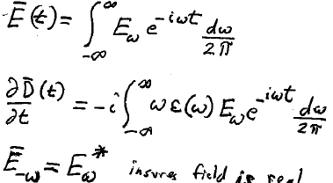

5. Finding the formula for total heat generated per unit volume in a medium by an electromagnetic pulse.
Any time dependent field can be written as a sum of monochromatic fields: Fourier expansion
Required to ensure that the field is real

Slide 13
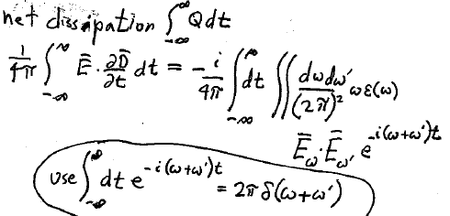
Electric part of net dissipation is a triple integral

Slide 14
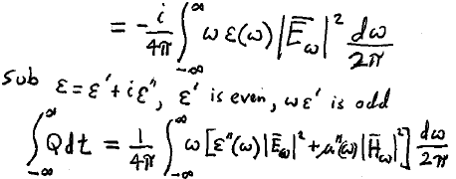




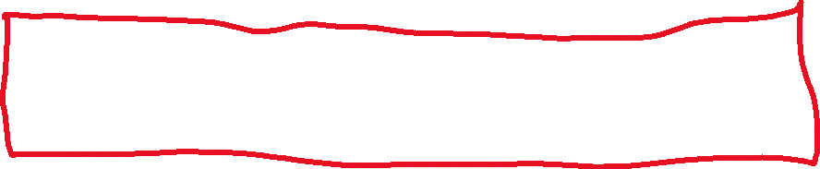
First integrate over ω’. Then the delta function changes ω’ to -ω
Total heat generated per unit volume by an electromagnetic pulse
This looks just like an integral over frequencies of the monochromatic case.
(E_{ω} has units of electric field times time).
Since the integrand is even, we don’t actually have to integrate over negative frequencies

Slide 15
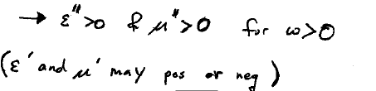



6. Electric and magnetic losses are determined by
By second law and
may be positive or negative
No restriction

Slide 16
7. Transparency ranges are spectral bands where losses are very small
ε” and μ” are never zero except at ω = 0.
However, they may be very small ε”<<|ε’|
Then, neglect absorption.
Now we can talk about definite internal energy of linear media as in the static case, except now it is not constant.
In static case, these were real constants independent of ω
For electromagnetic waves in a transparent dispersive medium, we don’t simply replace the constants ε and μ by the functions ε(ω) and μ(ω).
It’s more complicated.

Slide 17
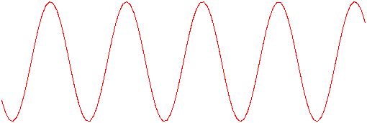
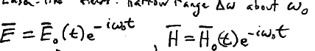
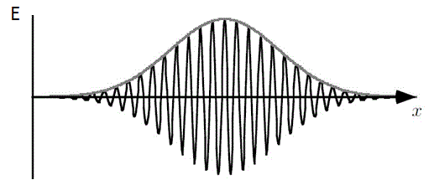




Energy density U doesn’t change in transparent media for purely monochromatic fields, because their amplitudes are unchanged since the dawn until the end of time.
Consider nearly monochromatic wavepacket
with a narrow range of frequencies
These amplitudes vary slowly compared with the “carrier”
Long smooth pulse

Slide 18
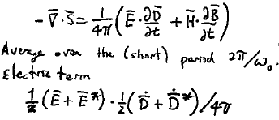








Substitute the real parts of the fields
Rate of change of energy in unit volume
Next, average over the short period
The electric part is
Are ~constant over this period.

Slide 19
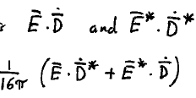













Time average to zero due to fast oscillating factors
Products
Leaving
In these remaining terms, fast oscillating factor disappears and there is no variation to average: Drop the <>
We need the time derivatives of D and D*.
The electric induction is
Integral operator

Slide 20


This is an integral-differential operator
If = constant.
This is the zeroth approximation, where nearly monochromatic wave is assumed perfectly monochromatic.
for monochromatic fields

Slide 21
Next approximation: Smoothly varying nearly monochromatic wave packet.
Expand the slowly varying amplitude as its own Fourier series.
Only small frequencies α << ω₀ appear in the expansion of the amplitude, since its variations are slow compared to the carrier ω₀.
We will consider just one of the Fourier components in this expansion for now:

Slide 22





Considering only the α^{th} Fourier component in the expansion of E₀(t)
The operator f is now acting on a monochromatic wave
Taylor expand f(α + ω₀) about α = 0.

Slide 23
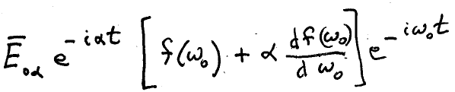

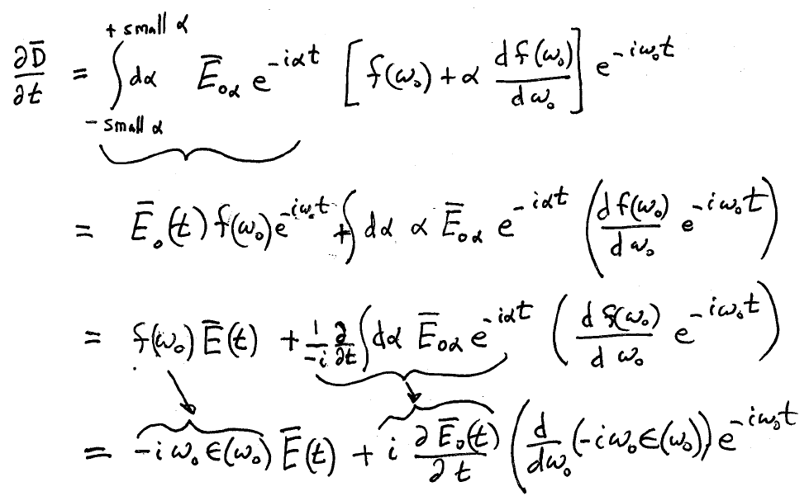
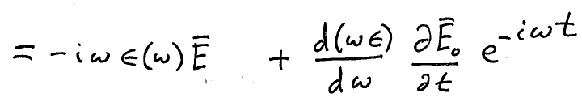




Now sum the Fourier components for the amplitude.
Drop subscript on ω₀

Slide 24
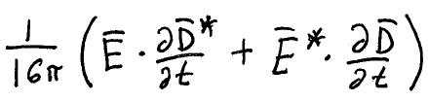
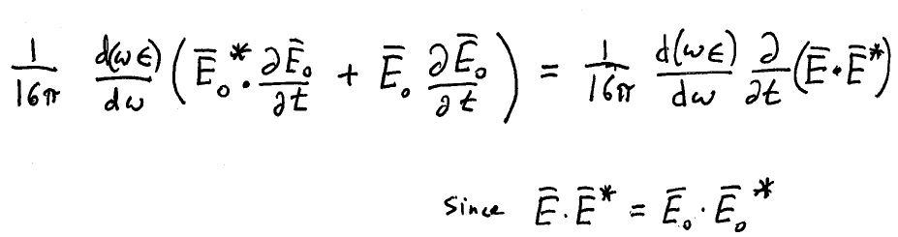
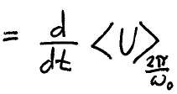
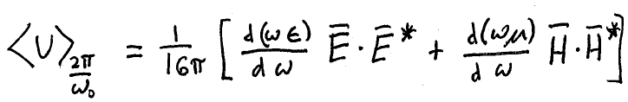
Substitute into
neglect ε” in transparency regions, so ε is real. The two EE* terms cancel leaving
Rate of change of electromagnetic energy density
Averaged over fast oscillations
Magnetic part added
Where averaged internal energy has definite value

Slide 25
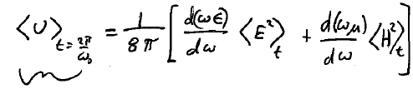
In terms of the real fields
Mean value of the electromagnetic part of the internal energy density of transparent medium

Slide 26
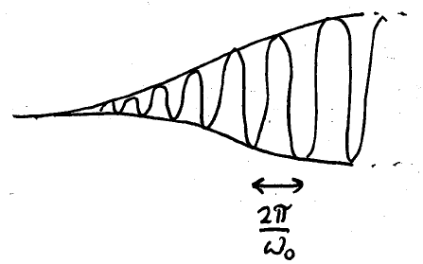
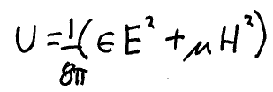

8. Mean value of the electromagnetic part of the internal energy density in a transparent medium
Compare to result for static case and for dispersion-less medium (dynamic case 1)
If there is no dispersion
Usual static result

Slide 27
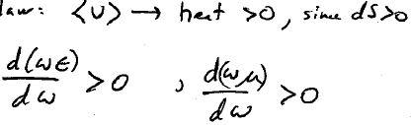

9. If you cut off the external source of electromagnetic energy, energy in medium must all eventually convert to heat.
Second law
Then

Slide 28
The formula
Was found by expanding dD/dt to first order in the small frequencies α, which are only small if the amplitude E₀(t) varies slowly.
The formula applies to slowly and smoothly varying wave trains, and not to ultra-short (< few-cycle) pulses.

