Slide 1
A plane monochromatic wave
Section 83

Slide 2
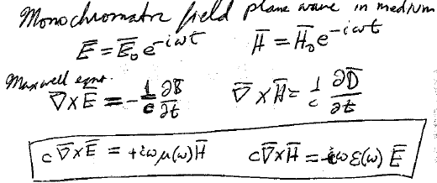

1. Monochromatic field
Maxwell equations
(dielectric medium)
These two equations are complete: The other two Maxwell equations follow

Slide 3
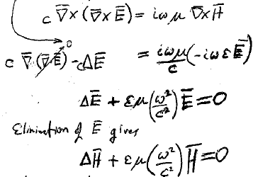









Assume a homogeneous medium. Eliminate H
div D = 0 (No extraneous charge)
Eliminate E instead
Wave equations

Slide 4
2. A plane wave in an infinite homogeneous medium
Plane wave in vacuum has spatial dependence e^{ik.r}, with real wave vector k
A wave propagating in matter has a complex wave vector k = k’ + i k”
Real numbers

Slide 5
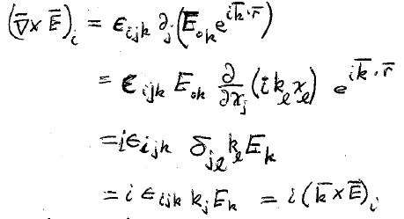
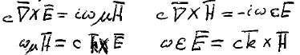
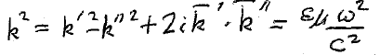







3. Relation between k’, k” and material properties for plane wave Exp[i k. r]
We’ll use the following relation to transform the Maxwell “curl” equations.
Had
New
Next, eliminate E and H (HW) to find relation for the complex wavevector k’ + i k”

Slide 6
Ways for wavevector of monochromatic wave to be complex
If ε or μ is complex, then k must be complex.
If ε and μ are real but one of them is negative, then –k”² must be nonzero and k’.k”= 0. Then k is complex.
If both ε and μ are real and positive, k can be real, but it still might be complex if k’.k” = 0 but k” is nonzero and k’² > k”².

Slide 7





4. What was a plane wave in vacuum, Exp[i k. r], is more complicated when k is complex
If k = k’ + i k”,
damping
Planes perpendicular to k’ are planes of constant phase
k’
Planes of constant amplitude are those perpendicular to k”
Direction in which wave is damped doesn’t necessarily coincide with direction of propagation.
Surface of constant E(r,t) are not necessarily planes: “inhomogeneous plane waves”.
These can occur even in homogeneous media where ε and μ are spatially uniform.

Slide 8










5. Relations between complex wavevector and complex fields
k, E, H are all complex.
The significance of these relations is not as obvious as it was in vacuum, where E, H, and k were mutually perpendicular and E = H.
In medium, E does not need to be perpendicular to the propagation direction, e.g. surface plasmon polaritons.

Slide 9
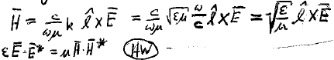
6. In the special case of transparent homogeneous medium, there is no damping, so k” = 0.
The wavevector
is real.
“refractive index”
Then from ωμH = ck X E and k.E = 0,
E, H, and k are mutually perpendicular.
(Both Re and Im parts)
If k = k l (l = unit vector)
Looks like energy densities are the same, but be careful

Slide 10
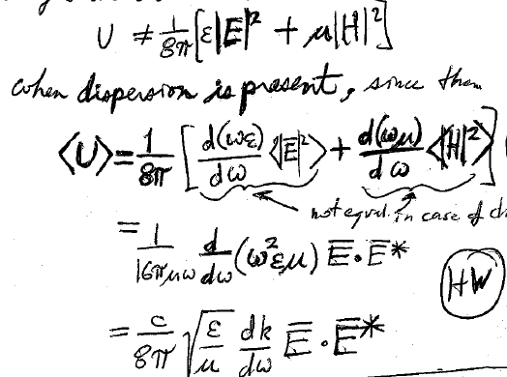




Electric and magnetic energy densities for monochromatic wave are not the same when there is dispersion
That’s because
Instead
(80.11)
Not equal if there is dispersion

Slide 11
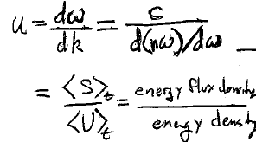
7. Electromagnetic wave energy propagates at the group velocity
For non-absorbing media k = n ω/c (83.7)
Mean value of Poynting vector
If there is no dispersion, n is independent of ω. Then u = c/n (section 75).

Slide 12
8. Now allow absorption but restrict k’ || k”
Surfaces of constant field are now planes ⊥ to k: “homogeneous plane wave”

Slide 13
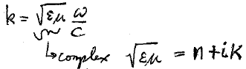






9. Complex refractive index
Let complex k || l (unit direction vector)
Define a complex “length” k so that k = k l
Write complex number in standard form
n = “index of refraction” (real)
κ = “absorption coefficient” (for field, not intensity.)
  More conventionally called “extinction coefficient”.
  Gives rate of damping of electric field wave.
  Caused by dissipation if ε or μ is complex
  Damping occurs without dissipation if εμ is real but negative (evanescent wave).

Slide 14
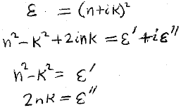
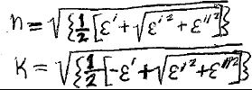



10. Relations between complex index and complex permittivity
At optical frequencies, μ ≈ 1.
Inverse relations

Slide 15
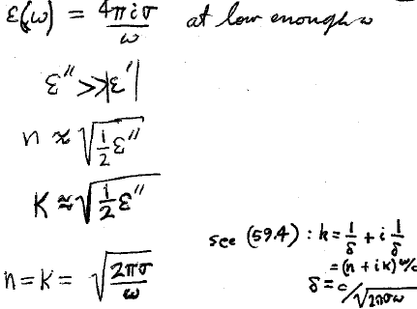
Conductors at low enough frequency have imaginary permittivity
Then
In quasi-static regime, dispersion is small

Slide 16
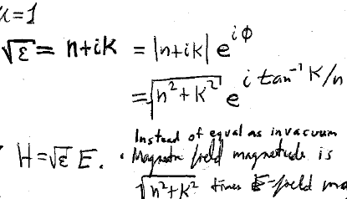






11. Homogeneous plane wave in lossy medium
Complex
H, E, and k are mutually perpendicular
If μ = 1
Instead of equal as in vacuum. H-=field magnitude is
times E-field magnitude
H and E are Arctan(κ/n) out of phase, instead of in phase
For conductor at low frequency n = κ and φ = Arctan[1] = π/4.

Slide 17



