Slide 1
Transparent Media
Section 84

Slide 2
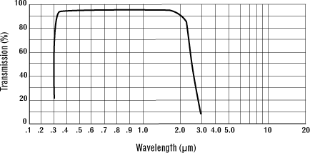
1. Media often have bands of transparency covering a broad spectrum
BK7 glass
For ω₁ < ω < ω₂, neglect ε”

Slide 3
For example, semiconductor silicon
Silicon
Germanium

Slide 4
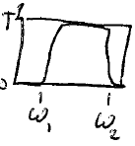
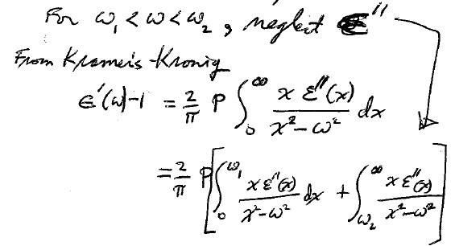
2. Kramers-Kronig formula simplifies for ω in transparency region
1
T
0
For ω₁ < ω < ω₂, neglect ε”
Note that ω is outside the integral limits {0,ω₁} & {ω₂, ∞},
There is no pole: Drop the “P”

Slide 5
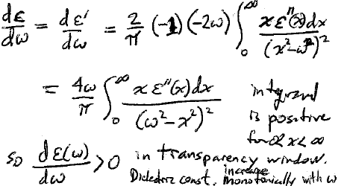
Put the two parts back together with the middle region (which doesn’t contribute)
Integrand > 0 for 0 < x < ∞
In the transparency window, i.e. the real permittivity increases monotonically with frequency.
so

Slide 6
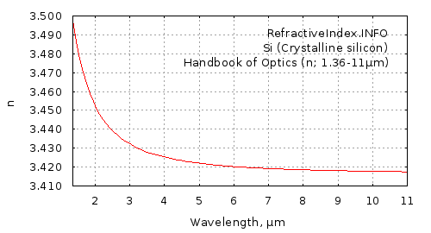
Index = Sqrt[ε]

Slide 7
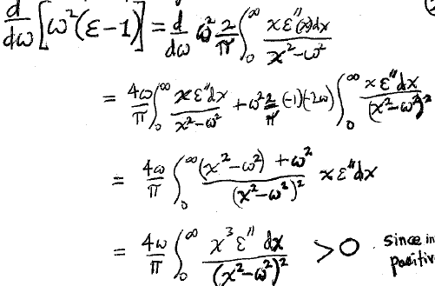
3. We can obtain a more restrictive inequality for the frequency dependence of permittivity
ε = ε’ for ω in the transparency range
Product rule of differentiation
Common denominator
Since integrand > 0
If ε < 1, dε/dω is larger than some positive number > 0.
In this case, ε rises faster with frequency than suggested by the previous condition dε/dω > 0.

Slide 8
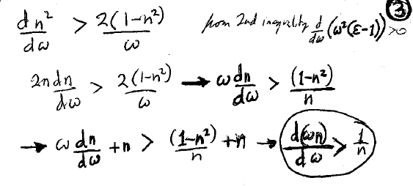
4. Inequalities for ε (and μ) ensure that u < c in the transparency range.
Group velocity u = dω/dk.
Example: for μ = 1 (optical range) and n = √ε (real and positive within transparency ranges)
The first inequality, dε/dω > 0, gives
The second inequality,
, gives
Add n to both sides

Slide 9
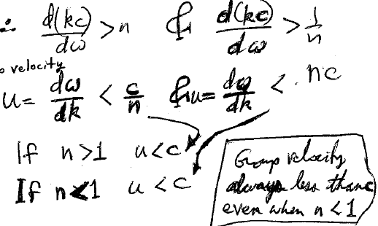
In a transparency range, nω = kc
Invert to get group velocity
The group velocity is always less than c, even when n < 1 and the phase velocity exceeds c.

Slide 10
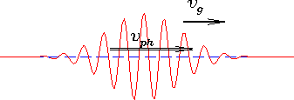
What is the direction of group velocity?
Can the wave packet travel opposite the direction of the phase front motion?
Since
and n and c are positive, then u >0.
The group velocity is in the same direction as the wavevector
Wave packets and phase fronts travel in the same direction.

Slide 11
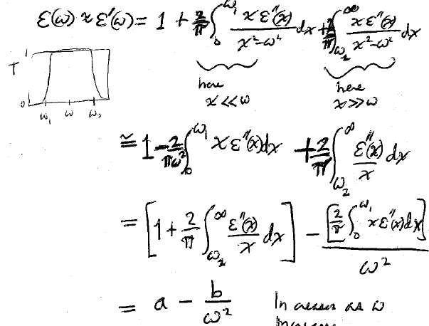
5. Dispersion formula for wide transparency window is plasma-like
In the middle of a transparency window ω₁ < ω < ω₂,
Increases with frequency.
a and b are positive constants.

Slide 12
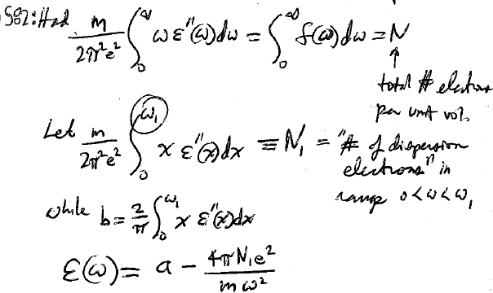
From section 82 we had
Total electron density
“dispersion electron density” in range 0 < ω < ω₁
All the electrons in the medium whose natural frequencies are below ω₁, and which can therefore be considered “free”.
But the constant b
So

Slide 13
6. If the transparency window is sufficiently broad, ε(ω) can pass through zero.
“dressed” plasma frequency
Often written in papers as
If ε < 0, the wave is damped, even if ε” = 0,
in which case spatial damping occurs without generation of heat.

Slide 14
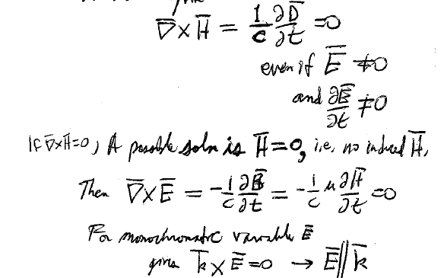
7. “Epsilon Near Zero” (ENZ)
At the frequency where ε = 0, D = εE = 0
Even if
and
A possible solution to curlH = 0 is H = 0, i.e. no induced H-field
Then
Then for a monochromatic time-varying E-field
This is a purely electric longitudinal wave.

Slide 15
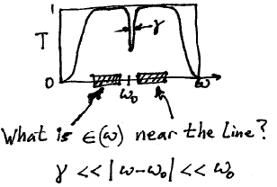
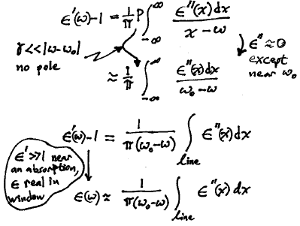
8. The integrated area of an absorption line gives the dispersion nearby.
Sharp line at ω₀ within a transparency region
ε’ becomes >> 1 as we approach the absorption line from below,
and permittivity is real within the transparency window.

Slide 16
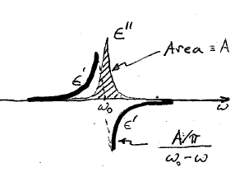
“Dispersion feature”

Slide 17
Dispersion features for actual materials

