Slide 1
Reflection and Refraction of Electromagnetic Waves
Section 86

Slide 2
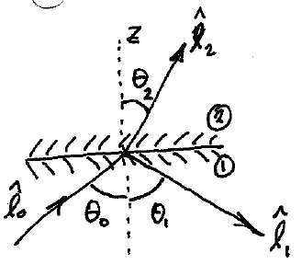
1. Plane boundary between two homogeneous media
Medium 2 might have absorption
Medium 1 is assumed transparent

Slide 3
2. Homogeneity of xy plane means all wavevectors lie in the same “plane of incidence”
The x and y dependence of the fields must be the same in all space.
Exp[i(k_{x}x + k_{y}y)] factor doesn’t depend on which side of the interface you are on.
Wavenumbers k_{x} and k_{y} must be the same for all three waves.
Choose coordinates such that k_{y} = 0.
All three propagation vectors then lie in the x-z plane.

Slide 4
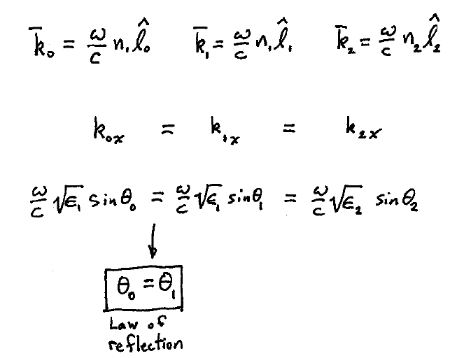
3. Relations for ray angles

Slide 5
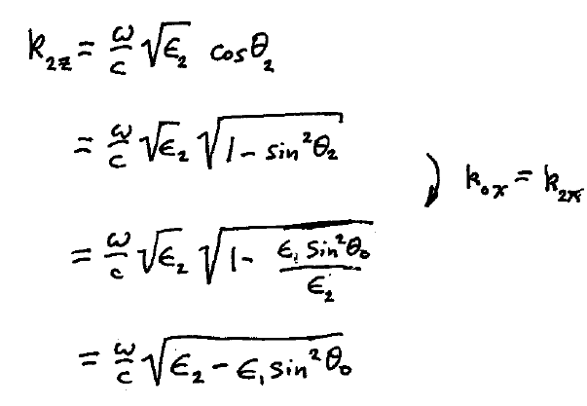

Slide 6
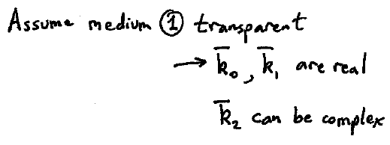
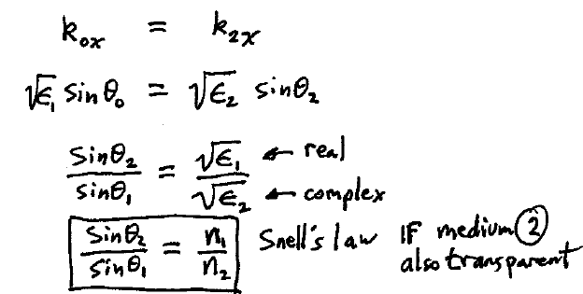
4. Law of refraction for transparent media

Slide 7
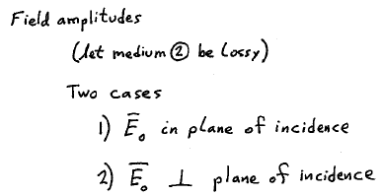
5. Field amplitudes of reflected and refracted waves

Slide 8
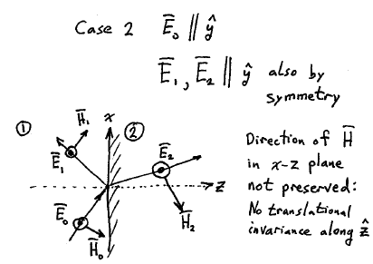
6. Case of transverse electric (TE) polarization, electric field perpendicular to plane of incidence.
Boundary conditions: E_{t} continuous -> E_{y} = E continuous
H_{t} continuous -> H_{x} = -c k_{z} E_{y}/ω continuous

Slide 9
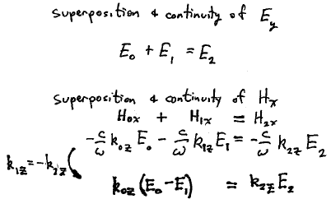
7. Apply BC and superposition principle

Slide 10
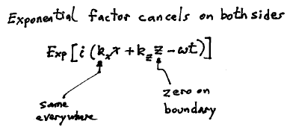
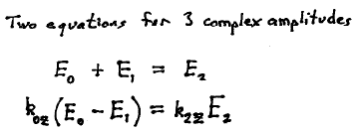

Slide 11
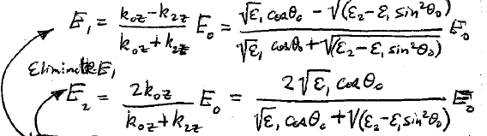
Eliminate E₂
Eliminate E₁
These are the Fresnel’s Formulae for the complex reflected and transmitted amplitudes
complex
E₀ can be taken as real since we are considering monochromatic linearly polarized incident wave

Slide 12
8. If both media are transparent, use Snell’s law to eliminate real permittivities (HW)

Slide 13
9. When E lies in the plane of incidence, we find the Fresnel Equations in terms of the single (y) component of H: H₀, H₁, and H₂.
E₁
E₀
Homework: Fresnel formula for TM polarization, (86.6) and (86.7) for transparent media.

Slide 14
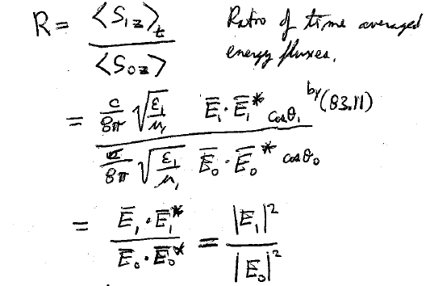
10. Reflection coefficient, or “reflectivity”, is what you actually measure.
Ratio of intensities (time averaged energy flux densities), are the only thing you can measure.

Slide 15
11. At normal incidence, both polarizations are equivalent
Assumed real
Can be complex

Slide 16
12. From here on, both media are assumed transparent
Skipped: discussion about transition layer
13. If permittivities of both media are real, Coefficients in Fresnel’s formulae relating E₁ and E₂ to E₀ are real.
The phase change Exp[iφ] on reflection must be real.
The only possibilities are φ = 0 or π.
Phase change for refraction is zero.
HW
If ε₂ > ε₁, E₁ is flipped (φ = π).

Slide 17
14. If both media are transparent, but light is incident at an oblique angle
E perpendicular to the plane of incidence
E lying in the plane of incidence
H is proportional to E with the same proportionality constant Sqrt[μ/ε] if the medium is the same, see (83.6)

Slide 18
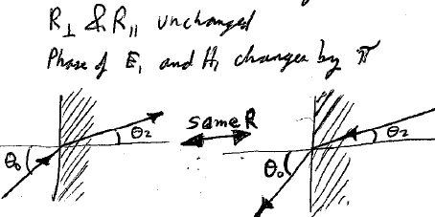
Are unchanged if we exchange θ₂ and θ₀ and reverse the sign of time.
Phase of E₁ and H₁ changes by π

Slide 19
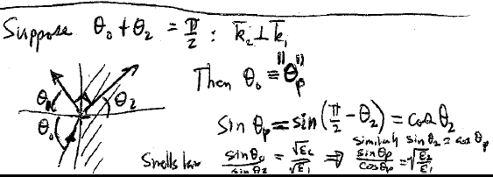
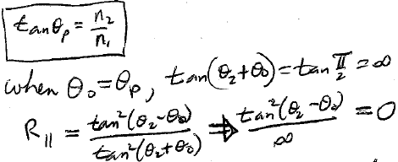
15. Reflection can lead to total polarization
Reflected light when θ₀ = θ_{p} is 100% polarized, with E perpendicular to the plane of incidence.
θ_{p} = “Brewster’s angle”.

Slide 20
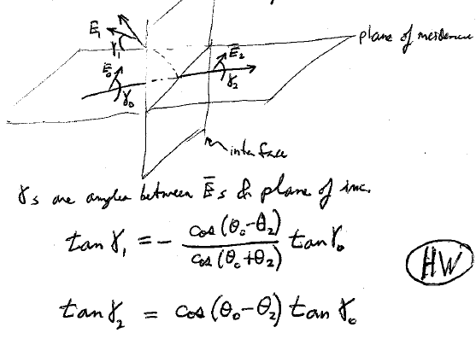
16. Reflection and refraction can rotate the direction of polarization
Orientation of plane polarized light can change after reflection or refraction (though it remains plane polarized.)

Slide 21
17. Partial polarization on reflection
Reflectance curves
Total internal reflection
Evanescent wave
Change of phase on total internal reflection

