Slide 1
Nuclear Forces 2

Slide 2


Slide 3























Slide 4
























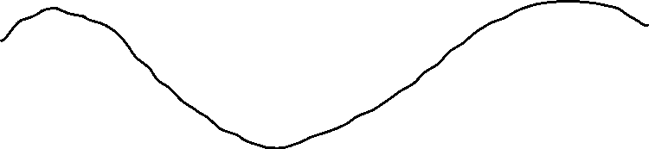


Slide 5
























Slide 6




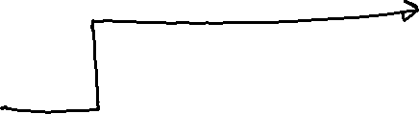
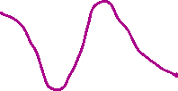











Slide 7






Slide 8

















Slide 9









































Slide 10






















Slide 11














Slide 12







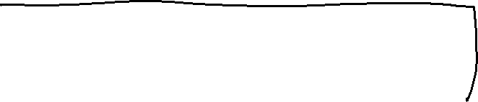




Slide 13



























Slide 14









































Slide 15




















Slide 16




















Slide 17






















Slide 18


























Slide 19






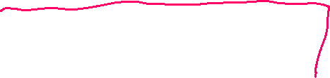





















Slide 20














































Slide 21






















2s+1=3,
Total spin vector can have 3 orientations

Slide 22































