Slide 1
Nuclear Forces 3

Slide 2





















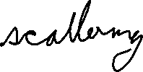











Slide 3




































(r)
even
odd

Slide 4












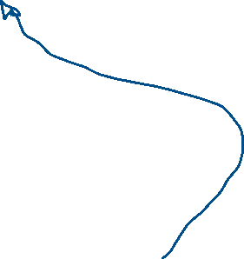





















Slide 5















For high energy incident neutron, its velocity will be much greater than the velocity acquired by the proton, so the neutron will be scattered forward.

Slide 6






































Slide 7





































Slide 8








Slide 9
















Slide 10

































Slide 11






























Slide 12


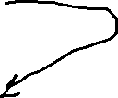




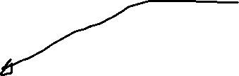



Slide 13

















































Slide 14











































Slide 15























Slide 16



































Slide 17









































Slide 18





















Slide 19























Slide 20























Slide 21





















Slide 22





















Slide 23




































Slide 24



















Slide 25




























