Slide 1
Nuclear Properties 1
Isotope charts, radioactive decay, nuclear masses

Slide 2
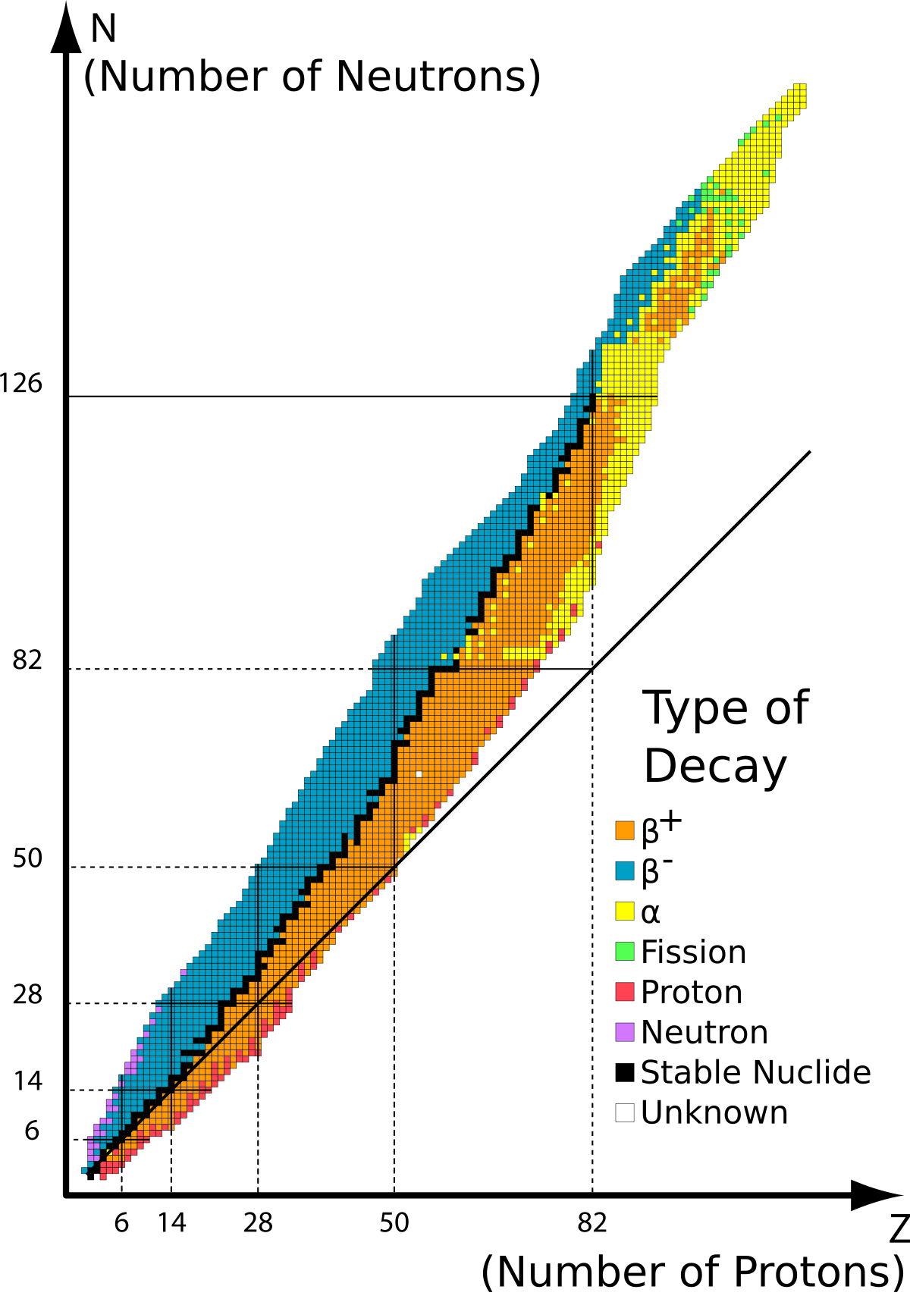
































Slide 3
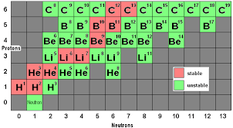


















Slide 4





















Slide 5
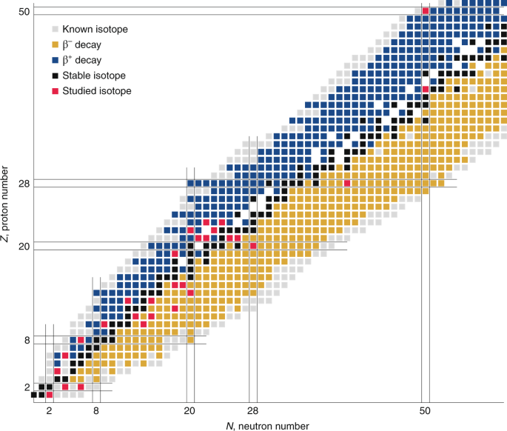











Slide 6



















Slide 7




















































Slide 8

























Slide 9










































Slide 10






























Slide 11






















Slide 12













































Slide 13





























Slide 14









After 1960, it became more common to define the atomic mass of C¹² to be exactly equal to 12.00 “u”, as the unit on the physical scale of atomic masses.
Instead of O¹⁶ to be exactly 16.00 “amu”.
The difference is an additive constant. The effect is to shift the f plot down a little bit. Does not affect BE calculations.

Slide 15
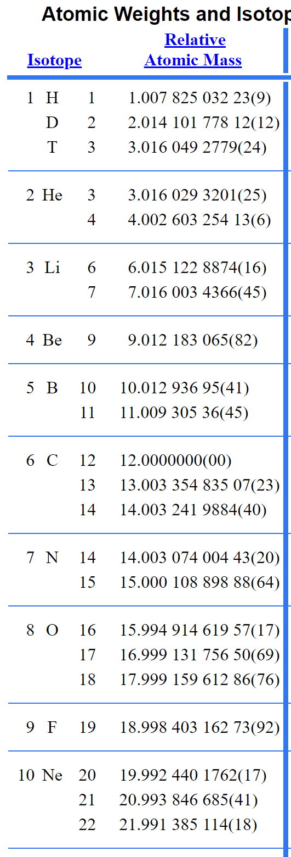





https://physics.nist.gov/cgi-bin/Compositions/stand_alone.pl

Slide 16























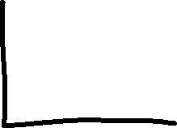

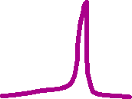
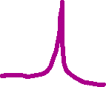


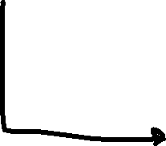


Slide 17














