Slide 1
Nuclear Properties 10
I.F. Radioactivity and its geological aspects
I.G. Measurement and biological effects of radioactivity

Slide 2












































Slide 3
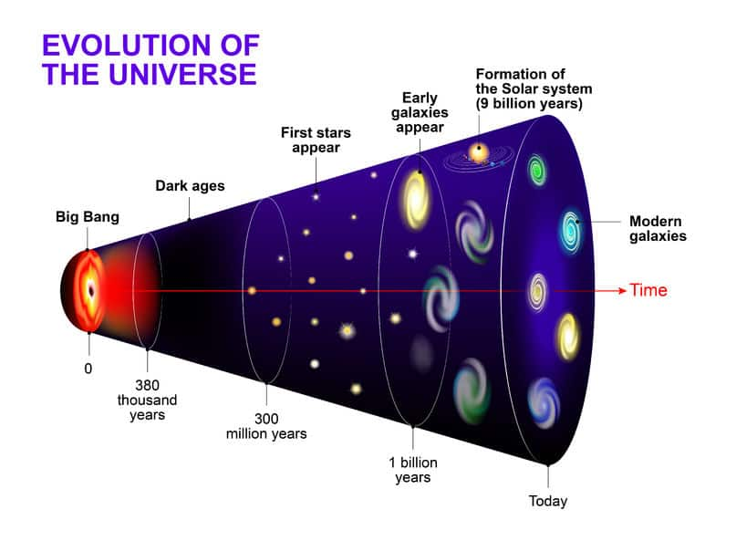

Slide 4























Slide 5


















Slide 6






Slide 7


























Slide 8
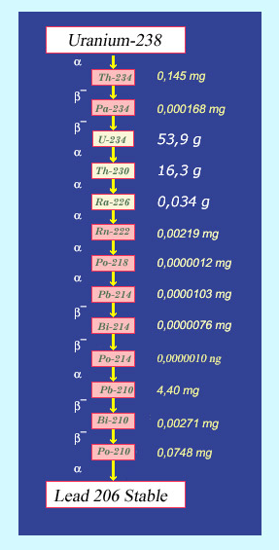






































Slide 9
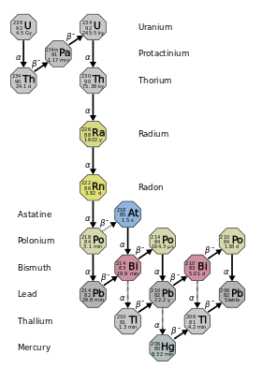
































Slide 10
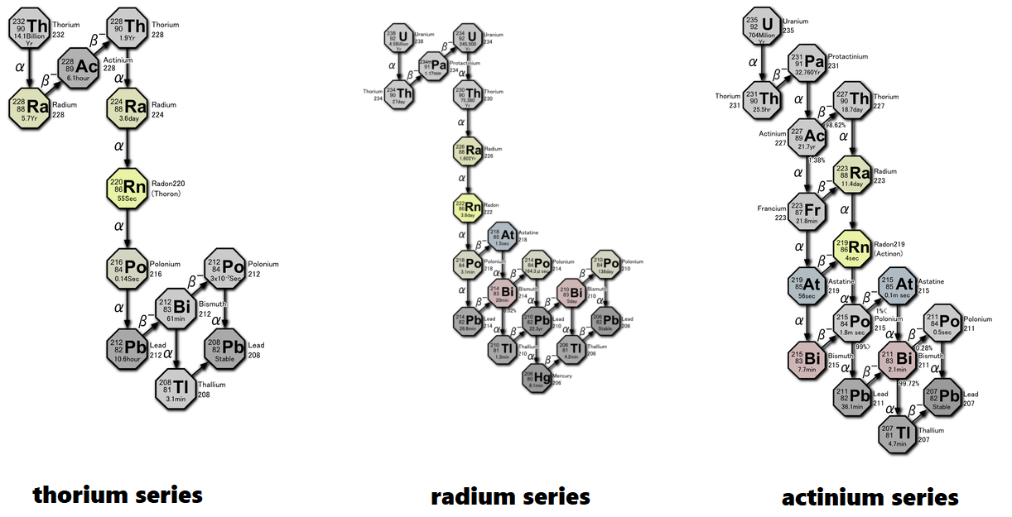
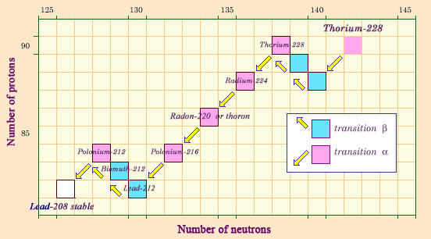







With branching
Thorium family
126
142

Slide 11
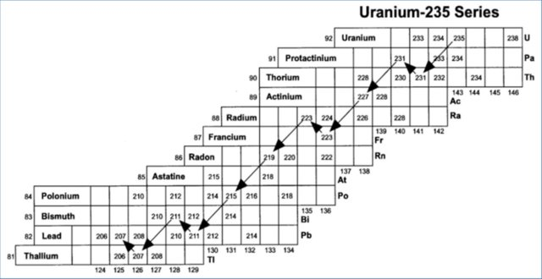





























Uranium-Actinium Series

Slide 12



















Slide 13














































Slide 14



























Slide 15

















Slide 16




















Slide 17






















Slide 18




























Slide 19




























Slide 20

























Slide 21
































Slide 22






























Slide 23




















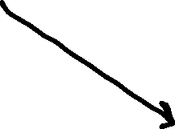


Slide 24



















Slide 25












Slide 26















Slide 27
























Slide 28



























