Slide 1
Nuclear Properties 2
Lecture 3. Binding energy

Slide 2



























Slide 3



















Slide 4














Slide 5



Slide 6







































Slide 7




































Slide 8








































Slide 9




























Slide 10
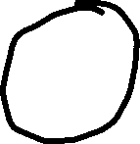






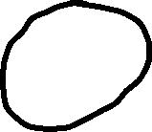
















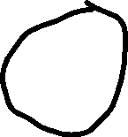



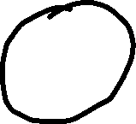















Mass on right is almost the same as the atomic mass M(A, Z+1)

Slide 11




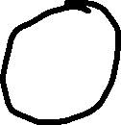


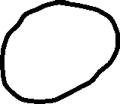














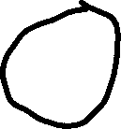

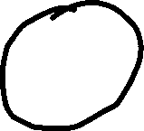









Mass on right is almost the same as the atomic mass M(A, Z+1)

Slide 12












































Slide 13


















































Slide 14













