Slide 1
Nuclear Properties 3
An example nuclear reaction

Slide 2
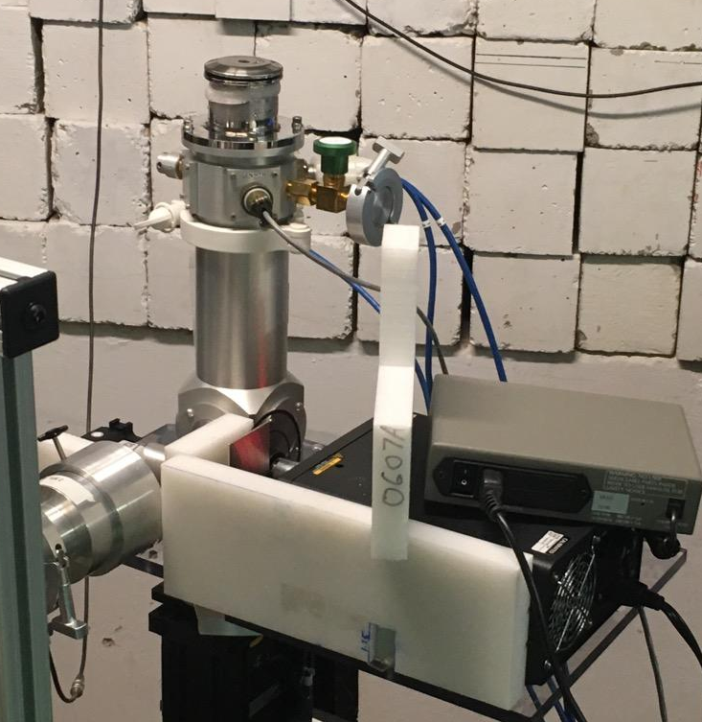






































Slide 3











































Slide 4































Slide 5





































Slide 6



























Slide 7


















Slide 8






























https://physics.nist.gov/cgi-bin/Compositions/stand_alone.pl
H 1 1.007 825 032 23(9)
D 2 2.014 101 778 12(12)
T 3 3.016 049 2779(24)
He 3 3.016 029 3201(25)
4 4.002 603 254 13(6)
Li 6 6.015 122 8874(16)
7 7.016 003 4366(45)
Be 9 9.012 183 065(82)
B 10 10.012 936 95(41)
11 11.009 305 36(45)
Neutron mass (wikipedia) = 1.008665 amu. This is exactly the same as the 1961 value.

Slide 9



















Slide 10




























Slide 11























Slide 12





















Slide 13



























