Slide 1
Nuclear Properties 8
I.D. Spin and Magnetic Moment

Slide 2


































Slide 3





























Slide 4















Slide 5



































Slide 6
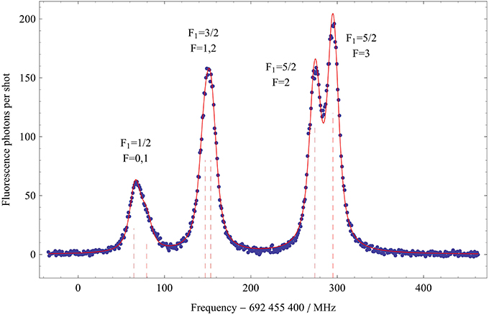
Interaction between electron and nuclear spin causes optical transitions to split

Slide 7

































Slide 8




































Slide 9












Slide 10







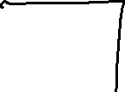































Slide 11






















Slide 12
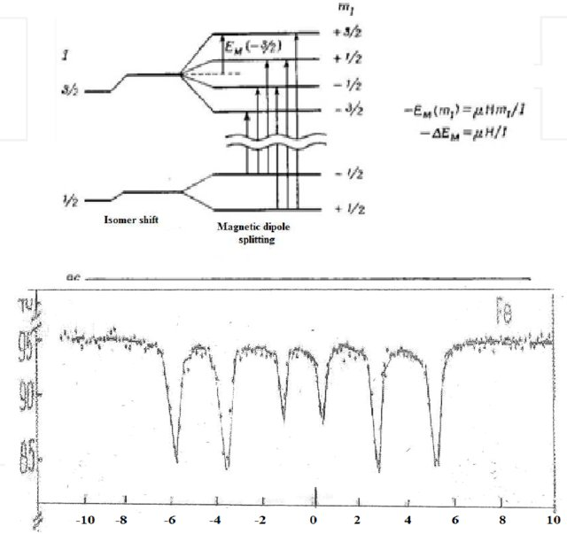















Magnetic hyperfine splitting of 57 Fe spectrum
It is known that upper term has J = 3/2. The multiplicity is 6. Therefore, either I = 3/2, or I > 3/2.
If we find a transition involving a term with J > 3/2, and the multiplicity is still 6, then I = 3/2.

Slide 13







































Slide 14


































Slide 15

























Slide 16



















































Slide 17
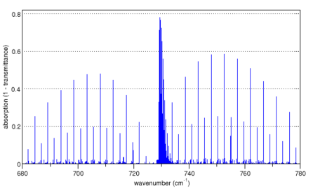
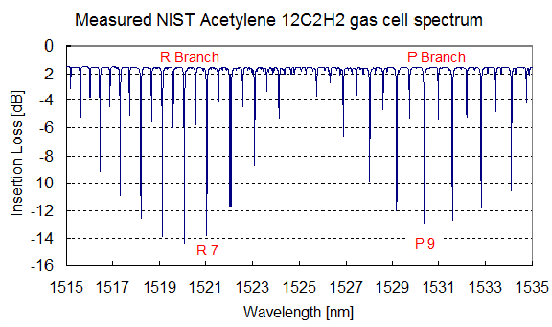
Spectrum of a perpendicular band from acetylene, C₂H₂
For acetylene the hydrogens of ¹H¹²C¹²C¹H have spin ½ and are fermions, so the total wavefunction is antisymmetric when two ¹H nuclei are exchanged. The nuclear spin function of the two hydrogens has three symmetric ortho states and one antisymmetric para states. For the three ortho states, the rotational wave function must be antisymmetric corresponding to odd J, and for the one para state it is symmetric corresponding to even J. The population of the odd J levels are therefore three times higher than the even J levels, and alternate line intensities are in the ratio 3:1.

Slide 18
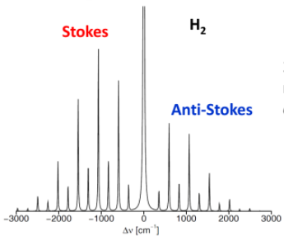
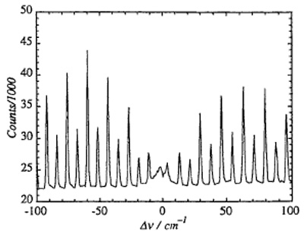
Raman scattering with emitted or absorbed rotational quanta.
N2
I must be 1, since then (I+1)/I = 2. And, in fact, the nuclear spin of 14N (99.3% abundant) is 1.

Slide 19
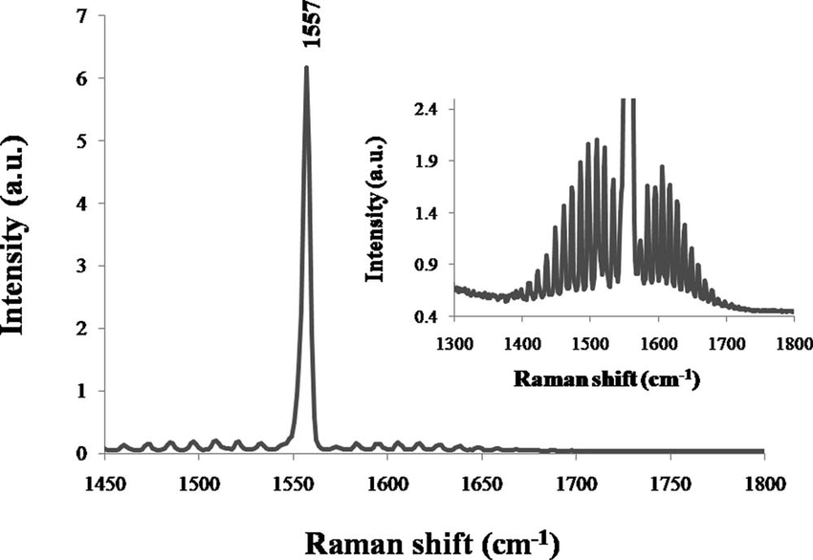
Pure O2. No alternation. Why not?
16O (99.5% abundant) has I = 0. σ can only be symmetric. No alternation.

Slide 20
This method of finding I works only for small molecules that exist in gas phase.
Works best if there is only one dominant isotope for the identical atoms.

Slide 21
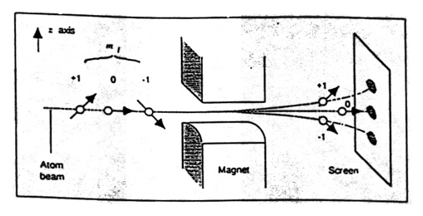















If one sees three dots on the screen, I = 1.
If one sees four dots, I = ?

Slide 22
















































Slide 23
