Slide 1
Nuclear Properties 9
Nuclear spin from spin of decay products
Nuclear magnetic moments
Nuclear quadrupole

Slide 2































Slide 3























Slide 4









































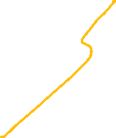


Slide 5

The existence of the neutron's magnetic moment and the large value for the proton magnetic moment indicate the nucleons are not elementary particles. For an elementary particle to have an intrinsic magnetic moment, it must have both spin and electric charge. The nucleons have spin-1/2 ħ, but the neutron has no net charge. Their magnetic moments were puzzling and defied a valid explanation until the quark model for hadron particles was developed in the 1960s. The nucleons are composed of three quarks, and the magnetic moments of these elementary particles combine to give the nucleons their magnetic moments.
Baryon | Magnetic moment of quark model | Computed ({\displaystyle \mu _{\text{N}}}) | Observed ({\displaystyle \mu _{\text{N}}})
p | 4/3 μ_{u} − 1/3 μ_{d} | 2.79 | 2.793
n | 4/3 μ_{d} − 1/3 μ_{u} | −1.86 | −1.913
The results of this calculation are encouraging, but the masses of the up or down quarks were assumed to be 1/3 the mass of a nucleon.^{[64]} The masses of the quarks are actually only about 1% that of a nucleon.^{[65]} The discrepancy stems from the complexity of the Standard Model for nucleons, where most of their mass originates in the gluon fields, virtual particles, and their associated energy that are essential aspects of the strong force.^{[65][70]} Furthermore, the complex system of quarks and gluons that constitute a nucleon requires a relativistic treatment.^{[71]} Nucleon magnetic moments have been successfully computed from first principles, requiring significant computing resources.^{[72][73]}

Slide 6




















































Slide 7






























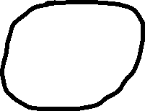


Slide 8




























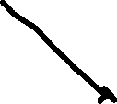













































Slide 9
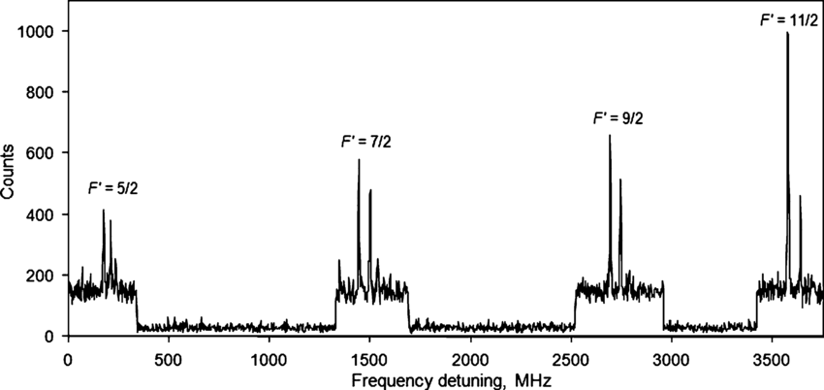
Hyperfine structure of ¹⁵⁴Eu at the 564.58 nm transition

Slide 10















































Slide 11













































Slide 12











Slide 13







