Slide 1
PtSi MWIR Camera SOP
2 Oct 2020

Slide 2
All the parts in the silver brief case. Not shown is the laptop computer.

Slide 3
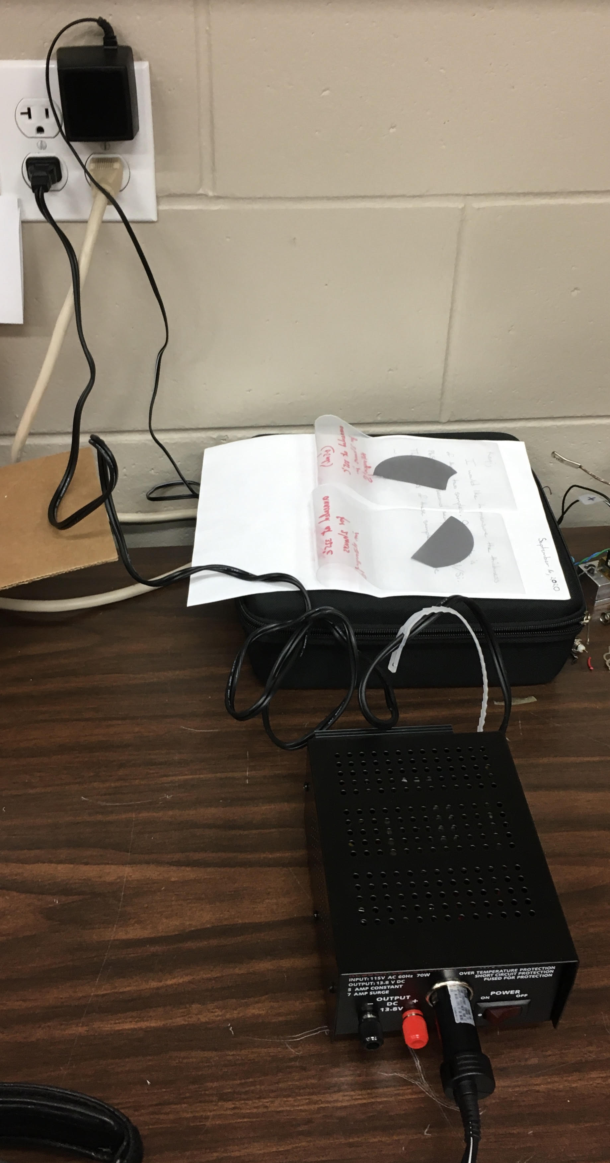

1. Plug in the power supply

Slide 4
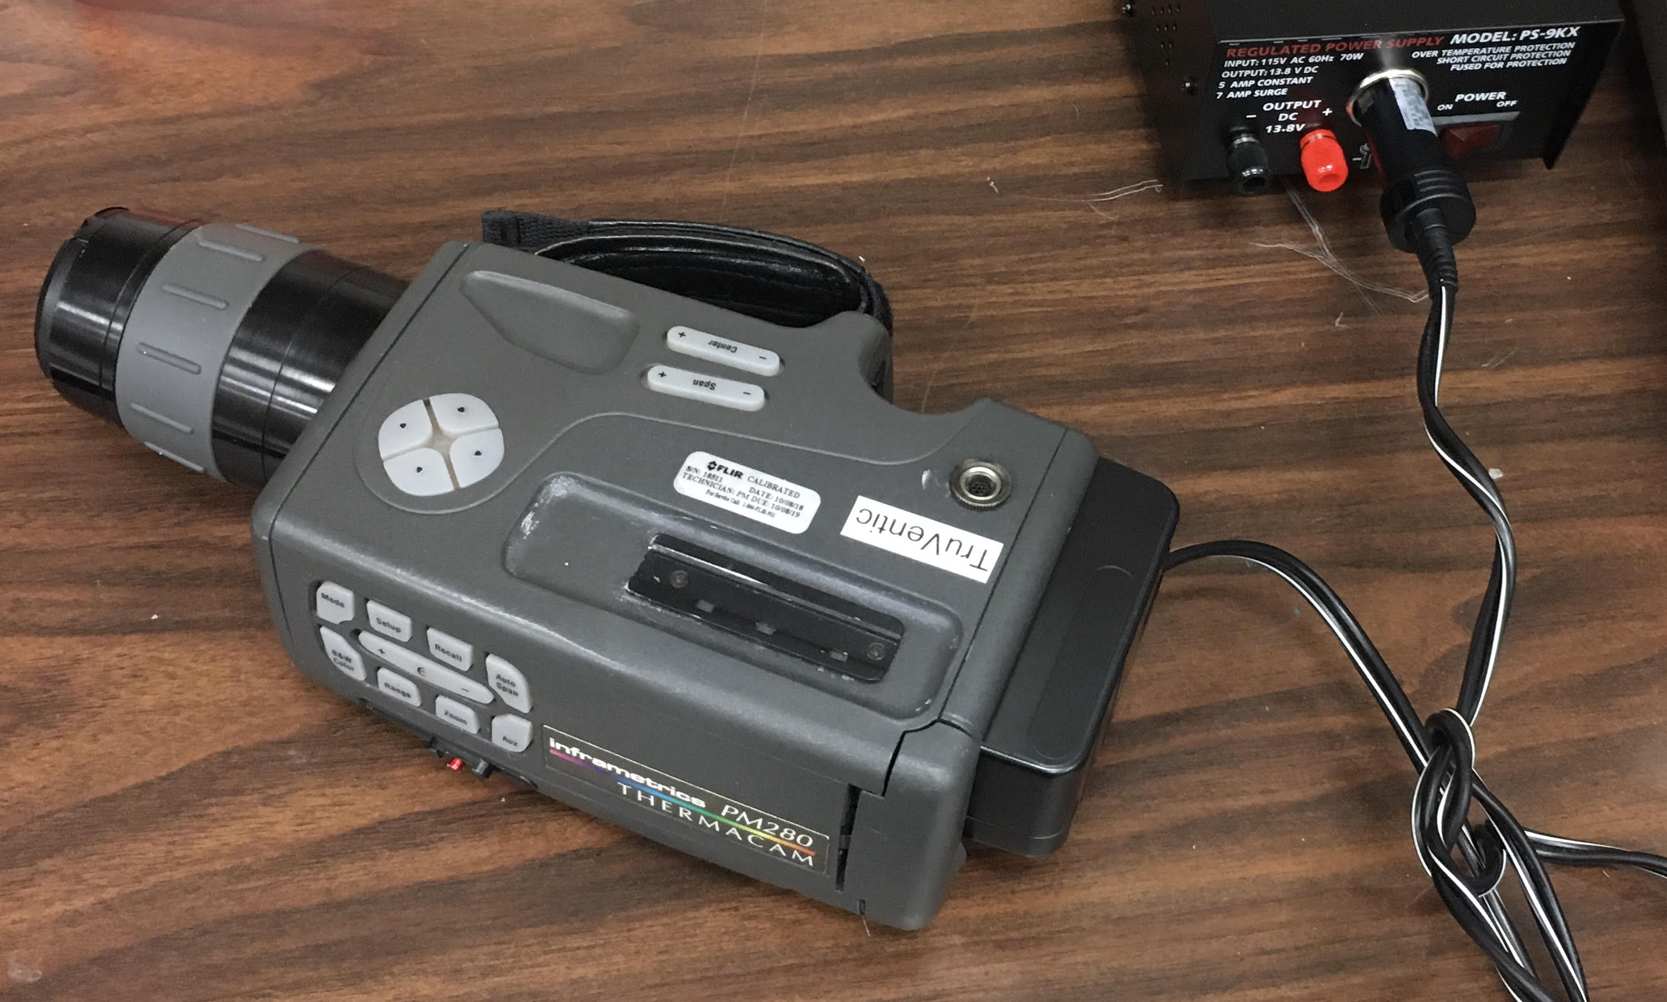



2. Connect the camera
This block detaches

Slide 5
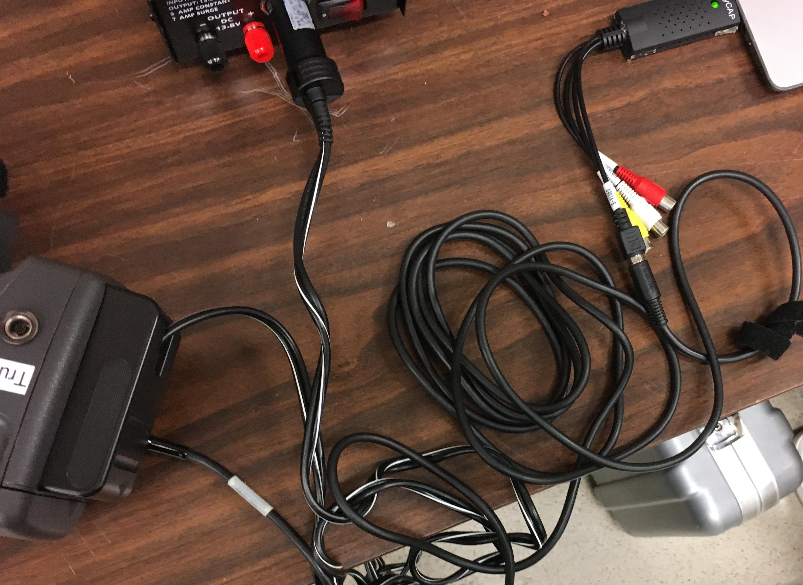


Easycap USB connector to laptop computer. Use right USB port, not the one shown.
3. Connect to computer
Use black cable

Slide 6
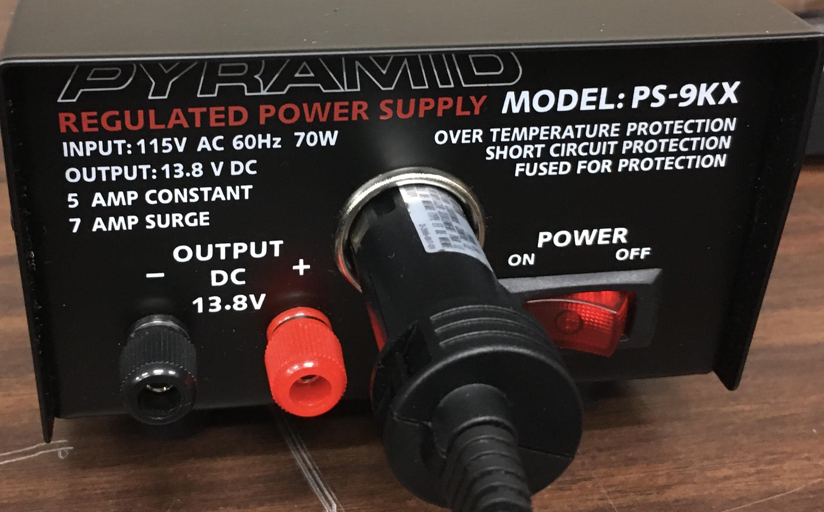

4. Turn power on.

Slide 7
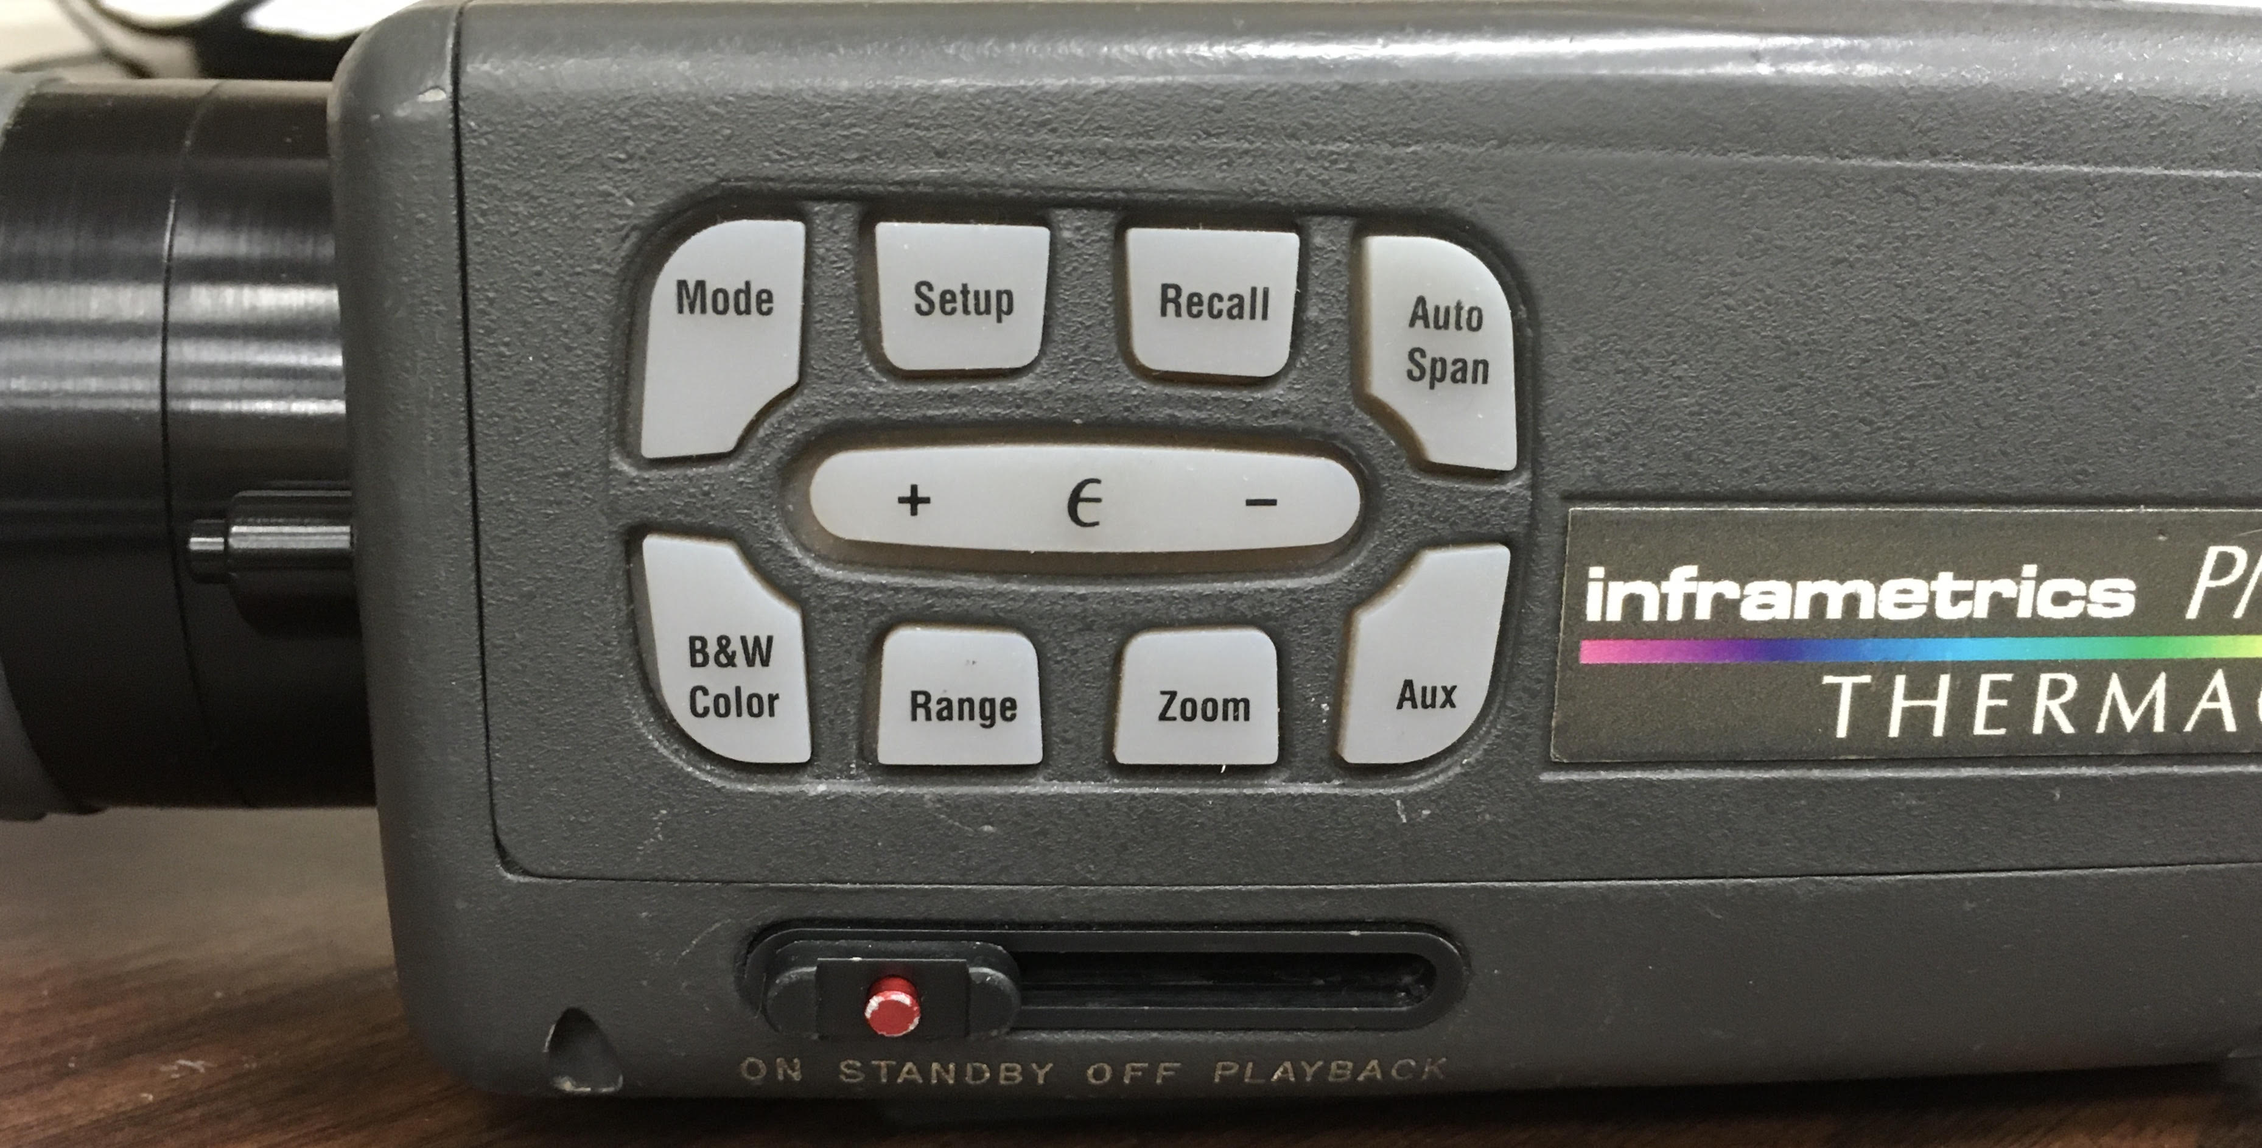

5. Turn Camera on. Takes 10 min to reach operating temperature

Slide 8



Laptop computer. Linux. User “Pedro”, Password “3833626”
Program: Cheese
Preferences: AV to USB 2.0
Use WebCam button to capture an image
Image appears in album. To save to USB drive, right double click on image you want.

Slide 9


Remove cap from camera
Choose Auto Span
4 ranges of integration time

