Slide 1
Reactions 2

Slide 2








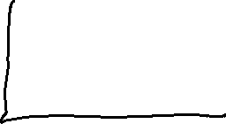





Slide 3









































Slide 4


























Slide 5




































Slide 6

































Slide 7







































Slide 8































Slide 9





























Slide 10











































Different, Statistical Physics, way of getting the same result.

Slide 11









































Slide 12

























































Slide 13


































Slide 14




































Slide 15










































Slide 16






























