Slide 1
Reactions 4
Examples of reactions that occur via an intermediate unstable compound nucleus.

Slide 2



































Slide 3
































Slide 4

































Slide 5




















































Slide 6






















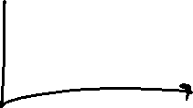




















Slide 7




































Slide 8
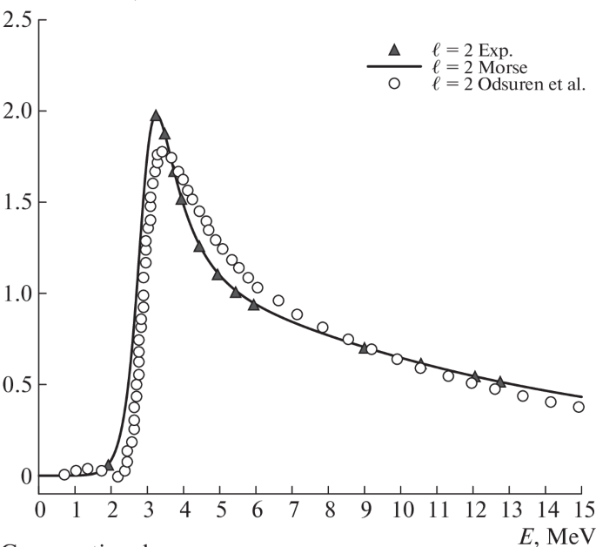
Alpha–Alpha Scattering Potentials for Various ℓ-Channels Using Phase Function Method
Anil Khachi,
Lalit Kumar &
O. S. K. S. Sastri
Physics of Atomic Nuclei volume 85, pages382–391 (2022)
Resonance position for ℓ=2 is found to be at 3.25 MeV which is close to the value typically quoted in literature [9, 29]

Slide 9






































Slide 10



























Slide 11






















Slide 12













































Slide 13




































Slide 14

































Slide 15
















































Because of it’s low p at 0.44 MeV, and l*hbar = b*p

Slide 16
































Slide 17























Slide 18





































Slide 19












































Slide 20


































Slide 21

































